Slide 1


Genetic Variance in Flocculin Protein Family
Sarah Dooley
Dr. Dale Beach
Notes:
Hi my name is Sarah Dooley, I will be participating in the PRISM program this summer. Thank you for taking the time to listen to my research proposal virtually. During this presentation I will be talking about how I have prepared with Dr. Beach over the spring course to understand flocculation at the molecular level specifically genetic variance in a flocculin protein
Over the spring course Dr. Beach and I have read literature about flocculun proteins in regaurd to flocculation in beer.
In general, my PRISM project centers around yeast. Yeast are a part of many amazing biological processes. A few words that come to mind to me when I think yeast are…..

Slide 2
Beer
Wine
Liquor
Champagne
Notes:
Beer, wine, liquor, and champagne. And as we know, there is a distinction between these alcoholic beverages and other beverages like, kombucha, but they all share one thing in common -- they are the fermentation products of yeasts, mostly Saccharomyces cerevisiae.

Slide 3
Fermentation
Yeast + Glucose
Alcohol (Ethanol) + CO2
Notes:
The reaction responsible for alcoholic beverages is generally referred to as fermentation. The reaction can generally be summarized as: Yeast + Glucose --> Alcohol (Ethanol) + CO2
The fermentation process begins with yeast, sugar, flavoring agents, and water,
yeast irreversibly convert sugar into alcohol and carbon dioxide. There are many other environmental factors and processes that are involved in the overall production of an alcoholic beverage.
Fermentation also occurs in baking bread, yeasts thrive on simple sugars and as the sugars are being metabolize, the carbon dioxide and ethanol are released, making the bread dough rise.
In my next slide I will talk about one of those important processes, flocculation specifically within beer.

Slide 4
Flocculation
Thousands of yeast cells form “floc” and clump together to rise to the surface or sink to the bottom to be removed
Lectin theory – molecular “Velcro”
Notes:
Flocculation is a complex process where thousands of yeast cells from flocs or clump together. It occurs near the end of fermentation where the flocs either sink to the bottom of the fermenter to be drained out, or the flocs of yeast float to the top to be siphoned off.
During fermentation, yeast cells are usually exposed to different stress conditions such as low pH and temperature, high total acidity, lack of nutrients and high ethanol content. In responses, flocculation is recognized as a mechanism to cope with those harsh conditions. And also by doing so, flocculation helps the brewer out when filtering the yeast out of the final product.
While flocculation can help with filtiering, the timing, and level of flocculation behavior, or lack of behavior is one of the major factors that contribute to the overall product being produced (Speers 2016). If yeast flocculate too early, the product will be under attenuated and sweet. If yeast do not flocculate, the product will be cloudy and have an undesirable yeasty and bitter taste. For appearance, low flocculation leads to a cloudy product and In comparison, high flocculation leads to a clear and crisp products.
The mechanism of how this process occurs is represented in the lectin model. The lectin model shows how clumping occurs physically between individual yeast cells. The flocculins or lectins which stick out of the cell walls of flocculent cells, selectively bind to the mannose residues present in the cell walls of adjacent yeast cells. This mechanism can be easily imagined as molecular “Velcro”.
+ hooks and loops

Slide 5
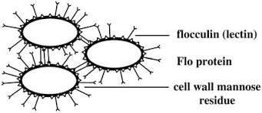
Mechanism of flocculation
Lectin theory – molecular “Velcro”
Notes:
The mechanism of how this process occurs is represented in the lectin theory model.
The lectin model shows the physical interactions between individual yeast cells and how a clump forms.
Flocculent yeast cells have flocculins or lectins that kind of look like arms in this top right figure, the lectins stick out of the cell walls and selectively bind to the mannose residues present in the cell walls of other flocculent yeast cells near by.
This mechanism can be easily imagined as molecular “Velcro”.
Velcro has plastic "hooks" that cling to cloth "loops” as you can see in this image.
For flocculation, the Flocculin protein acts like a hook and clings to the sugar ”loops”
When the lectin of one cell binds to the mannose sugar of another cell, the two are attached like Velcro.

Slide 6
3 Roads Brewery Yeast Strains
Strain | Level of Flocculation
Fermentis SafAle K97 | High
Fermentis SafAle US-05 Chico | Medium
BSI-550 Belgian Ardennes | Medium
S-11 French Saison | Low
Notes:
As mentioned earlier, the different levels of flocculation can effect the taste and appearance of the over all product, so it is essential to choose a yeast strain that flocculates in the appropriate manner to the product one wishes to brew. 3 roads brewery’s master brewer David Steeves has kindly provided yeast strains that they commonly use at their brewery and have been used in my previous research.
Overall, flocculation level within brewing strains are categorized as high, medium, and low.
Strains that have a high level of flocculation start to flocculate the earliest during fermentation. When brewing beer with high flocculating strains, sometimes a recirculation is necessary to re-suspend the yeast, but the product has less suspended yeast which makes the filtration process of the beer much easier, requiring less time and tools. Yeast strains that tend to be high flocculators are commonly used to produce Ale Beers like,IPAs and APAs.
Strains that have a medium level of flocculation tend to be the most commonly used strains. Medium flocculating strains will start to flocculate out when the sugars levels become less abundant. Temperature of the fermenter becomes a big apart in helping the yeast to flocculate. More work controlling environmental factors is needed on the brewer’s end when using medium flocculating yeast strains.
Strains that have a low level of flocculation tend to remain in the suspension for awhile after the fermentation is complete. Low flocculating strains tend to produce a hazier beer with yeast.
The ideal brewer’s yeast should show strong flocculation toward the end of fermentation and the behavior should also be constant during consecutive rounds of fermenting, cropping, storing and repitching in the beer industry. In many cases however and as in everything else in science, there are always exceptions. Many yeast strains commonly used in brewing industries fail to live up to these expectations and when attempting to have better control over the flocculation process, we can explore flocculation genetically.

Slide 7
Research Goal
Sequence the sugar binding domains of FLO1, FLO5, and FLO9 and determine sequence variance among them.
Primer design
PCR clone target genes (FLO1, FLO5, FLO9)
Sequence N-terminal domains & sequence comparison
Specific Aims:
Notes:
The aim of this work broadly is to achieve a better understanding of why individual yeast strains flocculate differently from one another at the molecular level.
The genotype of genes in the flocculation pathway can affect flocculation within different brewing strains.
We want to see if variation among these protein levels give reason to why different brewing strains flocculation more or less.
Defining the sequences of genes involved flocculation may give reason to why certain brewing yeast strains flocculate more or less, we can achieve this through our specific aims …

Slide 8
Structure of Flocculin Family
FLO1, FLO5, FLO9
N-Terminal Domain: Calcium Ion dependent & Maltose binding site
Central Region:
Tandem Repeats can occur
(Stalk-like structure)
C-Terminal Transmembrane Domain: Embedded in yeast cell wall
Notes:
Structure of FLO Flocculin Family
N-terminal is the sugar binding domain and needs Calcium ions to function.
The C-terminal domain which serves an an anchor to bind to yeast cell walls.
The central region however varies and encodes for the specific proteins. The central region can contain tandem repeats and is variable in length among many proteins. The length of tandem repeats within a protein or a gene makes very difficult to clone and sequence the full length or clone.
The FLO genes I have choses to study show the long tandem repeats in the protein sequence. This creates challenges when designing specific primers to each protein to ensure we are only amplifying one specific protein, FLO1, FLO5 or FLO9,

Slide 9
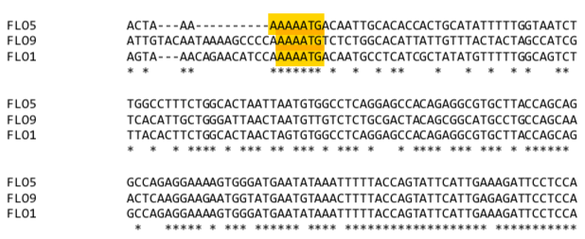
Flocculin Family Members are Highly Homologous
Family members show high sequence homology
Upstream regions (before ATG) are highly variable
Identity is high for the remainder of the proteins
Notes:
When attempting to design unique primers for these proteins we found that things were much more complicated. Designing primers for these proteins was so difficult because of how similar these protein sequences are and the tandem repeats that they have.
To address this, all three gene’s sequence was downloaded from SGD and we created a protein alignment. This alignment showed us that these proteins had extremely high sequence homology.
In this figure, the alignment is shown, the ATG highlighted region is showing the start of the gene. Before the start codon, there is high variation among the sequence, but following the ATG, there is high sequence homology between the 3 proteins, which are indicated by the stars. For space, only about 5% of the gene alignment is shown, the rest of the sequence is nearly identical to each other in the coding region.
To clone these proteins and examine how they are being expressed in different brewing strains we need to make sure we are creating primers that are unique to each protein and that the primer does not accidently stick to the FLO5 or FLO9 when we are trying to only look at FLO1.
This is frustrating when designing but because they are so similar in sequence but we know their specific functions are unique. [These two comments are not really related. The frustration is designing functional primers for PCR that are specific to individual proteins of the family and able to uniquely amplify only the target gene during the PCR reaction. ]
Flo 1 is the dominant protein that is responsible for cell adhesion, however the genome underwent a duplication and FLO5 is known to be a paralog to FLO1, By being members of FLO gene family, FLO1 5 and 9 all share high sequence homology and have tandem repeats in the central domain of flocculins. Additionally, these FLO genes have a high tendency to undergo recombination events due to the position of subtelomeres. These factors make it difficult to target each specific flow gene to sequence and study.
The long repeats that makes the genes difficult to sequence full length, and difficult to clone, but may have an important tole is increasing flocculation with length. While these genes share a similar function and structure, their specific function of each is unique.

Slide 10
How can FLO1, FLO5, and FLO9 be sequenced if they share high homology?
Carefully designed PCR Primers can target individual family members for cloning and analysis.
Notes:
How can FLO1, FLO5, and FLO9 be sequenced if they share high homology?
To sequence these proteins we are limited by the techniques we have. PCR is very specific when sticking to primers --- We are challenged with not knowing if these primers we designed at specific enough for PCR to bind at the intended locations and work properly.
When working with DNA, the primers actually have to figure out where they are able to stick to out of 100-2000 base pairs
[ Add something like – Sequencing these genes directly from the pool of DNA containing the entire family would be very risky.]
However, after carefully looking at the sequence alignment for these proteins we were able to find locations that were specific to each protein and confident these will work.

Slide 11
Polymerase chain reaction (PCR)
Technique used to make multiple copies of a segment DNA of interest
Many copies can be made from a small segment of DNA
Primers (F, R) define START and STOP positions of the copies.
F
F
R
F
F
Elongation
R
Denaturation
Primers Anneal
R
R
F
R
Notes:
Denaturation: strand separate or melt apart
Annealing: Primers stick , primers are the starting point for the DNA replication
Elongation: Polymerase is able to enlongate the DNA, matching nucleotide bases
The process will repeat or cycle and produce copies of the targeted DNA. Depending on how much product one wants to produce, PCR can cycle through. From on single DNA molecule large amounts of target DNA can be produced in a few hours– kind of magical

Slide 12
Primer Sequence must match template:
Double Stranded
Genomic DNA:
5’-C T C G T A T G C C C G T C C A T C C G T A A-3’
3'-G A G C A T A C G G G C A G G T A G G C A T T-5'
Possible Primer Designs:
5’-TATGCCCGAAT-3’
|||||||
3'-GAGCATACGGGCAGGTAGGCATT-5'
Defective :
3’ mismatch
5’-TATGCCCGTCC-3’---->
||||||||||
3'-GAGCATACGGGCAGGTAGGCATT-5'
Defective:
Internal
mismatch
5’-TATGCTTGTCC-3’
||||| |||
3'-GAGCATACGGGCAGGTAGGCATT-5'
Working Primer: full match
Notes:
Primers are limited in their capabilities to bind to genomic DNA and produce an amplified product. Primers are picky so we also have to be picking when designing them. With the genomic DNA you want to amplify, you have to create a reverse complementary base strand for it to be able to bind.
So some of the things you have to think about when designing a primer is that it must be complementary to the genomic DNA all the way through the length of the primer (17-28). I have two examples of defective primers on the left in red boxes.
- The first box is showing a primer and DNA match all the way up until the end. It is essential that the 3’ end base pair, if it does not match, the polymerase will not be able to initiate the new DNA.
- The second red box is showing a primer matching everywhere but the middle portion. Even though its only 2 base pairs mis matching, it will not work because it will “melt” or separate from the template strand during the PCR process and will not be able to initiate the new DNA.
- The green box on the right side of the screen shows a full primer match. With a full match, the PCR will be able to amplify the gene that you are targeting.

Slide 13
Gene isolation and PCR Cloning
Genomic DNA – all family members present
Repeat Region
N-Term
C-Term
Repeat Region
N-Term
C-Term
Repeat Region
N-Term
C-Term
Repeat Region
N-Term
C-Term
F
R
PCR Clone – Isolated, single gene analysis
Repeat Region
N-Term
C-Term
F
R
F
R
Independent PCR Reactions
for sequence and length analysis
Notes:
If we can clone the entire gene to separate it from the rest of the DNA, then we can 1) sequence the N-terminus and 2) use PCR to estimate the size of the repeat region (since there is evidence that repeat length does alter flocculation).
it's important to recognize that at first and the genomic DNA all family members are present so that means Flo 1, 5, and 9 are basically in a genomic pool among one another
This is why when designing, we have to be sure the primers we design will only match with the gene we want to isolate it
Once isolated, we can then sequence the N-terminal

Slide 14
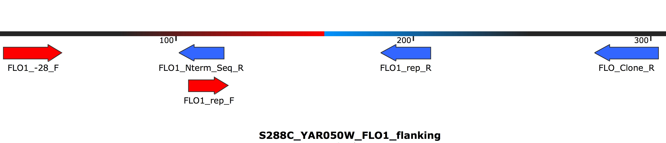
FLO1 primer mapping
*Repeat element was deleted to conserve space*
Notes:
We explicitly want to amplify the N-term region and should receive overlap wth these primers. But with other primers including the repeat elements were designed

Slide 15
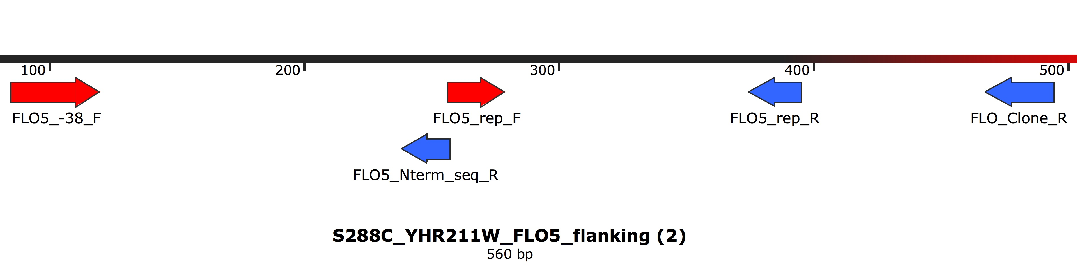
FLO5 primer mapping
*Repeat element was deleted to conserve space*
Notes:
We explicitly want to amplify the N-term region and should receive overlap wth these primers. But with other primers including the repeat elements were designed

Slide 16

FLO9 primer mapping
*Repeat element was deleted to conserve space*
Notes:
We explicitly want to amplify the N-term region and should receive overlap wth these primers. But with other primers including the repeat elements were designed

Slide 17
PCR Primer Design
Seq Name | Seq 5' to 3'
FLO1_-28_F | CTTGTCACCAGTAAACAGAACATCC
FLO5_-38_F | AAATGATTTTCTTTAAATTGATTAGCACCACTAAA
FLO9_-28_F | AGAACAATTGTACAATAAAAGCCCC
FLO_Clone_R | TTAAATAATTGCCAGCAATAAGGACGC
FLO1_Nterm_Seq_R | CGTACCCTTCGAAGTCATC
FLO5_Nterm_seq_R | CGTACCCTTCAAAGTTATC
FLO9_Nterm_Seq_R | CGTACCCTTCAAAGTCATC
Upstream Region
(low homology)
Common Primer
(identical end region)
N-Terminal Domain
Reverse Primer
(high homology)
Notes:
Primers designed
[You need to present the primers!! Unique forward primers are located in the upstream, regulatory region. Not the longer sequences due to the high Aor T content (GC pairs have more bonds, so with many AT pairs, we need longer primers to stick tightly. Each of the Unique Forward primers will pair with the common Reverse prime rlocated at the 3’ end of the gene.
Primers targeting the N-terminus can use the same unique forward primers and additional primers that may, with some trial and error to find the right conditions, capitalize on small changes in template sequences to provide these unique primers. While they may work to target these genes from the genomic DNA samples, these primers will become unique once the entire genes are cloned. ]
PCR designed SHOULD give us unique products despite the the DNA is very similar. The most i
EVEN THOUGH all of the DNA is in the same genomic mixture!! This is powerful JuJu-Magic!
To clone these genes and examine how they are being expressed in different brewing strains we needed to make sure we were creating primers that are unique to each protein and that the primer does not accidently stick to the FLO5 or FLO9 when we are trying to only look at FLO1.
We want in the future to measure the proteins in the N terminus but other primers were designed for troubleshooting

Slide 18
Conclusions
Unique primers were created to ensure sequence can be obtained from the N-terminus to determine variance
Single variants in sequence have the potential to give reason why different brewing strains flocculate at different levels
Future work could include targeting the central region, C terminus, or full gene
Repeat Region
N-Term
C-Term
F
R
F
R
Sequence
Comparison
Amplicon Length
Comparison
Notes:
While the high sequence homology can be frustrating to work with, single variants in their sequence has the potential to give reason why different brewing strains flocculate at different levels
If you carefully examine any sequence, primers can be created single handedly
In the future, we could focus on the tandem repeats in each protein to investigate if the length of repeats heavily influence level of flocculation. Once the clones are obtained as well a lot more experiments can take place, like using fluoresce to see when genes are active, deletion of genes, overexpression …

Slide 19
Questions? dooley.sarah1@live.longwood.edu
Notes:
Thank you again for taking the time to listen about my research. If you have any questions, feel free to follow up with an e-mail @ dooley.sarah1@live.longwood.edu

Slide 20
References
Gianvito PD, Tesnière C, Suzzi G, Blondin B, Tofalo R. FLO5 gene controls flocculation phenotype and adhesive properties in a Saccharomyces cerevisiae sparkling wine strain. Scientific Reports. 2017;7(1).
Longtine MS, Iii AM, Demarini DJ, Shah NG, Wach A, Brachat A, Philippsen P, Pringle JR. Additional modules for versatile and economical PCR-based gene deletion and modification in Saccharomyces cerevisiae. Yeast. 1998;14(10):953–961.
Saccharomyces Genome Database | SGD. https://www.yeastgenome.org/
Tofalo R, Perpetuini G, Gianvito PD, Schirone M, Corsetti A, Suzzi G. Genetic diversity of FLO1 and FLO5 genes in wine flocculent Saccharomyces cerevisiae strains. International Journal of Food Microbiology. 2014;191:45–52.

