Slide 1
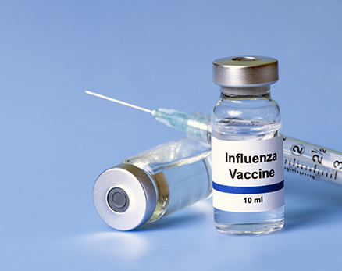
Fact or Myth: The flu can be caused by the flu vaccine
Arleigh Wood
HONS-BIOL302 Comprehensive Anatomy and Physiology II
April 22, 2020

Slide 2
Abstract
To many, the flu vaccine seems like a threat to an otherwise healthy individual. People often get the flu after receiving the flu shot, which does not promote confidence in the general public. For the vaccine to work, adaptive immunity must be activated by the introduction of the viral particles in a safe manner. An effective immune response from the vaccine generates flu-like symptoms or the virus may mutate away from the original vaccination. Overall, an individual stands a better chance at maintaining health during flu season by receiving a flu shot.

Slide 3
The Goal of the Myth Project
The goal of this experiment was to pick a common, widely accepted myth regarding medicine and debunk the myth through proven research and explanation of the body’s system involved. The myth I wanted to disprove is that the flu vaccine causes the flu. This misconception prevents herd immunity in many communities and allows the flu virus to run ramped for much longer than necessary. This was done by a careful dissection of the construction of the flu vaccine and how the immune system interacts, as well as how the flu still arises after inoculation.

Slide 4
The Myth
The flu vaccine has the potential to cause the flu.
Reasoning
One of the only annual vaccines
Testing positive for the flu after vaccine
Feeling flu symptoms shortly after vaccine
Large increase in cases of the flu over last decade

Slide 5
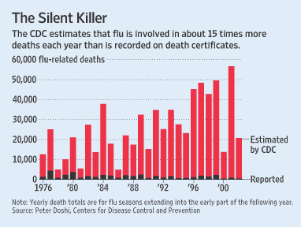
The Myth

Slide 6
The Myth

Slide 7
The System
How the flu virus is handled
Invades immune system and activates both innate and adaptive systems
Innate immune cells activate adaptive immune cells
Triggers antibodies that neutralize disease, prevent further spread
(van de Sandt, et al. 2012)

Slide 8
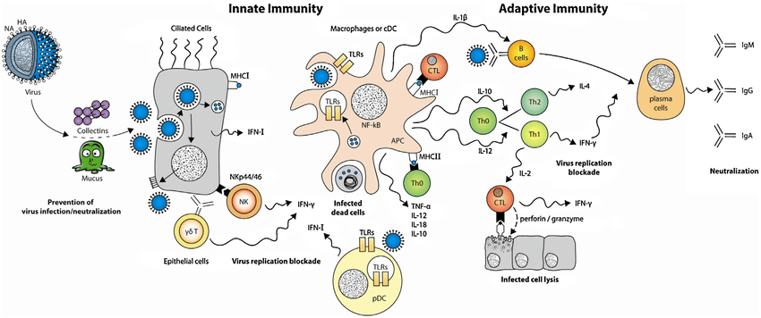
The System
(Elisa, et al. 2013)

Slide 9
The System
Vaccination Design
Mimics real infection to create a memorable, protective immune response
A viral subunit (protein) is introduced at the skin, to the blood stream, and then tissues
Creates a minor immune response by activating innate cells (Nausea, Fever)
Innate cells stimulate adaptive cells, create antibodies and immune response
Soema, et al. 2015

Slide 10
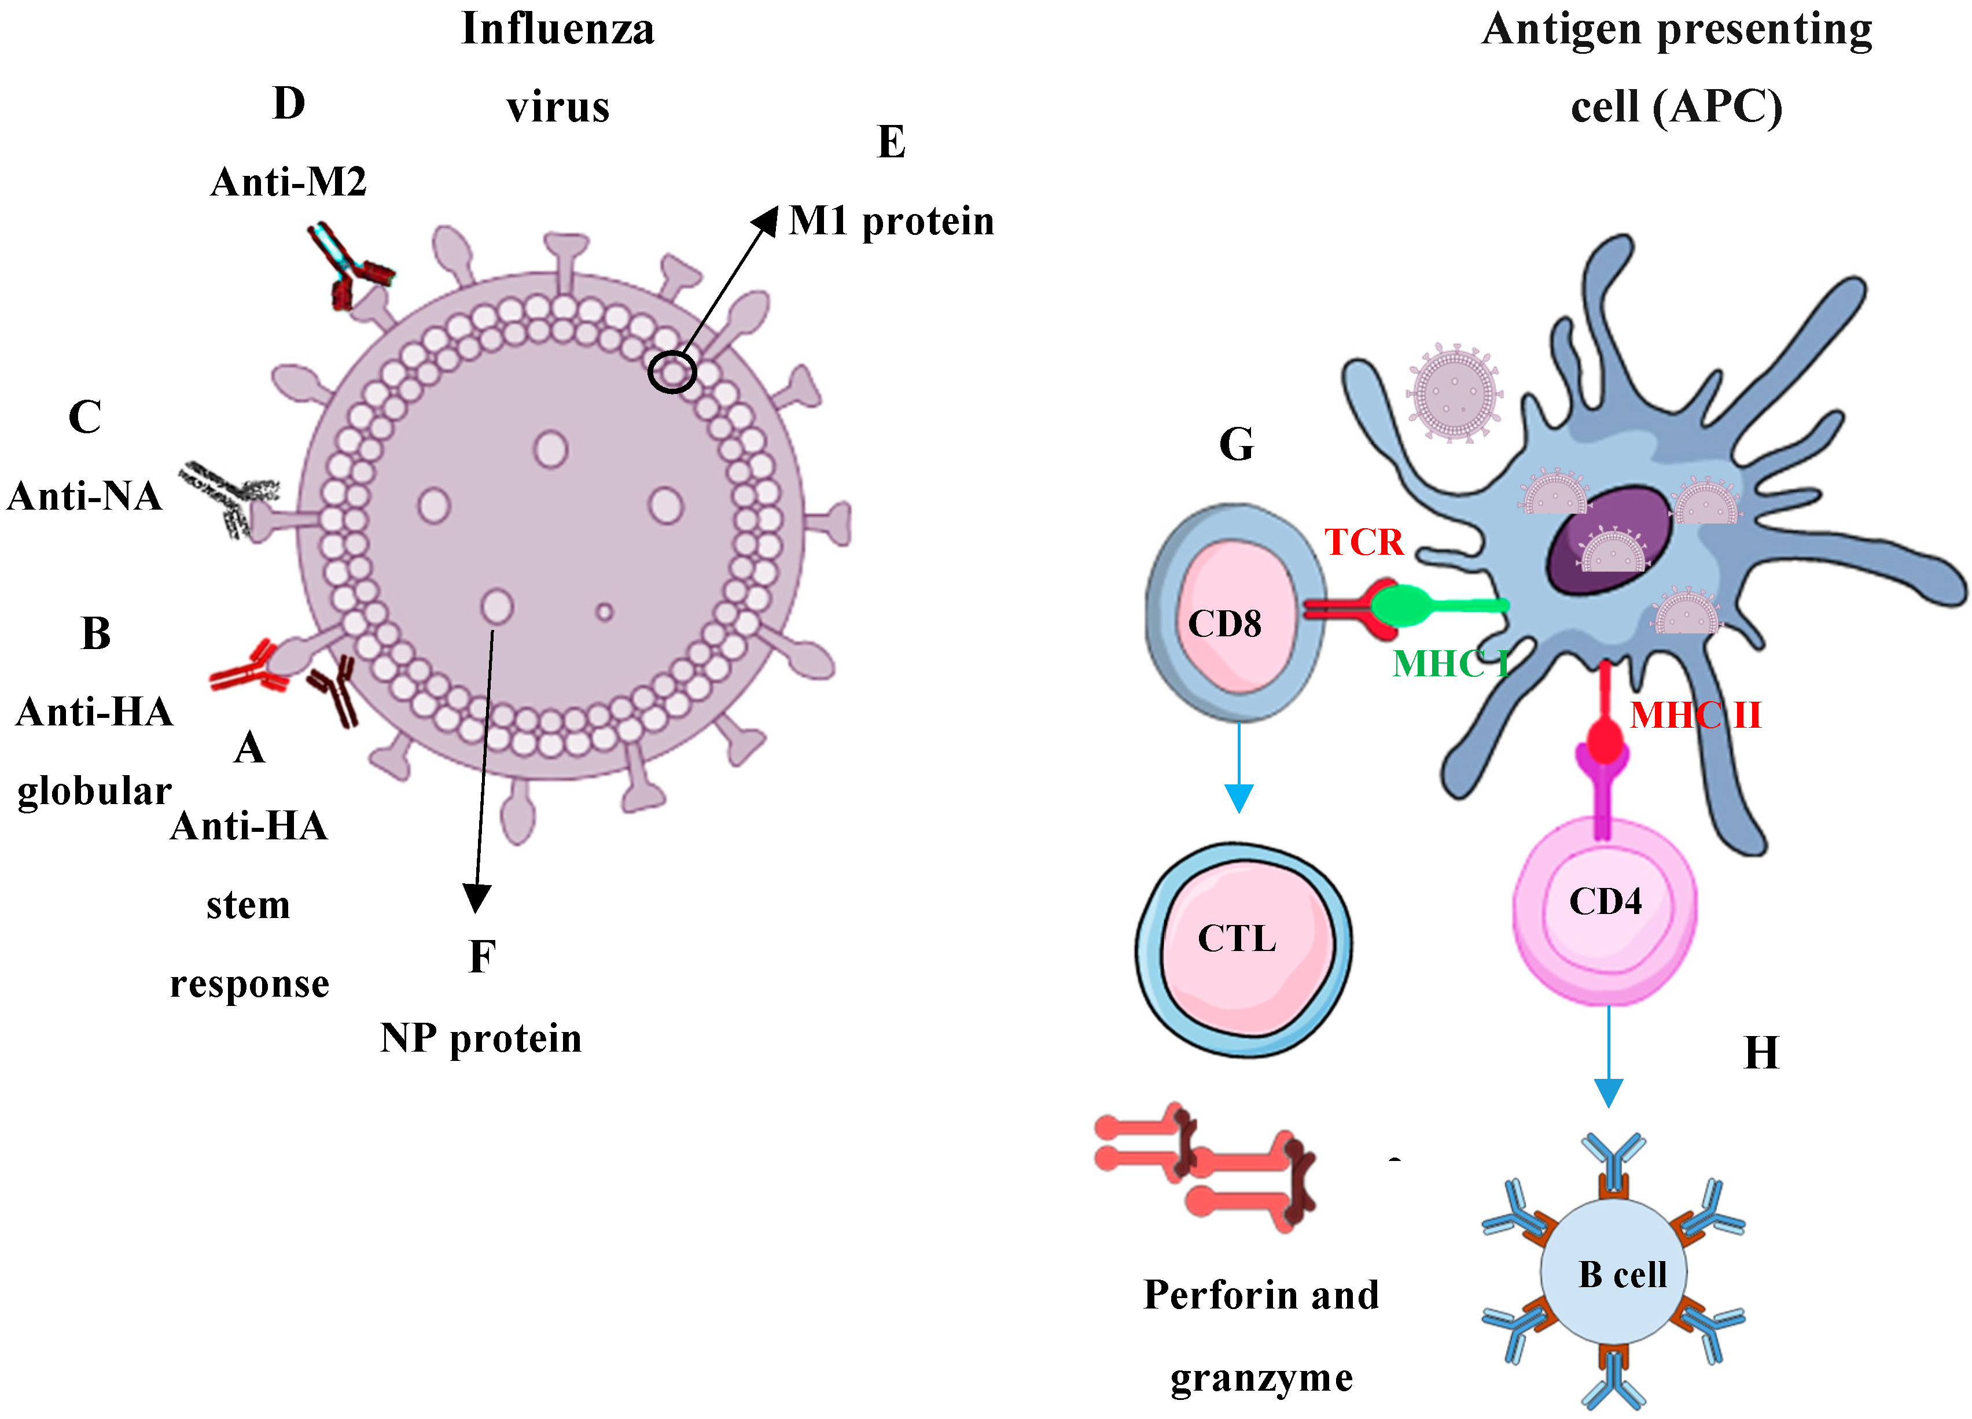
The System
(Poh and Jazayeri , 2019)
(Janeway, et al. 2001)

Slide 11
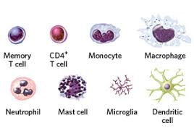
The Evidence
Subunit vaccine design prevents toxicity (Soema, 2015)
The vaccine looks like the virus, creates immune response as a “primer” (Houser & Sabarro, 2015)
Antibodies create memory for virulent flu strain; attack harder and faster on second exposure (Nichol, et al. 1995)
Probability of contracting the flu after vaccine is decreased significantly
2019-2020 Flu season: 37-50% effective (CDC, 2020)
Protein Subunits of Virus
Whole virus

Slide 12
How can I still get the flu then?
Vaccine is not 100% effective (CDC, 2020)
Influenza virus mutates rapidly (Nichol, 1995)
Flu can be contracted before 10-day incubation of vaccine (Savard, et al. 2011)

Slide 13
The Evidence
(Savard, et al. 2011)

Slide 14
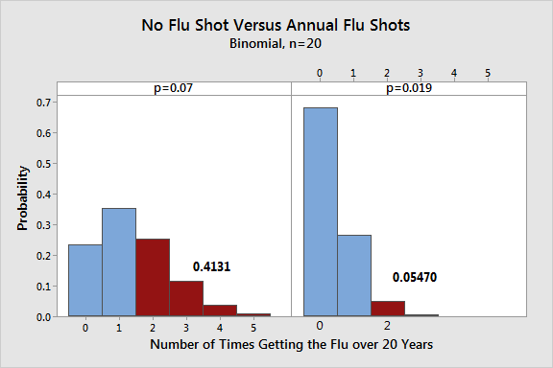
The Evidence

Slide 15
Conclusion
Likeliness of the population getting flu vaccination continues to decrease
Design of the flu vaccine prevents true infection
Getting the flu vaccine increases probability of remaining healthy during flu season

Slide 16
References Cited
Center for Disease Control and Prevention (2020). Interim Estimates of 2019–20 Seasonal Influenza Vaccine Effectiveness — United States, February 2020. Accessed from https://www.cdc.gov/mmwr/volumes/69/wr/mm6907a1.htm
Crisci, Elisa & Mussa, Tufaria & Fraile, L. & Montoya, Maria. (2013). Review: influenza virus in pigs.. Molecular Immunology.
Houser, K., & Subbarao, K. (2015). Influenza vaccines: challenges and solutions. Cell Host Microbe, 17(3), 295–300. https://doi.org/10.1016/j.chom.2015.02.012
Janeway CA Jr, Travers P, Walport M, et al., (2001). B-cell activation by armed helper T cells. Immunobiology: The Immune System in Health and Disease. 5th edition. New York: Garland Science.
Nichol, K et al. (1995). The effectiveness of vaccination against influenza in healthy working adults. N Engl J Med. 333(14): 889-893.
Poh, C.L. Jazayeri, S.D. (2019) Development of Universal Influenza Vaccines Targeting Conserved Viral Proteins. Vaccines, 7(4), 169.
Savard, C., Guérin, A., Drouin, K., Bolduc, M., Laliberté-Gagné, M. E., Dumas, M. C., Majeau, N., & Leclerc, D. (2011). Improvement of the trivalent inactivated flu vaccine using PapMV nanoparticles. PloS one, 6(6), e21522. https://doi.org/10.1371/journal.pone.0021522
Soema, P.C.; Kompier, R.; Amorij, J.P.; Kersten, G.F. (2015). Current and next generation influenza vaccines: Formulation and production strategies. Eur. J. Pharm. Biopharm. 94, 251–263
van de Sandt, C. E., Kreijtz, J. H., & Rimmelzwaan, G. F. (2012). Evasion of influenza A viruses from innate and adaptive immune responses. Viruses, 4(9), 1438–1476. https://doi.org/10.3390/v4091438

