Slide 1
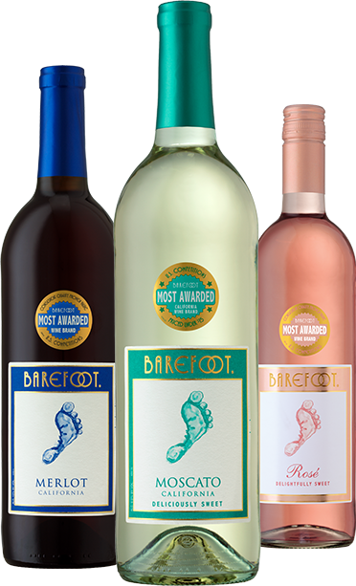
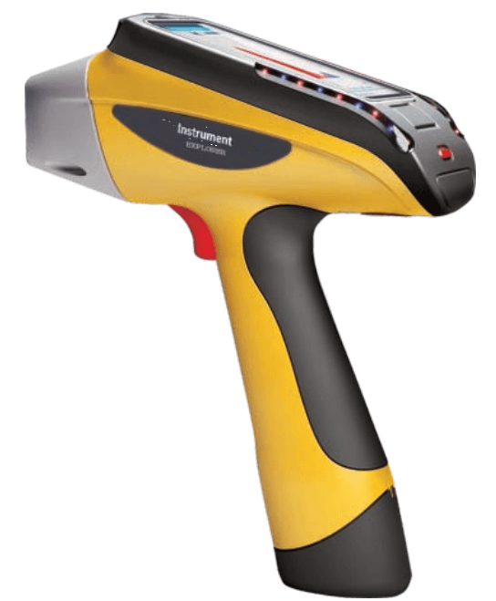
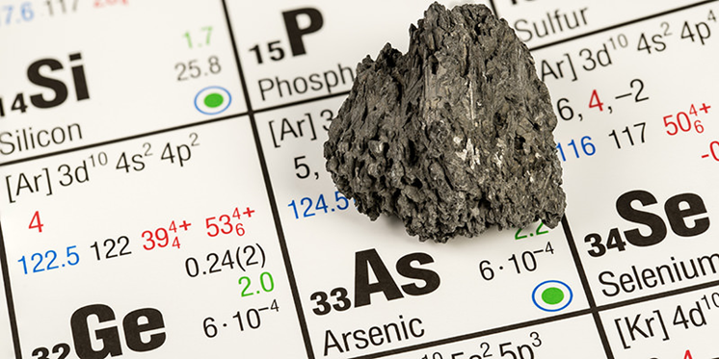
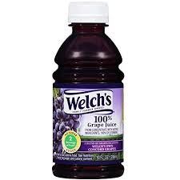
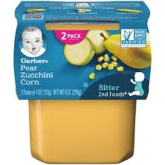
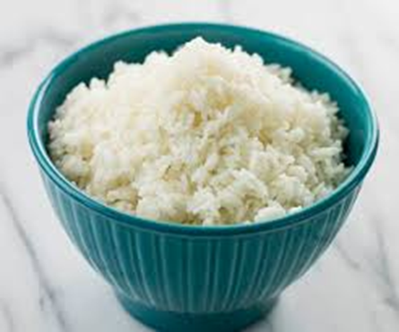
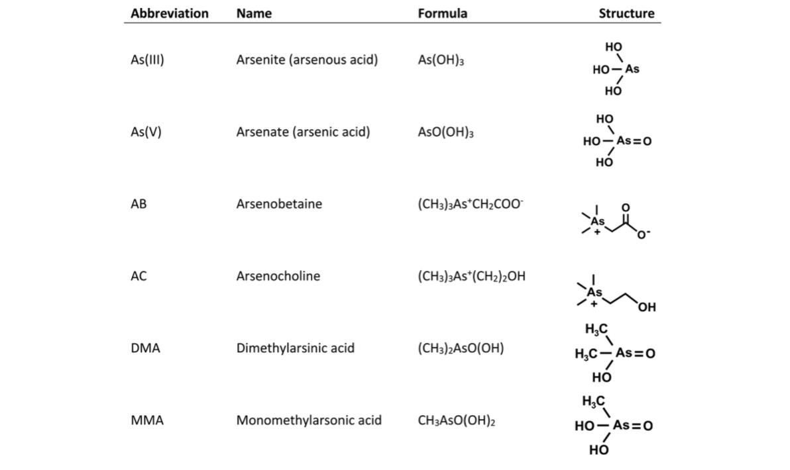
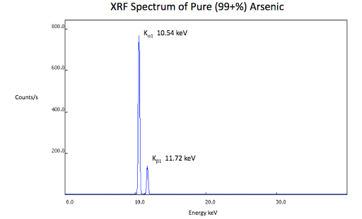
Analysis of Arsenic in Wine by XRF
Hannah S. Meyls
CHEM 403
Longwood University, Department of Chemistry and Physics, 201 High Street, Farmville, VA 23909
Abstract: Arsenic contamination in food and beverages is a problem due to the harm it can cause consumers. Currently in the United States there is no regulation limit. Red, white, and pink wines will be analyzed for their concentration of inorganic arsenic. Analysis of the wines will be analyzed by x-ray fluorescence spectroscopy (XRF). From this experiment we hope to develop a new method for measuring low concentrations of arsenic in wine.
Introduction
Proposed Project
Goals and Future Direction
Arsenic, a carcinogen, is a naturally occurring metalloid found in the earth’s crust and various types of rocks.
The World Health Organization and recent studies in the United States have discovered that diet is a main source of arsenic exposure (1).
In this proposal, XRF will be used to analyze various wine for their arsenic concentration.
XRF is a noninvasive instrumental technique that produces a set of characteristics used for an inorganic species.
An XRF spectrum of pure aesenic is shown in Figure 2.
Concentrations of arsenic in wine will be analyzed, since it is harmful and toxic to ingest.
To differentiate this project from others XRF would be used to quantify and identify arsenic.
XRF is not a common analytical method used for wine analysis, but if it is proven a reliable method it will be a cheaper and faster alternative method.
Future directions would include testing other products thought to have arsenic such as grape juice, baby food, and rice.
Methodology
Wines used:
- Barefoot brand cabernet sauvignon
- Barefoot brand merlot
- Barefoot brand rosé
- Barefoot brand pinot grigio
Procedure (Fig. 1)
Table 1. Common organic and inorganic arsenic species found in foods (1).
Figure 2. A XRF spectrum of pure arsenic (99%+)
Figure 1. Proposed arsenic extraction procedure.
Step 1
Prepare arsenic trioxide: Dissolve 2.5g Na₂MoO₂ in 1 L of water containing 5mL sulfuric acid.
Step 2
Prepare arsenic standard : Add 0.13g of As₂O₃ to 10 mL of 1M NaOH. Add 10 mL of neutralized 0.5M sulfuric acid and dilute to 1 L with water.
Step 3
Prepare wine standards: Spike wine with As₂O₃ in the range of 0.1 ppb to 80 ppb. Precipitate arsenic into a sulfide using concentrated perchloric acid .
References:
1. Tanabe, C. K.; Nelson, J.; Ebeler, S. E. Journal of Agricultural and Food Chemistry 2019, 67, 4154-4159.
2. Reymont, T.M.; Dubois, R. J. Analytica Chimica Acta. 1971, 56, 1-6

