Slide 1
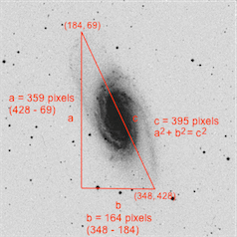
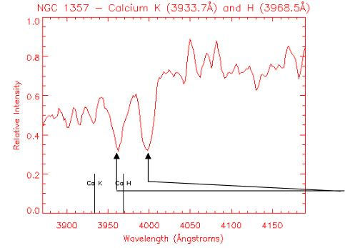
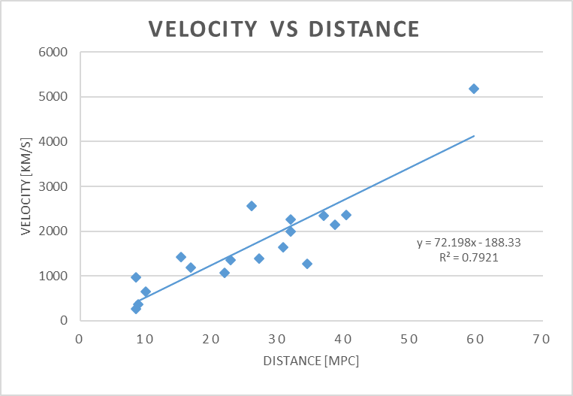
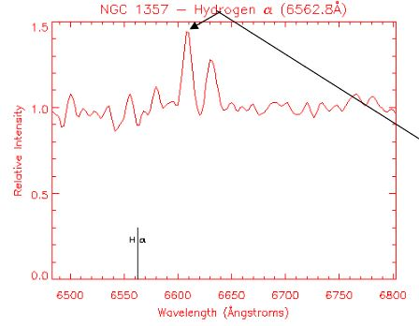
Hubble’s Law Experiment Nick Zebhideh Longwood University, Farmville, VA 23909
Purpose
The purpose of this experiment was to calculate an experimental Hubble constant value and use that value to calculate an estimated age of the universe using data drawn from the Hubble Law Lab from the University of Washington. Both experimental values were then compared to the most recent accepted values respectively.
Experimental Plan
We used provided website to collect our data from 18 out of 27 samples of galaxies provided using the instructions on that website. However, we did not use any galaxies that were labeled bad via the lab instructions.
Results
Results Chart
 | Experimental Value (slope method) |  | Standard Error |  | Accepted Value
Hubble Constant | $$66\left[\frac{\frac{Km}{s}}{MPc}\right]$$ |  | $$4\left[\frac{\frac{Km}{s}}{MPc}\right]$$ |  | $$\left(70±7\right)\left[\frac{\frac{Km}{s}}{MPc}\right]$$
Age of Universe | $$14.7billion years$$ |  | $$3.3 billion years$$ |  | 13.7 billion years
Approximate Age of Our Sun |  | 5 $billion years$
Estimated Age of the Oldest Stars |  | 12.5 $billion years$
Document Name: Hubble_Lab.docx, Hubble_Lab.excel
Activity 1
Measure and record the values for the angular separation of each galaxy by selecting
the two points on the picture of the galaxy which are furthest from one another. In the image of the galaxy below, the endpoints of hypotenuse of the triangle would be where the mouse pointer would need to click to accurately determine the angular separation.
Activity 2
Measure and record the values for the wavelengths of both the Calcium H and
Calcium K on the redshift graphs for each galaxy. This is done by selecting the two lowest points, or troughs, of the graph. The leftmost value is the Calcium K value, and the rightmost trough is the Calcium H value.
Activity 3
Measure and record the values for the wavelengths of the Hydrogen redshift graphs
for each galaxy. This done by section the peak of the highest point on each graph.
Background on Hubble’s Law
In the 1900’s, Edwin P. Hubble observed that galaxies move apart from one another. He determined their speed by analyzing the redshift of the light produced by them. From this, Hubble concluded that the universe expanded at a uniform rate. This was the contrary of previous beliefs that the universe was static. Today, the rate at which the universe expands is referred to as the Hubble constant,${ H}_{°}$. Over the past century, many others have repeated Hubble’s experiment which led to a large variation in results.
Accepted Values
Hubble Constant¹: 69.8 $\left[\frac{\frac{Km}{s}}{MPc}\right]$
Age of Universe²: 13.77 billion years
Linest Calculation graph: Hubble_lab.exls
Theory
The relationship between the distance and speed of galaxy’s is expressed by Hubble’s
Law such that,
$$v={ H}_{°}∙d$$
where ${ H}_{°}$ is the Hubble constant, v is the recessional velocity, and, d is the distance from that galaxy. Since, Hubble’s constant is equal to velocity over distance, its inverse gives the time that the universe has been expanding. This can be used as an estimate for the maximum age of the universe.
$$Max Age=\frac{1}{{ H}_{°}}$$
The Hubble constant is given by the ratio of recessional velocity over distance. The
recessional velocity of a galaxy which is derived from the Doppler formula,
$$z=\frac{v}{c}$$
where v is the recessional velocity, and c is the speed of light, $3×{10}^{6}km/s$, and z is the value of the redshift. Redshift, a phenomenon in which the light emitted from galaxies moving away from us shifts into red light spectrum, can be expressed as,
$$z=\frac{\left(λ−λ_{°}\right)}{λ_{°}}$$
, where$λ$ is the measured wavelength from our reference frame, and, $λ_{°}$, is the actual wavelength of the light emitted. The three most common spectral lines of a given galaxy are used for wavelength in order to calculate redshift.
Trigonometry is used to find the distance to each galaxy. The distance to a galaxy is
modeled as a triangle where the hypotenuse is the distance, d, the angle of the triangle is the angular distance, a, and the side of the triangle opposite of the angle is the galaxy’s size, s, such that we can say,
$$d=\frac{s}{a}$$
Note: We assume that, s, is 22 KPc because all galaxy’s used for this experiment are spiral galaxies so we may use the “standard ruler” assumption.
Images provided from: 223 Hubble_law_Spectra_hints.pdf
Conclusion
Our results make sense because our Hubble constant and the accepted value fall within one uncertainty of each other. It could be argued that our age of the universe, although it can be considered inconsistent because it does not fall with two uncertainties of the accepted value, still makes sense. The age of the universe has to be greater than the age of the oldest stars. Additionally, supermassive stars take millions if not a billion years to form and our age accounts for that time.
Our R² value for our graph is .79. This means there is some error in the fitment of our line and, therefore, some error in the velocities and distances our galaxies. If our R² value was .99 and our age was inconsistent then we could determine that our experimental value for our age is not valid. It also is important to note that Hubble’s constant throughout time has varied because of the difficulty of calculating the actual distance between galaxies and their actual distances across them. This proved to be difficult nearly a century ago and is still a considerable obstacle today.
Sample Calculations
Linest function was used to find our best value for Hubble constant by plotting
Velocity vs Distance. The slope of that plot is our best value for our Hubble constant and the error in slope is our error for our Hubble constant.
Our error for our age of the universe was found by taking the partial derivative of
age equation
Maximum Age of Universe Sample Calculation using the Hubble constant found using the linest function where m is the slope of the graph or, ${ H}_{°}$
$$Age=\frac{1}{m}$$
$$Age=\frac{\left(\frac{1}{66\left[\frac{\frac{Km}{s}}{MPc}\right]}∙\left(3.09×{10}^{19}\left[\frac{Km}{MPc}\right]\right)\right) }{\left(3.16×{10}^{7}\left[\frac{s}{year}\right]\right)}$$
$$Age=14.7billion years$$
Note: The age sample calculation also converts the time into years
Spectral Line Values Given
Spectral Line | $$λ_{°}\left[Angstrom\right]$$
Calcium (CaII) K | 3933.7
Calcium (CaII) H | 3869.5
Hydrogen (H⍺) | 6562.8
References
¹New Hubble Constant Measurement Adds to Mystery of Universe's Expansion Rate. (n.d.). Retrieved from https://hubblesite.org/contents/news-releases/2019/news-2019-28
²How old is the universe?: Determining the Age of the Universe. (2014, July 23). Retrieved from https://skyandtelescope.org/astronomy-resources/age-of-the-universe/

