Slide 1
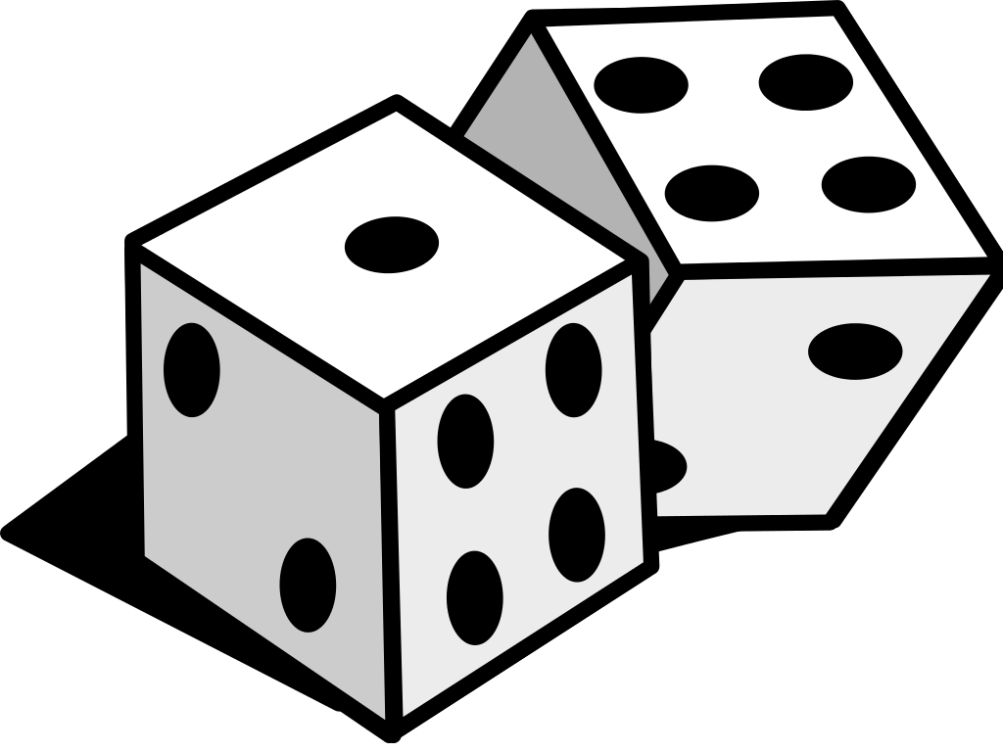
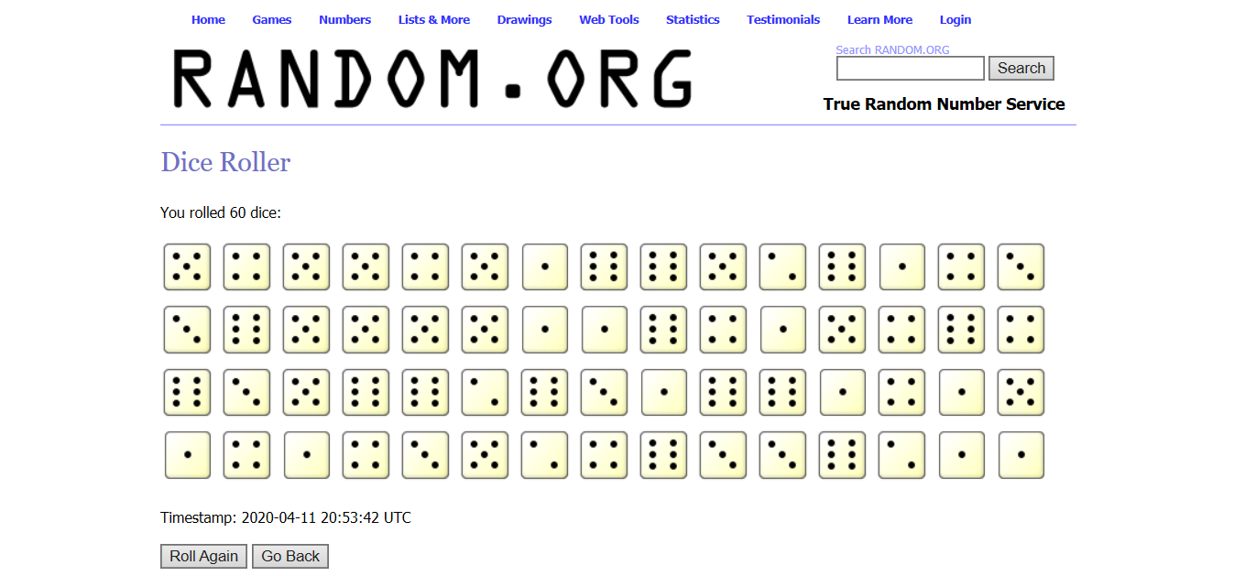
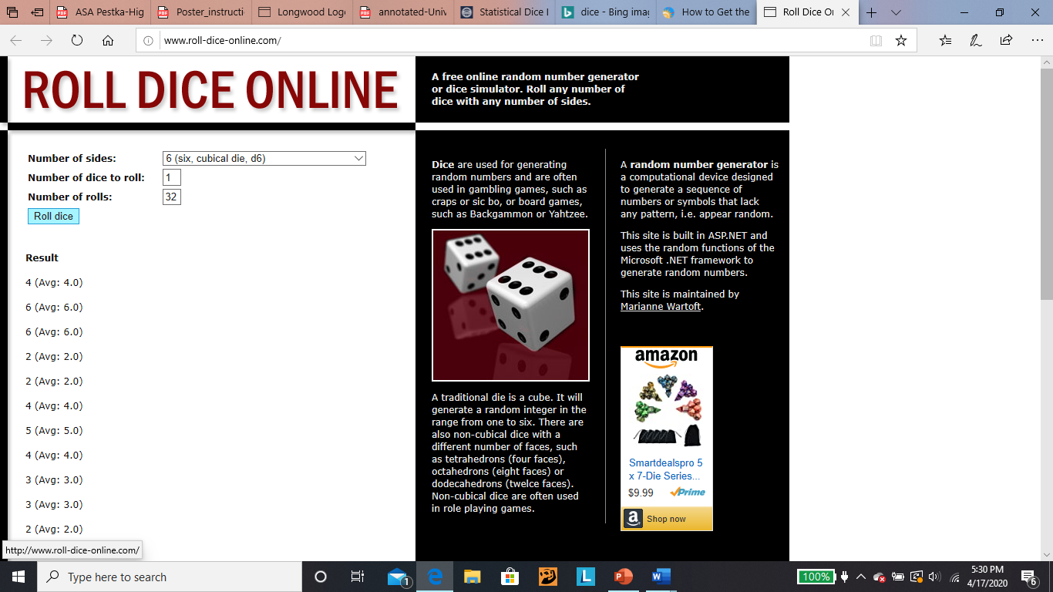
Statistical Mechanics, Thermodynamics, and Dice?
2020 Research and Creative Inquiry Showcase
Ibrahim Maday
Longwood University
Objective
In this experiment we will
explore the realm of statistical mechanics by rolling dice.
calculate the multiplicity and entropy of varying dice rolls.
determine the type of distribution pattern that it follows.
Background
Three laws of thermodynamics are:
1st Law. Conservation of Energy: Energy added into a system must equal energy removed.
2nd Law. The total entropy in a system will either increase or remain constant.
3rd Law. As the temperature of a system approaches zero, its entropy approaches the lowest value.
According Stanford University, statistical mechanics is the most fundamental field of physics. Statistical mechanics are a set of techniques that can be applied to all physical systems, no matter the size nor the laws that the system obeys. These techniques assume that a system can exist in a discrete set of microstates, where a microstate defines all possible variables.¹
Theory
Our “physical system” will be serval virtual dice. Each die will be rolled separately, and that value will become a “microstate”, once we roll all the individual dice, we will add up the values and the sum will be a macrostate. The total number of microstates in a microstate is known as the multiplicity (w). For example, we roll a 5 from an eight-sided dice then we roll 2 from the 4-sided dice, our macrostate is 7, but our multiplicity is 4 because there are 4 total ways of rolling a 7. We can also calculate the probability of rolling a 7 by dividing the multiplicity by the number of rolls,
Probability = w/ N Equation 8.1
where the N is the number of rolls and w is the multiplicity. We can measure the total number of
microstates in a system by finding out its entropy.
S=kb∗ln(w), Equation 8.2
where S is entropy, kb is the Boltzmann constant (1.38∗10−23 (J/K), and w is the multiplicity. If were to roll an 2 in using 2 dice our entropy will be 0 because the multiplicity is one.
Experimental Plan and Outcomes
Experiment Part 1:
Roll 4 and 8-sided dice 32 times. Record each outcome in a table.
Calculate the multiplicity expected.
Record actual multiplicity (how many times did each macrostate actually occured).
Calculate the entropy estimated and actual for each case (this should be included in your table).
Make a histogram of actual and expected multiplicity
Make a histogram the actual and expected entropy
Calculate the mean, standard
deviation and standard error for the
expected
and actual multiplicities.
Experiment part 2:
Repeat the experiment
1 with the
same dice but increase
the
number of
rolls to 128.
Experiment part 3:
Now repeat
experiment 1 using four,
six and eight-sided
dice together for 192
rolls.
For experiments 3 and 4 you will need to calculate the multiplicity using all 3 dice.
Experiment part 4:
Now repeat the above experiment (Parts A-H) using four, six and eight-sided dice together for 384 rolls.
This image shows the random.org dice generator
which was used to roll the six sided dice.
Conclusion
In this lab we explored the world of statistical mechanics using dice rolls. We have rolled over 1000 virtual dice to understand the three fundamental concepts of statistical mechanics: microstates, macrostates, and multiplicity. We then used those concepts to find the probability of getting a certain outcome also to calculate its entropy. We determined that our model follows a normal distribution pattern and that entropy seeks the highest amount of multiplicity.
References
^{1”}Introduction to Statistical Mechanics”by Peter Eastman web.stanford.edu/~peastman/statmech/thermodynamics.html.
Acknowledgments
https://www.random.org/dice/ - 6-sided dice
http://www.roll-dice-online.com/ - 4-sided and 8-sided dice
Microsoft Excel – calculating and organizing data
Table 1: w Expected vs. Actual of Experiment 1
Macrostate | w Expected | w Actual
1 | 0 | 0
2 | 1 | 1
3 | 2 | 1
4 | 3 | 2
5 | 4 | 6
6 | 4 | 6
7 | 4 | 5
8 | 4 | 5
9 | 4 | 2
10 | 3 | 1
11 | 2 | 2
12 | 1 | 1
This table shows the expected and actual multiplicities of the experiment part 1.
The following graphs are suggesting that there is a normal distribution in both the multiplicity and entropy, however the correct distribution is the Poisson Distribution since we are limiting our dice rolls to a certain number. If we were to conduct this experiment where the dice rolls approached infinity, we will have a normal distribution curve. We can see this pattern in the graphs; every time we increase the number of rolls our graphs draw closer to a normal distribution graph.
This image shows the random.org dice generator
which was used to roll the four and eight sided dice.

