Slide 1
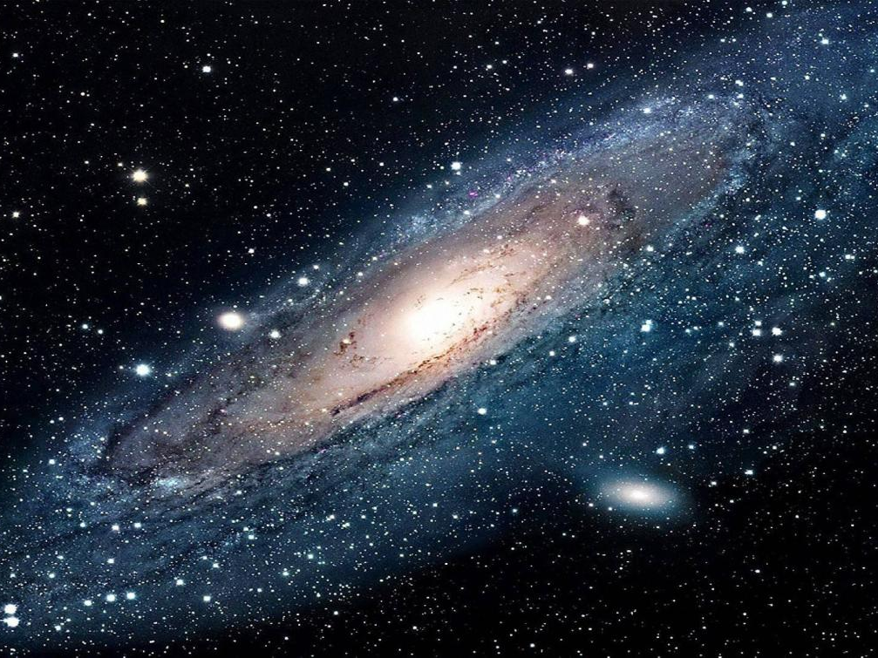
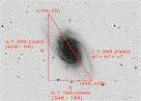
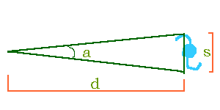
Hubble’s Law Spring Showcase for Research and Creative Inquiry, April 22, 2020 Rayshad Lindsay Longwood University, Farmville VA, 23909
Purpose:
In the work is to determine the value for Hubble’s constant based on observing images and spectra of various spiral galaxies and determining the age of the universe.
Background:
In the 1920’s, Edwin P. Hubble discovered a relationship that is now known as Hubble's Law.¹
Hubble’s Law states that the recessional velocity of a galaxy is proportional to its distance from us:
v = H_{o} * d
(v is the galaxy's velocity, d is the distance to the galaxy (in megaparsecs; 1 Mpc = 1 million parsecs), and H_{o} proportionality constant, called "The Hubble constant.”)²
By rearranging the equation, Hubble’s constant can be express as
$\text{H}\text{o}$ = $\frac{v}{d}$
Hubble's Law implies that a galaxy moving away from us twice as fast as another galaxy is twice as far away.
The velocity, v, of a galaxy is measured using the Doppler effect. The radiation coming from a moving object is shifted in wavelength:
$\frac{Δλ}{λ}$ = $\frac{v}{c}$
(Wavelengths are measured in Angstroms (Å) and the speed of light, c, has a constant value of 300,000 km/sec.)³
The method for determining intergalactic distance is to assume that all galaxies of the same type are approximately the same physical size.
This is known as "the standard ruler" assumption. Spiral galaxies, like our Milky Way Galaxy, are generally about 22 kiloparsecs (22,000 parsecs) across.⁴
distance = true size / angular size
The age of the universe can be determined by Hubble constant:
Age of the Universe = $\frac{1}{\text{H}\text{o}}$
Methodology and Results:
Phase one: Determine the galaxy’s distance by measuring its apparent (angular) size (a), the galaxy's true size (s = 22kpc), and the distance to the galaxy (d):
d = s/a
Phase two: Determine the galaxy’s redshift by comparing absorption and emission lines in the spectrum of light coming from this galaxy to the known stationary wavelengths of some strong absorption and emission lines, namely the calcium "K" and "H" absorption lines (Figure 2) and the Hydrogen α emission line (Figure 3):
Redshift z = $\frac{\text{λ}\text{measured}\text{−}\text{λ}\text{true} }{\text{λ}\text{true} }$
Calculate the average redshift (z) from each redshift wavelength:
z_{average} $= \frac{\sum{z}}{Nλ}$
Sample Calculation:
z_{average =} $\frac{0.0074 +0.0076+0.0069 }{3}$ = 0.0073
Phase three: Determine the recessional velocity, v, the speed that the galaxy moving away from our own galaxy:
v = c z_{average}
Sample Calculation
v = (3x 10⁵km/sec)(0.0073)
v = 2190 km/sec
Phase Four: Determine Hubble’s constant using each galaxies distance and velocity.
Using the LINEST function in Microsoft Excel:
Phase Five: Determine the age of the universe from the measure Hubble’s constant.
Age of the universe = $\frac{1}{60.26 \frac{km}{Mpcs}}$ * $\frac{3.09 x {10}^{19}km}{1Mpc}$ * $\frac{1 yr}{3.16 x {10}^{8}s}$ = 16.2 billon years
Outcome:
Hubble’s Law does in fact tells that the galaxies are accelerating moving away from us.
The measure Hubble constant is precise but not very accurate.
The major problem in this lab is determining the accurate angular size due to the brightness color for each galaxy.
Future Work
Improve on the distances for small size galaxies using other methods.
Enhancing images each galaxies for better accuracy.
Reference:
1-3. Bahcall, Neta A. “Hubble's Law and the Expanding Universe.” PNAS, National Academy of Sciences, 17 Mar. 2015,.
4-5.The galaxy images and redshift available on, https://depts.washington.edu/astroed/HubbleLaw/galaxies.html.
Acknowledgement:
The author wants to thank Robert C. Kennicutt Jr. of University of Arizona for sharing galaxy images and spectra online.
Galaxy ID
1357
1832
2276
2775
2903
3034
3147
3227
3368
3623
3627
4775
5248
5548
6181
6217
6643
6764
z average | Velocity km/sec
0.0073 | 2190
0.0069 | 2070
0.0079 | 2370
0.0049 | 1470
0.0014 | 410
0.0007 | 210
0.0088 | 2640
0.0051 | 1521
0.0044 | 1330
0.0034 | 1020
0.0026 | 770
0.0056 | 1690
0.0036 | 1080
0.0099 | 2960
0.0082 | 2470
0.0043 | 1290
0.0047 | 1420
0.0083 | 2500
Galaxy ID | Angular Size (milli-radians) | Distance (Mpc) S = 22 kpc
1357 | 0.924 | 23.81
1832 | 0.789 | 27.88
2276 | 0.742 | 27.5
2775 | 1.19 | 18.49
2903 | 1.691 | 13.01
3034 | 2.221 | 9.91
3147 | 1.222 | 18
3227 | 1.361 | 16.16
3368 | 2.3 | 9.565
3623 | 2.826 | 7.785
3627 | 2.359 | 9.326
4775 | 0.715 | 30.77
5248 | 1.752 | 12.56
5548 | 0.516 | 42.62
6181 | 0.805 | 27.33
6217 | 0.709 | 31.03
6643 | 1.049 | 20.97
6764 | 0.701 | 31.38
Table 4: The average redshift (z) and velocity for each galaxy.
Figure1: Image of a spiral galaxy measuring in an angular size distance
Table 1: The angular size and distance for each galaxy
Galaxy ID | Distance (Mpc) | Velocity (km/sec)
1357 | 23.81 | 2190
1832 | 27.88 | 2070
2276 | 27.5 | 2370
2775 | 18.49 | 1470
2903 | 13.01 | 410
3034 | 9.91 | 210
3147 | 18 | 2640
3227 | 16.16 | 1521
3368 | 9.565 | 1330
3623 | 7.785 | 1020
3627 | 9.326 | 770
4775 | 30.77 | 1690
5248 | 12.56 | 1080
5548 | 42.62 | 2960
6181 | 27.33 | 2470
6217 | 31.03 | 1290
6643 | 20.97 | 1420
6764 | 31.38 | 2500
Figure 3: The slope line graph of the measure Hubble constant with each galaxy velocity and distance.
 |  | Calcium (CaII) K $λtrue$ (3933.7 Å) |  | Calcium (CaII) H $λtrue$ (3968.5 Å) |  | Hydrogen (Hα) $λtrue$ (6562.8 Å)
Galaxy ID | Measured | Redshift (z) | Measured | Redshift (z) | Measured | Redshift (z)
1357 | 3962.9 | 0.0074 | 3998.6 | 0.0076 | 6608.2 | 0.0069
1832 | 3961.4 | 0.007 | 3996.2 | 0.007 | 6606.7 | 0.0067
2276 | 3967.6 | 0.0086 | 3997 | 0.0072 | 6615.2 | 0.008
2775 | 3954.4 | 0.0053 | 3988.5 | 0.005 | 6592 | 0.0044
2903 | 3938.9 | 0.0013 | 3973 | 0.0011 | 6574.2 | 0.0017
3034 | 3937.4 | 0.0009 | 3973 | 0.0011 | 6564.1 | 0.0002
3147 | 3969.1 | 0.009 | 4002.4 | 0.0085 | 6621.4 | 0.0089
3227 | 3949.8 | 0.0041 | 3985.4 | 0.0043 | 6607.5 | 0.0068
3368 | 3946.7 | 0.0033 | 3981.5 | 0.0033 | 6606.7 | 0.0067
3623 | 3941.2 | 0.0019 | 3977.6 | 0.0023 | 6602 | 0.006
3627 | 3944.3 | 0.0027 | 3979.2 | 0.0027 | 6578 | 0.0023
4775 | 3959.1 | 0.0065 | 3990 | 0.0054 | 6595.8 | 0.005
5248 | 3947.4 | 0.0035 | 3983.1 | 0.0037 | 6586.6 | 0.0036
5548 | 3949 | 0.0039 | 4003.2 | 0.0087 | 6674.9 | 0.017
6181 | 3966.8 | 0.0084 | 4004.8 | 0.0091 | 6609.8 | 0.0072
6217 | 3950.5 | 0.0043 | 3986.2 | 0.0045 | 6589.6 | 0.0041
6643 | 3952.9 | 0.0049 | 3986.2 | 0.0045 | 6594.3 | 0.0048
6764 | 3964.5 | 0.0078 | 4009.4 | 0.01 | 6609.8 | 0.0072
Slope
Uncertainty Slope
60.2603841 | 368.15499
13.1162746 | 302.738061
y-intercept
Uncertainty. Slope
Hubble’s constant
(H_{o} $±δ\text{H}\text{o}$)
60.26 $±$ 13.12 $\frac{km}{Mpcs}$
Table 5: LINEST function for the measure Hubble ’s constant
Figure 2: The wavelength for both the Calcium k and H lines in a galaxy spectra measure in Angstroms(Å).⁴
Figure 3: The wavelength of the Hydrogen α emission line in a galaxy spectra measure in Angstroms(Å).⁵
Table 2: The measurement wavelength and redshift for each galaxy
Galaxy ID
1357
1832
2276
2775
2903
3034
3147
3227
3368
3623
3627
4775
5248
5548
6181
6217
6643
6764
z average
0.0073
0.0069
0.0079
0.0049
0.0014
0.0007
0.0088
0.0051
0.0044
0.0034
0.0026
0.0056
0.0036
0.0099
0.0082
0.0043
0.0047
0.0083
Table 3: The redshift (z) average for each galaxy

