Slide 1
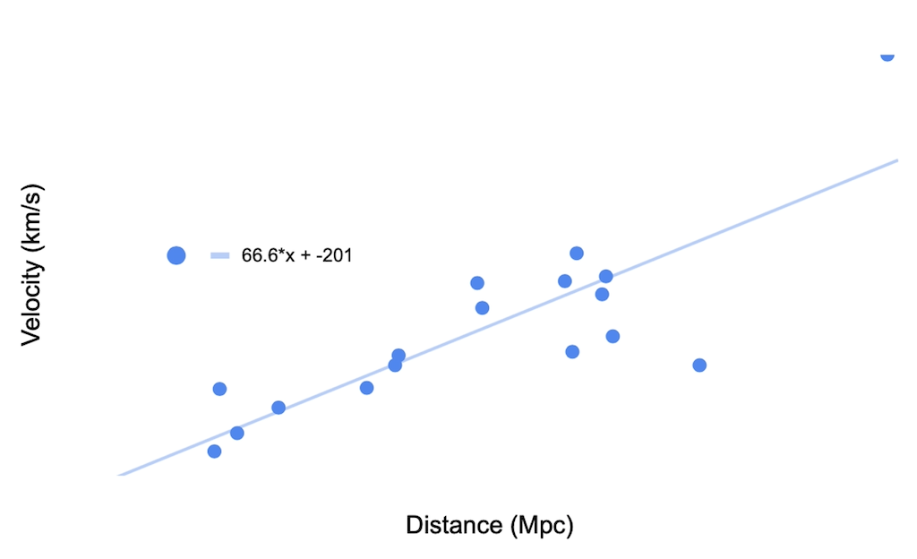
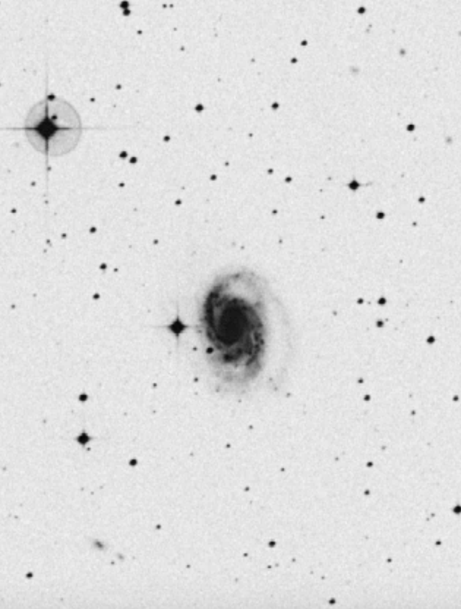
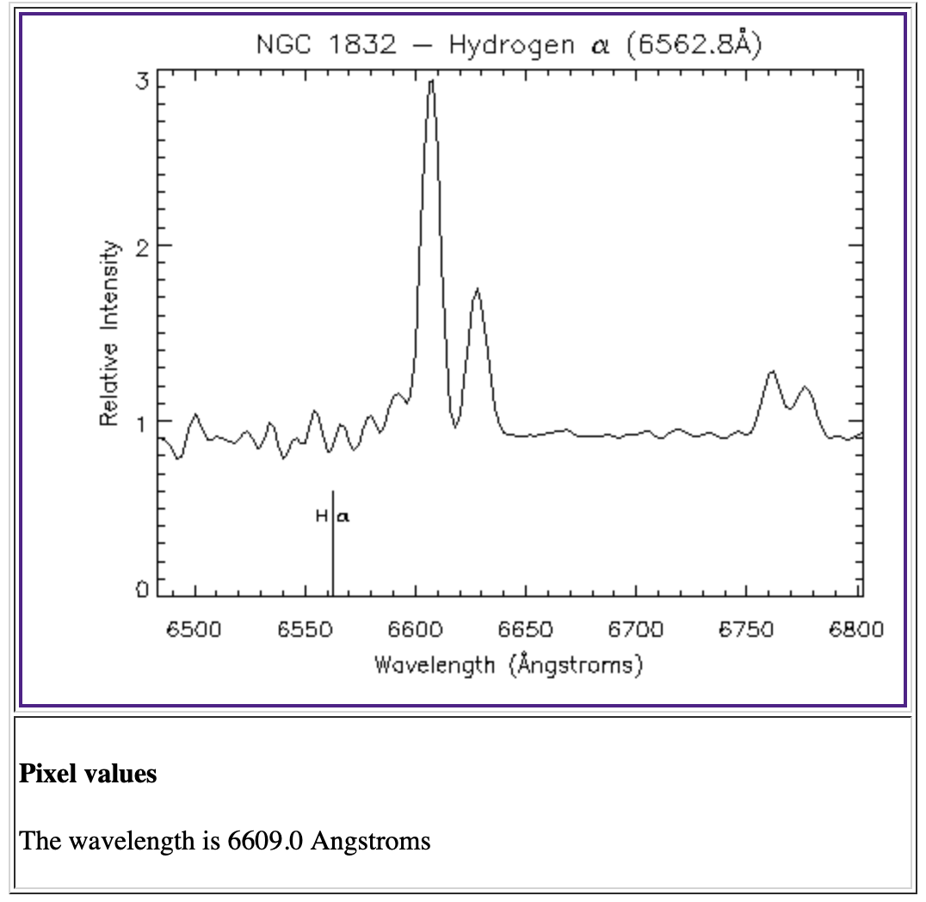
Hubble’s Law Experiment William Coleman Longwood University, Farmville, VA 23909
Objective
The objective of this experiment was to calculate the age of the universe. This was done by using provided astronomical data to calculate an experimental Hubble’s constant to which Hubble’s law was applied.
Theory Cont.
We use the following formula to find recessional velocity
$Z=\frac{V}{C}$ _{(1.4)}
Where V is recessional velocity and C is the speed of light.
We apply Hubble’s law to our data to get our Hubble’s constant.
We know that the age of the universe is calculated by
seconds = $\frac{1}{H_{0}}$ _{(1.5)}
where H₀ is our calculated Hubble’s constant
Error was found using statistical analysis with the aid of the LINEST function in excel.
Error was propagated using standard methods and the following equation,
${SE(U)}^{2}=$ ${(\frac{1}{∂H_{0}})}^{2}∗{SE(H_{0})}^{2}$_{(1.6)}
Where SE(U) is error in the calculated age of the universe, H₀ is Hubble’s law, and SE(H₀) is Hubble’s constant error.
Results
The calculated Hubble’s constant is found by plotting all 17 galaxies’ recessional velocity on the Y axis of a graph and the distances of the galaxies were plotted on the x axis resulting in the following graph
The slope of this graph gives our average Hubble’s constant which is 66.6±11.7 $\frac{km}{sMp}$
The Calculated age of the universe based on this constant is 14.7±$8.3∗{10}^{−5}$ Billion years.
This age is inconsistent with the common accepted age of the universe. This result is likely due to an underestimation of error and our assumption of the galaxy’s true size being 22 kpc.
Sources
A. James, “Infographic On Hubble Constant,” NASA Hubblesite.org, January 8, 2020
J. Tate, “Hubble’s Law,” UniverseToday.com, September 14,2009
“Hubble’s Law,” http://hosting.astro.cornell.edu/academics/courses/astro201/top_lss.htm
“The Hubble Law,” https://depts.washington.edu/astroed/HubbleLaw/galaxies.html
History on Hubble’s Law
In 1929 an astronomer named Edwin Hubble would publish a paper in which he made the discovery that there is a linear correlation between the distance and velocities of observable galaxies. This relationship can be quantified as,
$V=H∗d$_{(1.1)}
where V is the recessional velocity, d is the distance from earth and H is Hubble's constant.
Current Accepted Values
Hubble’s Constant: 67.4±.5$\frac{km}{sMp}$
Age of the universe: 13.799±.021 Billion Years
Experimental Design
Galaxy images and spectral emission/absorption lines were selected from depts.Washington.edu/astroed/hubblelaw/galaxies.html
The images were as follows,
Theory
To find our experimental Hubble’s constant we begin by selecting 17 galaxies and assuming their true size to be 22 kpc.
We then apply the following equation
D= $\frac{22kpc}{A}$_{(1.2)}
Where D is a galaxies distance from earth and
A is the angular size of the observed galaxy.
We use the redshift of Calcium (k) and (H) absorption lines and the redshift of the Hydrogen emission spectrum to find recessional velocities of each galaxy.
Redshift if found using the following equation
$Z=\frac{λ measured − λ true}{λ true}$ _{(1.3)}
Where Z is redshift, λ measured is the measured emission or absorption wavelength from the galaxy, and λ true is the true lab measured wavelength.
Image of galaxy used to Image of hydrogen emission find angular size

