Slide 1


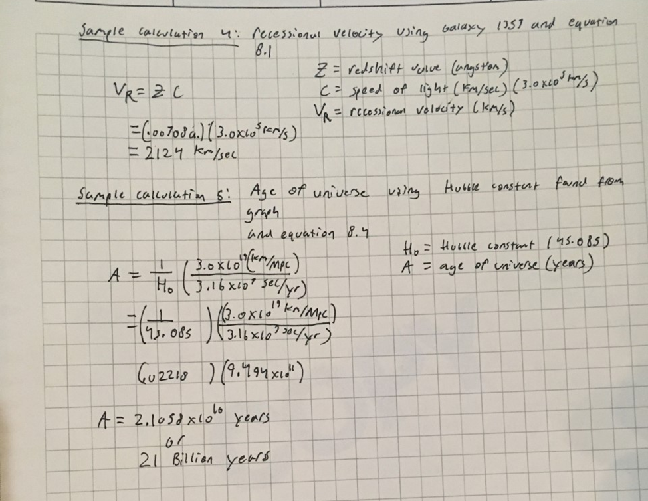
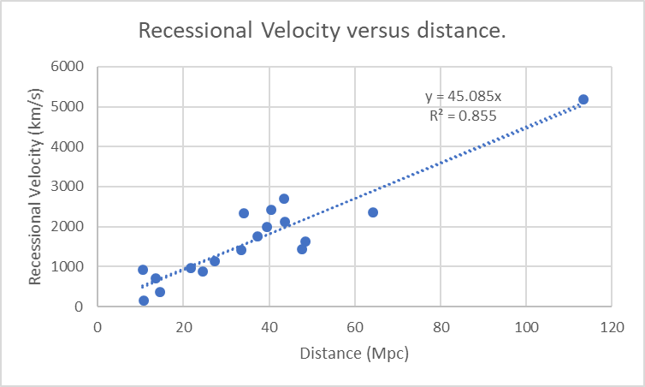
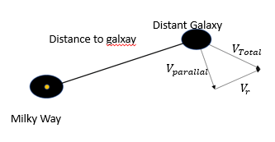
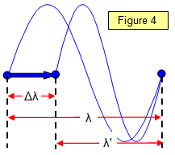
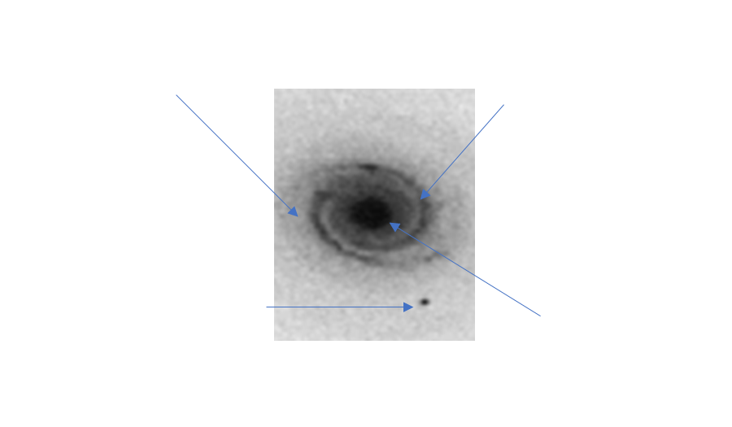
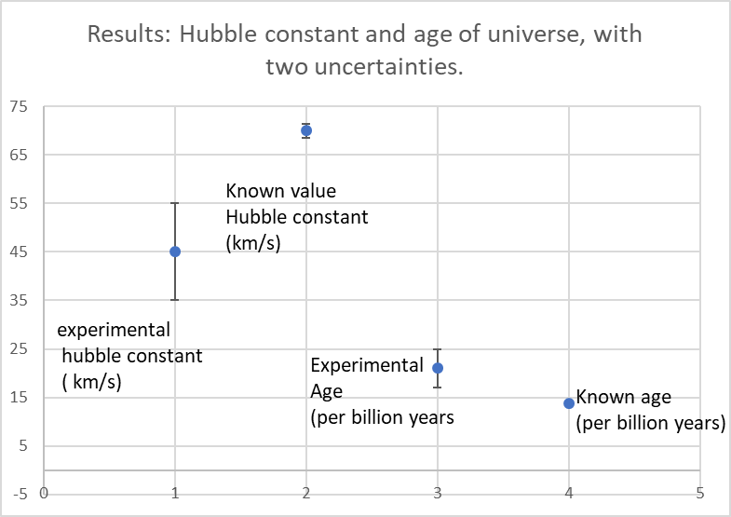
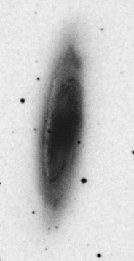
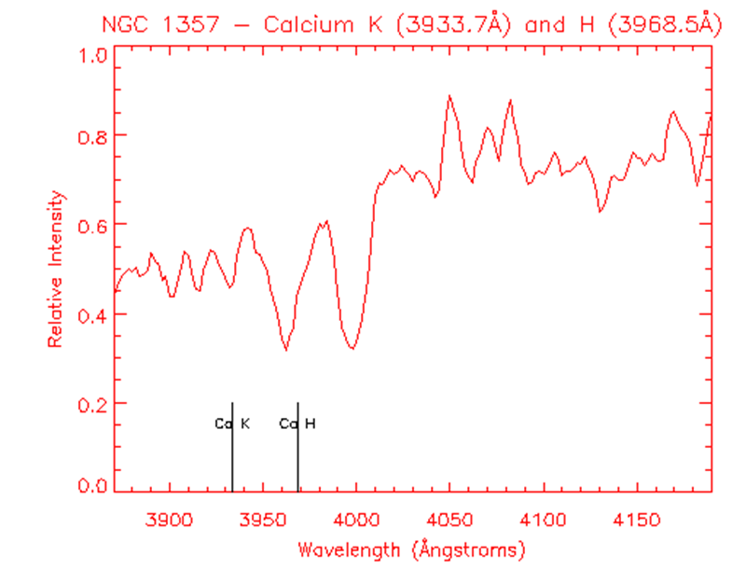
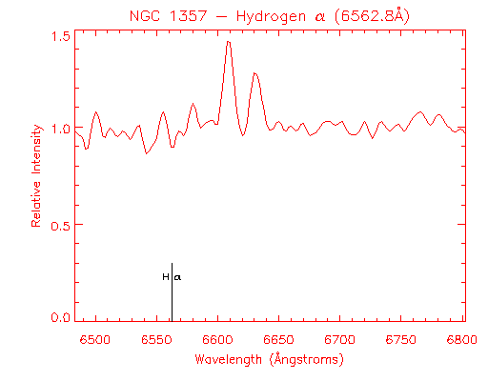
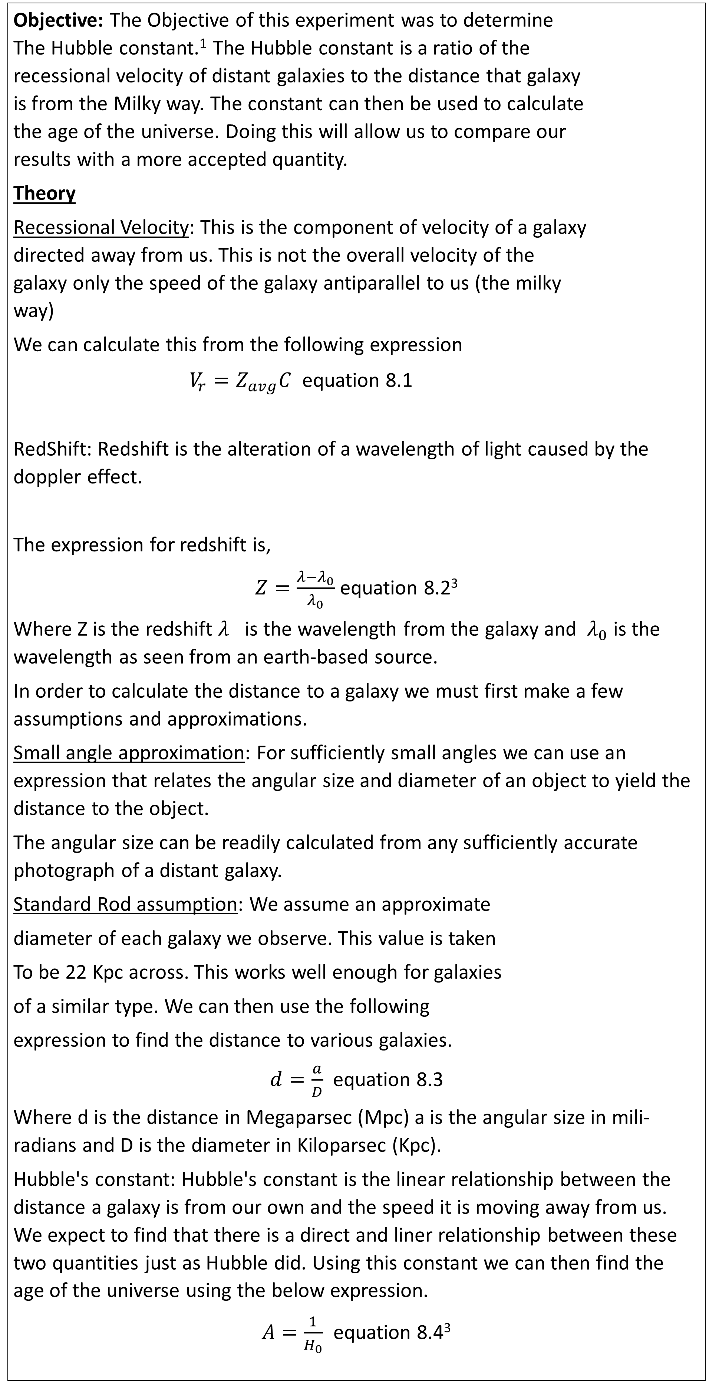
Hubble’s constant and the age of the Universe
Comparing distance and recessional velocity of distant Galaxies.
Andrew Burghaus
Longwood University | Physics 223
Faculty Member: Dr. Kenneth A Pestka II Physics Department
Objective: The Objective of this experiment was to determine The Hubble constant.¹ The Hubble constant is a ratio of the recessional velocity of distant galaxies to the distance that galaxy is from the Milky way. The constant can then be used to calculate the age of the universe. Doing this will allow us to compare our results with a more accepted quantity.
Theory
Recessional Velocity: This is the component of velocity of a galaxy directed away from us. This is not the overall velocity of the galaxy only the speed of the galaxy antiparallel to us (the milky way)
We can calculate this from the following expression
$V_{r}=Z_{avg}C$ equation 8.1
RedShift: Redshift is the alteration of a wavelength of light caused by the doppler effect.
The expression for redshift is,
$Z=\frac{λ−λ_{0}}{λ_{0}}$ equation 8.2³
Where Z is the redshift $λ_{}$is the wavelength from the galaxy and $λ_{0}$ is the wavelength as seen from an earth-based source.
In order to calculate the distance to a galaxy we must first make a few assumptions and approximations.
Small angle approximation: For sufficiently small angles we can use an expression that relates the angular size and diameter of an object to yield the distance to the object.
The angular size can be readily calculated from any sufficiently accurate photograph of a distant galaxy.
Standard Rod assumption: We assume an approximate
diameter of each galaxy we observe. This value is taken
To be 22 Kpc across. This works well enough for galaxies
of a similar type. We can then use the following
expression to find the distance to various galaxies.
$d=\frac{a}{D}$ equation 8.3
Where d is the distance in Megaparsec (Mpc) a is the angular size in mili-radians and D is the diameter in Kiloparsec (Kpc).
Hubble's constant: Hubble's constant is the linear relationship between the distance a galaxy is from our own and the speed it is moving away from us. We expect to find that there is a direct and liner relationship between these two quantities just as Hubble did. Using this constant we can then find the age of the universe using the below expression.
$A=\frac{1}{H_{0}}$ equation 8.4³
Procedure and Data
This lab was completed using Washington.edu's Hubble law web page⁴ which contains both the necessary images of the galaxies but also their respective red shift values.
Distance of galaxy:
The following Image shows the webpage utilized to find the angular size.
This is done by first identifying the long axis then by selecting the furthest point on that axis. The webpage then generates the necessary angular size measurement. It is important to note that while doing this the area of sharpest contrast was chosen. Looking at the figure below it is clear to see that there is a point of sharp contrast where the grey region meets the light gray region. For the purposes of consistency it was decided that the angular distance would be measured from the furthest reaching grey region. This exclude any area of the galaxy the light grey region occupies.
Finding the redshift value:
The following figures show the wavelengths of the galaxy selected from the list the webpage provides.
In the top can be seen the observed values here on earth. The troughs of the first image and the peak of the second image represent the redshifted values. With this data it was possible to then graph the distance and velocities and observe a linear trend.
Results
Graphing the respective velocity and distance for each galaxy yielded the following results.
Conclusion:
There is a definite relationship between the distance a galaxy is to us and the speed at which it recedes from the milky way, from this graph the age of the universe can then be calculated.
This value shown below is fairly off from values taken from Nasa’s “Tests of the big bang” webpage.⁵ This is likely due to the way in which the angular size of the galaxies was measure. As discussed under procedure and data section a significant portion of each galaxy was removed so that a more consistent measurement could be made.
This likely reduced the Hubble constant which in turn meant a greater age than should be expected.
Error analysis:
There were two sources of error that were accounted for in the experiment the error in Hubble’s constant was calculated using a linest function which was preformed on the recessional velocity vs distance data. The error in the age of the universe was then calculated using a partial derivates method preformed on equation. This resulted in the error bars that can be seen in the “Results, experimental” figure above.
Experimental improvements:
Better measuring technique
Less approximating, finding definite values will likely reduce total error present in experiment
Larger range of data set. This experiment only contains some 18 galaxies, there is a vast quantity more that could be included.
Future experiemtns:
The implications of Hubble's discovery of an ever-expanding universe lead to many questions. The most popular and likely well known of these is the force causing this expansion sometimes called “dark matter”⁶
A sample calculation of recessional velocity and the
Hubble constant
2.
Galactic edge, light grey
Galactic rim, grey
Here is an example of the data taken for the experiment
Close proximity
abnormality
Galactic center, black
Sources & Photo Credits
Hubble finds proof universe is expanding , People and discoveries, PBS.org
School physics, doppler effect.
(3) Physics-formulas-Hubble’s law, astronomyonline.org
(4) Hubble Law, Washington.edu. Depts.Washington.edu/asttro.ed/hubblelaw/galaxies.html
(5) Tests of big bang: The CMB.NASA.gov
(6) Bryner, Jeanna. Mysteries of Dark energy confirmed by new method. Space.com
CONTACT:
Andrew Burghaus
Physics Major, Math and German Minor, 2020
Andrew.Burghaus@live.longwood.edu

