Slide 1
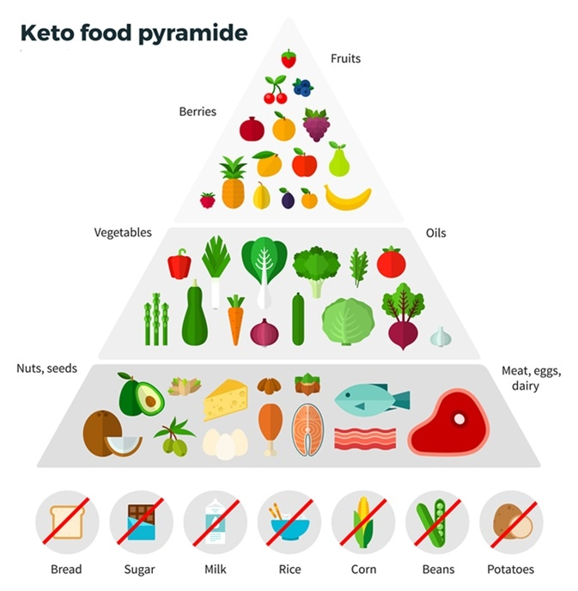
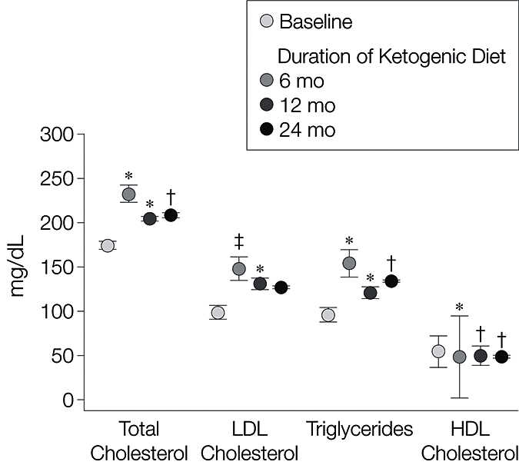
Overview of Health Consequences in The Ketogenic Diet and Efficacy in Treating Type-2 Diabetes
A Proposal
Talbot Thames
Longwood University
Abstract
How will the experiment be conducted?
The ketogenic diet is an increasingly popular tool for weight loss. It has shown benefits for Type II Diabetes patients in reducing the use of medication for treatment and keeping blood glucose levels to manageable levels. This approach to diabetes management is stunted, however, due to a multitude of adverse effects such as acidosis and atherogenic risk factors. Dietary trials were performed to assess the efficacy of both diets in reducing blood glucose levels and other against the contemporary western diet, composed of a moderate-carbohydrate and moderate-fat macronutrient profile. Upon completion, diabetic subjects in both the high-carbohydrate and low ketogenic diet should show a reduction in blood glucose in line with recommended levels. Ketogenic diet subjects will elicit several worrying symptoms such as headaches, gastrointestinal disturbances, and ketoacidosis, along with higher total cholesterol and HDL cholesterol. This trial supports previous studies that show a high risk involved with KD. High fiber whole food diets may provide similar benefits with Type II diabetic patients without associated risk factors. KDs should only be used clinically as an emergency solution when others are ineffective. This research underscores the need to assess quality of macronutrients along with their respective ratios relative to total caloric intake.
90 volunteers with obesity and Type-2 diabetes will be assigned with either a Ketogenic diet (<20 g daily carbohydrates), A high fiber plant-based diet (>350 g, < 400g daily carbohydrates), or a typical western diet (>200g, <300g daily carbohydrates) for three months.
90 volunteers without diabetes will also be assigned either of the three diets, in order to assess each diet’s risk factors in the development of diabetes.
Each volunteer will be required to keep a ledger detailing the foods they ate, along with macronutrient and caloric intake count. Volunteers are asked to cook their own meals from home as often as possible. This is to ensure caloric intake can be tracked more effectively. Subjects will come back for monitoring bi-weekly for recording of glucose levels, weight and general symptoms.
Introduction
Figure 1. An overview of the typical ketogenic diet consisting of no high-carbohydrate foods; replacing them with foods high in fat such as meat, nuts, and dairy.
The ketogenic diet (KD) is a growingly popular tool for weight loss consisting of high fat foods that are low in carbohydrates (Figure 1).
KD has shown benefits for Type II Diabetes patients in reducing the use of medication for treatment and keeping blood glucose to manageable levels.
In non-diabetic subjects, the Ketogenic diet has been shown to cause diabetic symptoms.
High fat intake leads to Intramyocelluar lipid production, spurring insulin resistance.
The ketogenic diet has been shown to cause adverse effects such as acidosis and atherogenic risk factors (Figure 2).
KD therefore could represent a high-risk way of alleviating diabetic symptoms
High fiber plant-based diets may provide similar benefits with Type II diabetic patients without associated risk factors.
Quality of macronutrients may be more important than macronutrient balance itself.
Potential Results
What are the potential conclusions?
Both the plant-based and ketogenic diets are expected to reduce weight loss, diabetic medication, and keep blood glucose levels manageable.
No expected statistical difference in weight loss between diet groups.
Subjects on the ketogenic diet are expected to show an increase in atherogenic risk factors.
Ketogenic diet could show negative symptoms, such as high blood pressure, acidosis, gastrointestinal disturbances, hyperlipidemia, arrhythmia, and low blood platelet count.
The plant-based diet is not expected to have these symptoms.
This study suggests that dietary guidelines should focus on quality of macronutrients, not only macronutrient levels themselves.
The ketogenic diet could be successful in achieving lower blood glucose levels, along with some patients reducing or even completely halting medication.
This result could be marred by adverse effects in some individuals, such as kidney stones, enlarged hearts, gastrointestinal disturbances, and atherogenic risk factors.
Both total cholesterol and LDL cholesterol are expected to increase in those on KD.
Blood glucose levels could rise in subjects in the ketogenic diet without diabetes the plant-based diet and western diet did not experience a similar increase. This is likely due to intramyocellular lipid production.
The ketogenic diet can both elevate the risk for developing Type II diabetes while also enabling a reduction in medication for the disease. Ketogenic diets come with inherent risks due to nature of the diet however and must be used with extreme caution.
High carbohydrate plant rich diets could have similar positive results with diabetes with less reported adverse effects.
Quality of macronutrients, such as unsaturated fats, unprocessed sugars, whole foods, and a move to plant-based nutrition could award greater health overall than the ratio of macronutrients.
Figure 2. The ketogenic diet increases several atherogenic risk factors compared to baseline, such as total cholesterol, LDL cholesterol and triglycerides. HDL or “good” cholesterol is lower than baseline.
Citations
Bennett C. Best and Worst Foods to Eat on the Ketogenic Diet. 2018 Nov 13 [accessed 2020 Apr 21]. https://www.news-medical.net/health/Best-and-Worst-Foods-to-Eat-on-the-Ketogenic-Diet.aspxGuo, Zengkui. “Intramyocellular Lipid Kinetics and Insulin Resistance.” Lipids in Health and Disease, vol. 6, no. 1, 2007, p. 18., doi:10.1186/1476-511x-6-18.
Kuhlmann, J., et al. “Intramyocellular Lipid and Insulin Resistance: A Longitudinal In Vivo 1H-Spectroscopic Study in Zucker Diabetic Fatty Rats.” Diabetes, vol. 52, no. 1, Jan. 2003, pp. 138–144., doi:10.2337/diabetes.52.1.138.
Masood, Wajeed. “Ketogenic Diet.” StatPearls [Internet]., U.S. National Library of Medicine, 18 Feb. 2020, www.ncbi.nlm.nih.gov/books/NBK499830/.
“New CDC Report: More than 100 Million Americans Have Diabetes or Prediabetes.” Centers for Disease Control and Prevention, Centers for Disease Control and Prevention, 18 July 2017, www.cdc.gov/media/releases/2017/p0718-diabetes-report.html.
Noto, Hiroshi, et al. “Correction: Low-Carbohydrate Diets and All-Cause Mortality: A Systematic Review and Meta-Analysis of Observational Studies.” Plos One, vol. 14, no. 2, July 2019, doi:10.1371/journal.pone.0212203.
Paoli, Antonio. “Ketogenic Diet for Obesity: Friend or Foe?” International Journal of Environmental Research and Public Health, vol. 11, no. 2, 2014, pp. 2092–2107., doi:10.3390/ijerph110202092.
Yancy, William S, et al. “A Low-Carbohydrate, Ketogenic Diet to Treat Type 2 Diabetes.” Nutrition & Metabolism, vol. 2, no. 1, 2005, doi:10.1186/1743-7075-2-34.
Kwiterovich, Jr PO, Vining EPG, Pyzik P, Skolasky, Jr R, Freeman JM. Effect of a High-Fat Ketogenic Diet on Plasma
Cardiac complications in pediatric patients on the ketogenic diet, T.H. Best, D.N. Franz, D.L. Gilbert, D.P. Nelson, M.R. Epstein. Neurology Jun 2000, 54 (12) 2328-2330; DOI: 10.1212/WNL.54.12.2328

