Slide 1
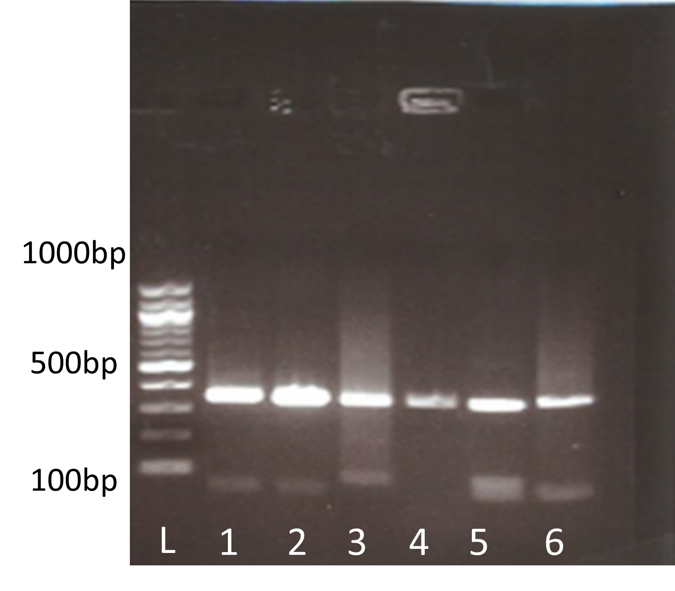
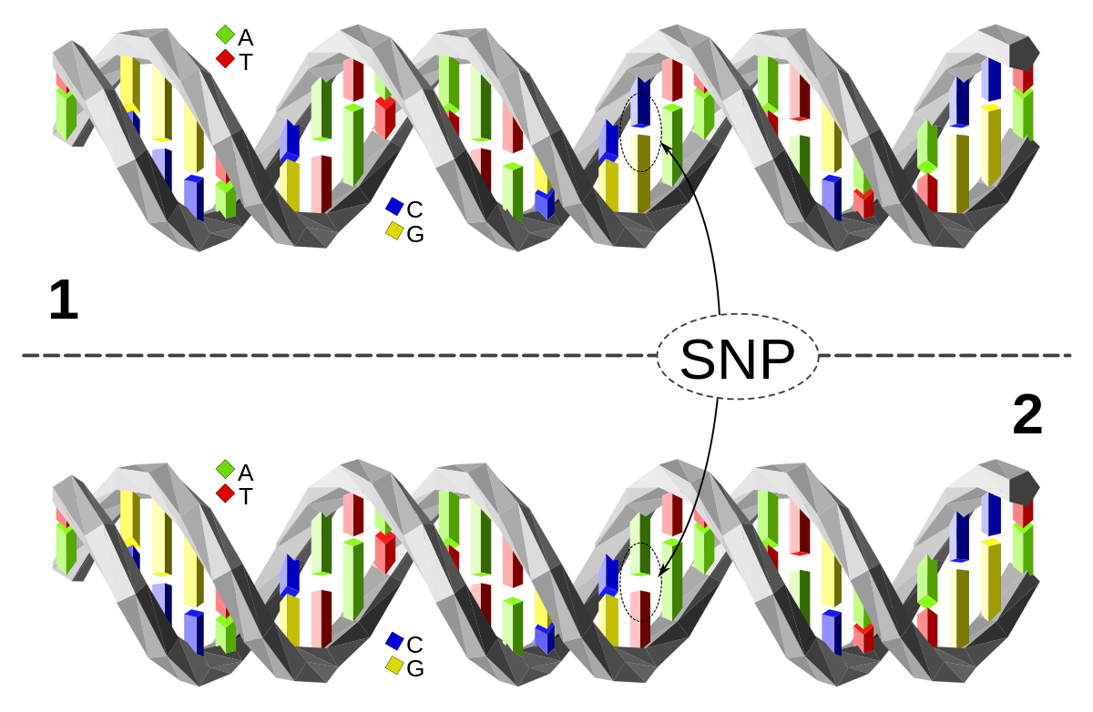
Curly Hair Trait: Homozygous or Heterozygous
Kaysi Bing
BIO 250, Longwood University
Background
Results
Single Nucleotide Polymorphism (SNP) are known to be single pair mutations in DNA
Certain SNP sequences are associated with traits and some diseases that effect humans
Researchers completed a study using the SNP rs17646946 to determine if the Europeans inherited the Trichohyalin gene (Medland, Sarah 2009 ).
It was discovered that SNPs can be used for Homogeneity testing where they can discover common diseases in most humans (Shastry, Barkur 2002)
Figure 2- This is the gel electrophoresis results from the DNA samples. The Base Pair ladder is to the left for reference.
Table 1- This table represents the sample information of the subject. It includes the A280 results from the nanodrop.
Figure 1- This picture represents a Single Nucleotide Polymorphism.
Specific Aim
Figure 3- This is the Chromatograph from samples 5b and 6b.
Research Aim: To connect the SNP rs17646946 AG genotype and curly hair
Hypothesis: People expressing a GG genotype at the SNP rs17646946 are most likely to have the curly hair trait
Conclusion
The results proved that the hypothesis was correct where people expressing the GG genotype at SNP rs17646946 will have inherited the curly hair trait.
Limitations to the experiment
Cross-contamination is a common cause of errors in most DNA studies and has been recognized for over 25 years (Drexler, et. al 1999).
Small sample sizes can be an issue to some studies.
Methods
Data Collection
Saliva Samples
Phenotypes collected
Amplification using Polymerase Chain Reaction
Sterile Water-60uL
Primer Mix-5uL
Gel Electrophoresis
Human Saliva-5uL
PCR Master Mix-25uL
Agarose Gel ran at 120V for 20 minutes.
DNA Purification
Gene Jet Kit
Sanger Sequencing
Using 100uL of Binding Buffer
Chromatographs
Used SnapGene viewer
References
Medland, Sarah E., et al. "Common variants in the trichohyalin gene are associated with straight hair in Europeans." The American Journal of Human Genetics 85.5 (2009): 750-755.
Shastry, Barkur S. "SNP alleles in human disease and evolution." Journal of human genetics 47.11 (2002): 0561-0566.
Drexler, H. G., W. G. Dirks, and R. A. F. MacLeod. "False human hematopoietic cell lines: cross-contaminations and misinterpretations." Leukemia 13.10 (1999): 1601-1607.

