Slide 1
APPROACHING DIVERSITY THROUGH INTERNATIONAL TEACHERS
OLIMPIA J. CERVANTES
Longwood Summer Literacy Institute July 2018

Slide 2
WHO AM I?
Special Education
Library Science
Puppetry
Children’s Author
Honduras-Morocco-Qatar-Mongolia

Slide 3
What is Diversity?
“Diversity can be define as people coming together from different races, nationalities, religions, and sexes to form a group, organization, or community.”
Sarah T. “The Importance and Benefits of Diversity.” 14 May 2012. http://www.teenink.com/opinion/environment/article/465407/The-Importance-and-Benefits-of-Diversity/

Slide 4
“Diversity is not always just what background you come from but is any unique difference between human beings. Diversity includes physical appearance, religious belief, and race but your opinions and thoughts and the impact they make on society are also part of diversity.”
Sarah T. “The Importance and Benefits of Diversity.” 14 May 2012.
http://www.teenink.com/opinion/environment/article/465407/The-Importance-and-Benefits-of-Diversity/

Slide 5
Ways to Approach Diversity
I. Preparing Yourself
II. Activities to Promote Diversity
III. Morocco –Qatar- Mongolia
Notes:
https://en.wikipedia.org/wiki/Flag_of_Qatar
https://en.wikipedia.org/wiki/Flag_of_Mongolia
http://flagpedia.net/morocco

Slide 6
I. Preparing Yourself
Flexibility and Adaptability:
Be OK with changes.
Mental Preparation:
Cultures may have a different sense of time.
(3 days may be 3 weeks or 3 months)
Read the country’s general facts:
Area, Weather, Physical Geography, Religion, Population, Cultural Expectations, History
http://thefactfile.org/
Notes:
Know that some things may not be in your control.

Slide 7
School’s Population
% Locals
% Foreign
(Find out about your students’ background: Country, Language, Ethnicity, Religion, and T.C.K. Kids)
Learn the basics of the local language.
Bring from your home country: favorite books, souvenirs, clothes.

Slide 8
If you have hobbies or interests inquire of any clubs or groups you can join before hand.
Ask the school to send you the curriculum you will be using.

Slide 9
Modeling Diversity Yourself
Showing respect of the new culture while sharing yours.
Find out what is forbidden or frowned upon.
https://www.oh-i-see.com/blog/2013/11/11/20-cultural-dos-and-taboos-manners-around-the-word/

Slide 10
II. Activities to Promote Diversity
Classroom Library
Have a classroom library that reflects a wide range of languages and experiences.
Maps and Globes
Teach Geography
Decorate your room with maps, globes, flags and get your students excited about the world.
Add pushpins to countries students have visited or lived.
Talk about a custom or a holiday on that country.

Slide 11
Festival Calendar
Have a yearly calendar. Celebrate with your students in your class.
Children love parties so give them an excuse to celebrate a variety of holidays.
https://www.scholastic.com/teachers/articles/teaching-content/holidays-sampler-around-world/

Slide 13
RAMADAN

Slide 14
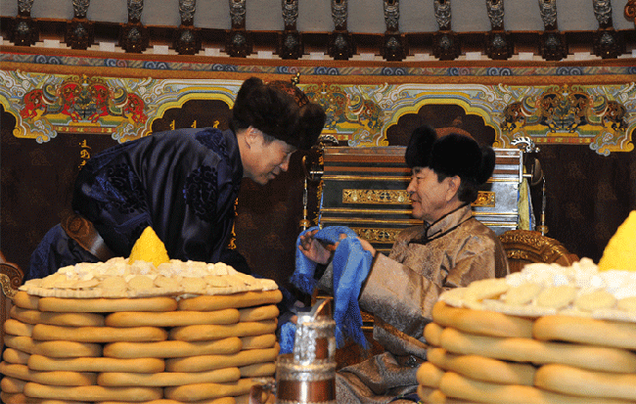
TSAGAN SAR
https://www.toursmongolia.com/tour/lunar-new-year-or-tsagaan-sar-2018

Slide 15
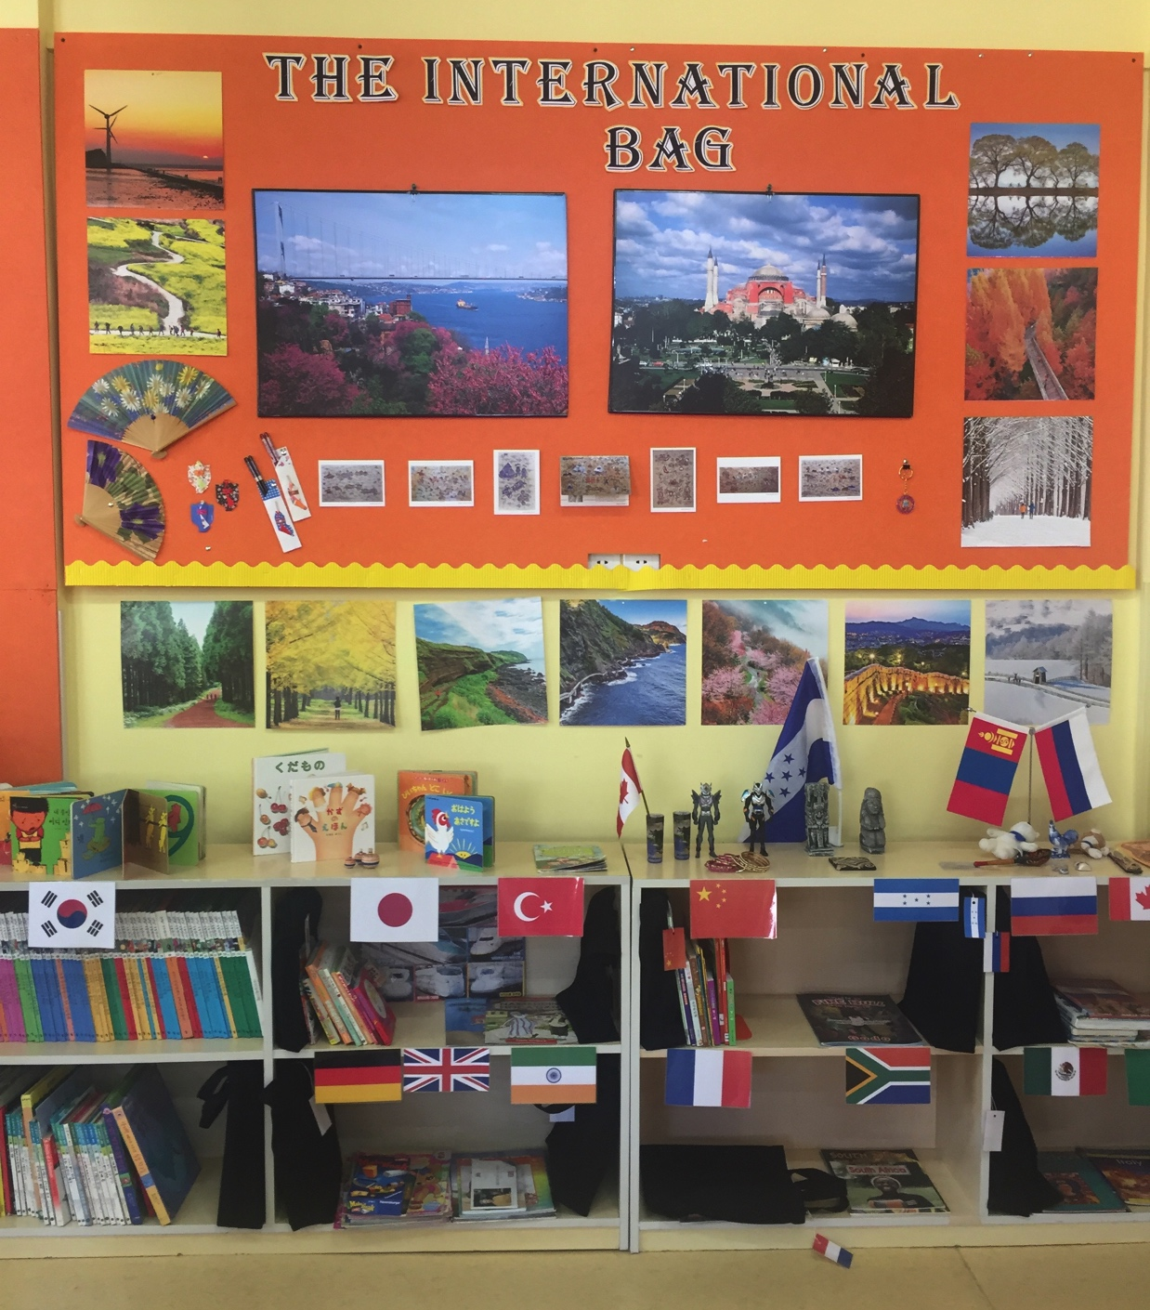
The International Bag
Students will promote their countries by including in a bag books, pictures, posters, post cards, music, souvenirs, toys, games, recipes, or flags.

Slide 17
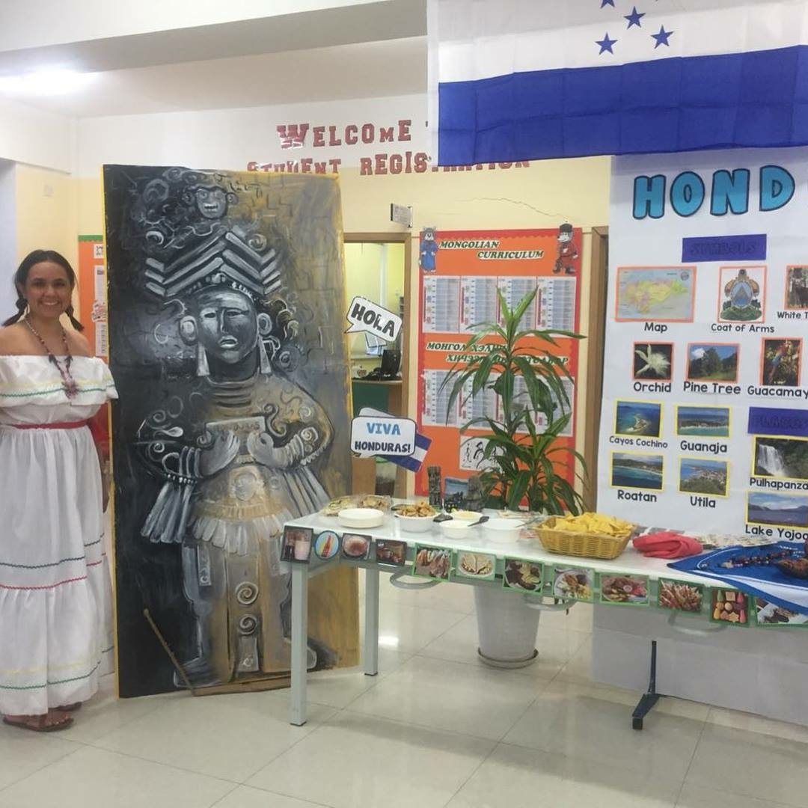
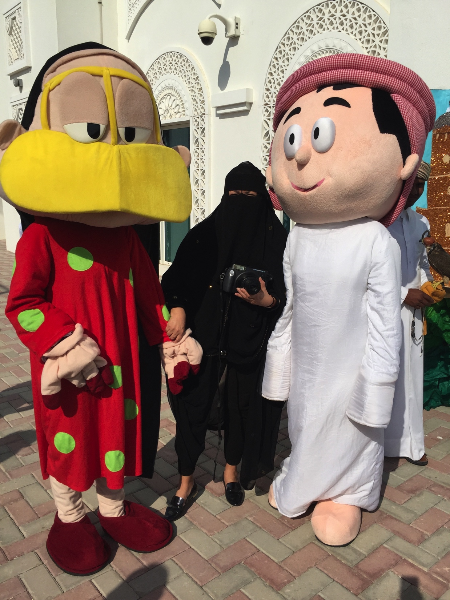
International Day

Slide 18
A World Full of Stories
Write titles of multicultural stories in a small paper. Pick one randomly for storytelling.
“Books should reflect a wide variety of languages and experiences, featuring themes and people of different races, religions, countries, ages, abilities, family structures.”
“10 ways for Promoting Diversity in the Classroom.” https://diversityineducation.com/articles/10-Ways-for-Promoting-
https://www.dreamstime.com/stock-photos-book-globe-image9930193
Notes:
“10 ways for Promoting Diversity in the Classroom.” https://diversityineducation.com/articles/10-Ways-for-Promoting-
https://www.dreamstime.com/stock-photos-book-globe-image9930193

Slide 19
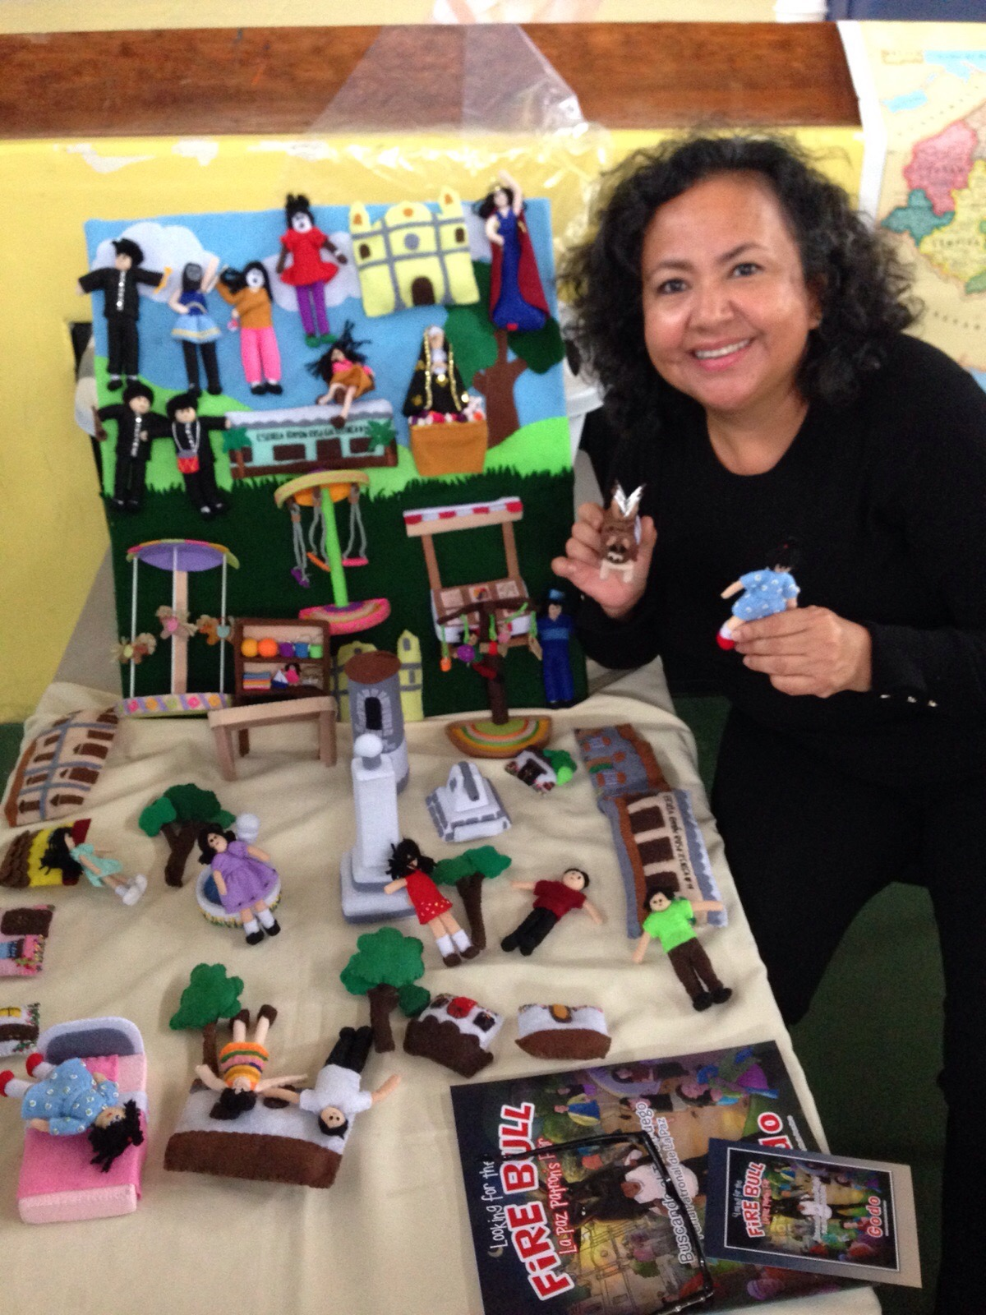

Slide 20
Play Music From Other Cultures
“Music is a universal language. At home or in a childcare center, music, including music from other cultures, should be part of the structure of everyday play. By exposing children to other cultures in a positive way, they gain understanding and learn acceptance of other.”
Multicultural Music in Early Childhood.” Rattigan, Marlene. 2018. http://teaching.monster.com/benefits/articles/4143-multicultural-music-in-early-childhood
Notes:
“Multicultural Music in Early Childhood.” Rattigan, Marlene. 2018. http://teaching.monster.com/benefits/articles/4143-multicultural-music-in-early-childhood

Slide 21
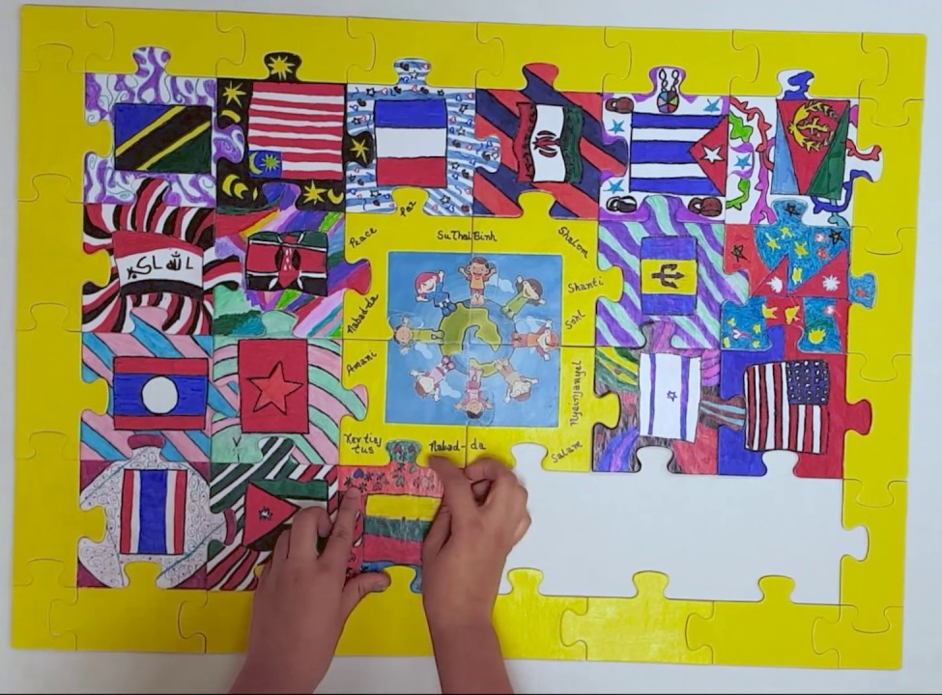
Portraiture
Is a rich opportunity to showcase other cultures across time and space.
Collage with Diverse People
Puzzle:
We All Fit Together
https://www.youtube.com/watch?v=Z-zm9C8lB78

Slide 22
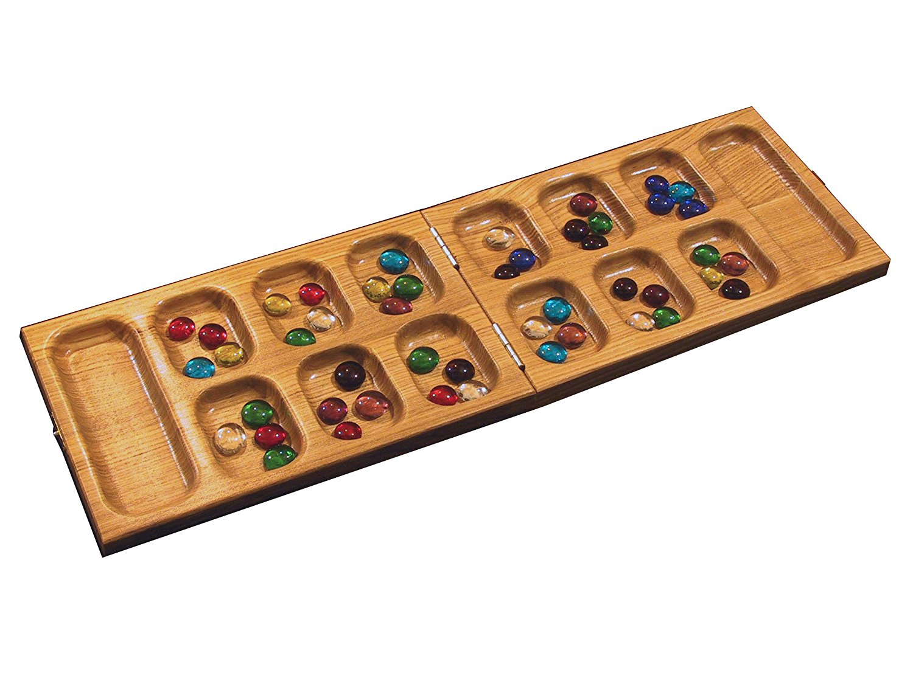
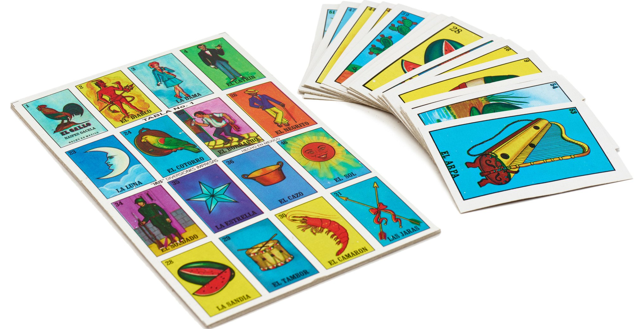
International Game Night
“ Whether poorer rich, cold or hot, big or small, each country has toys and games that all kids (and adults!) love playing.”
“Over 20 Toys and Games from Around the World.” Watt,Anna.Web.8 Dec.
https://multiculturalkidblogs.com/2014/12/08/20-toys-games-from-around-the-world/

Slide 23
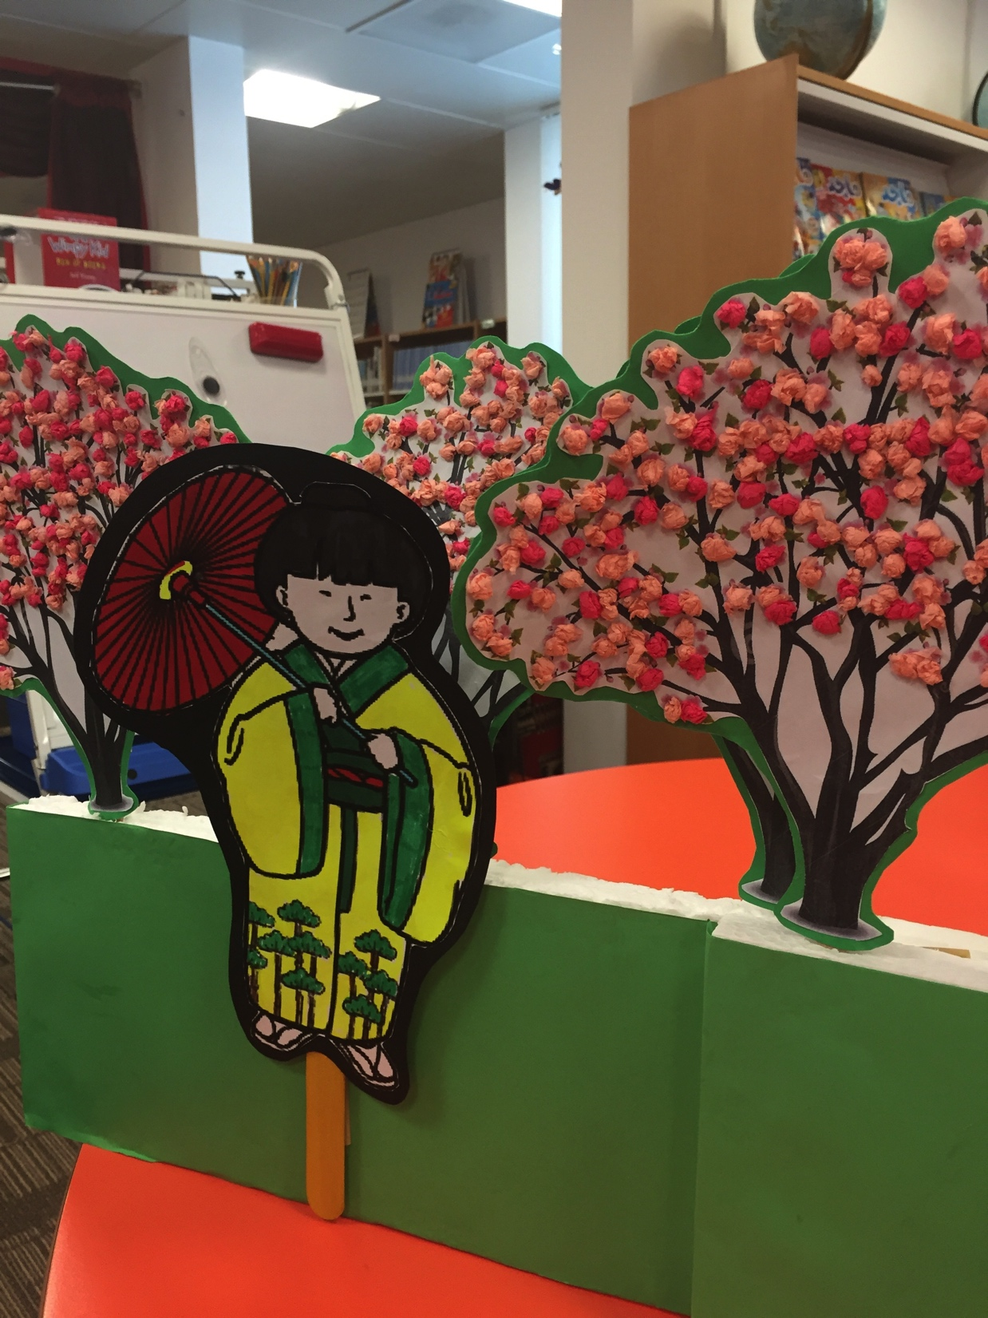
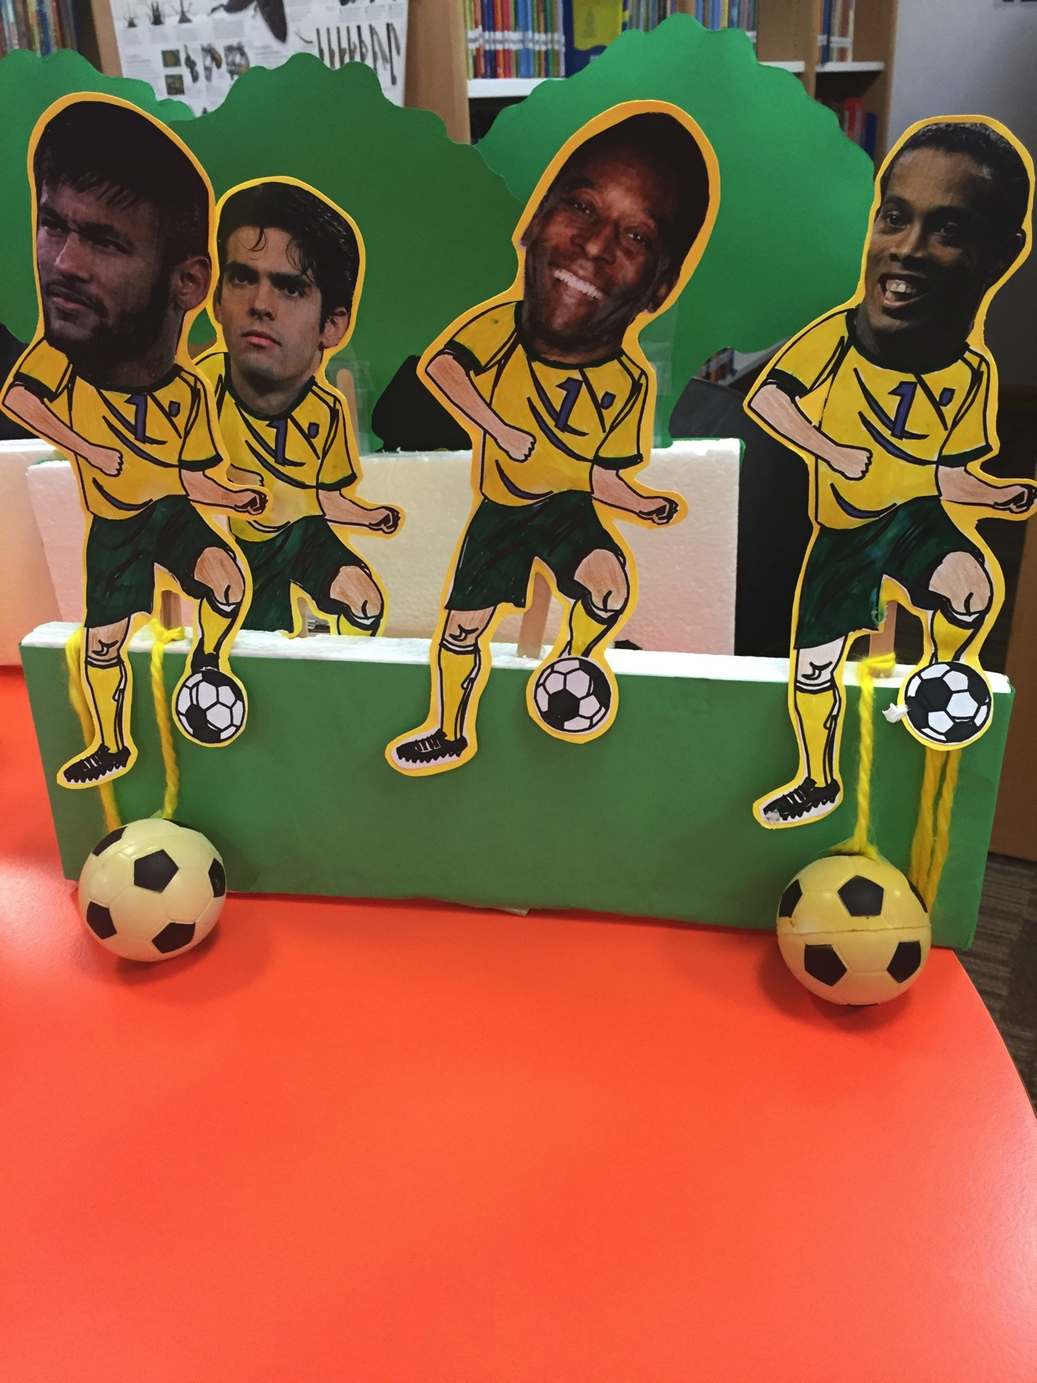
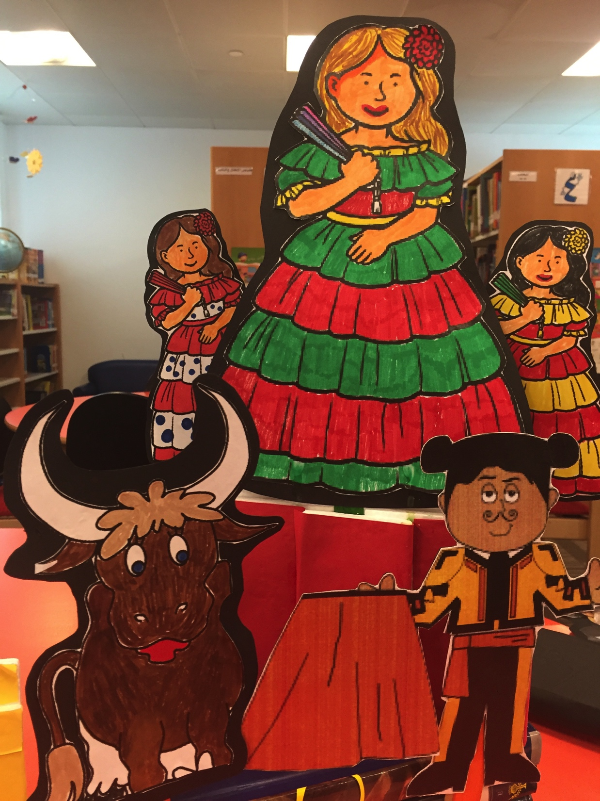
International Puppet Shows

Slide 24
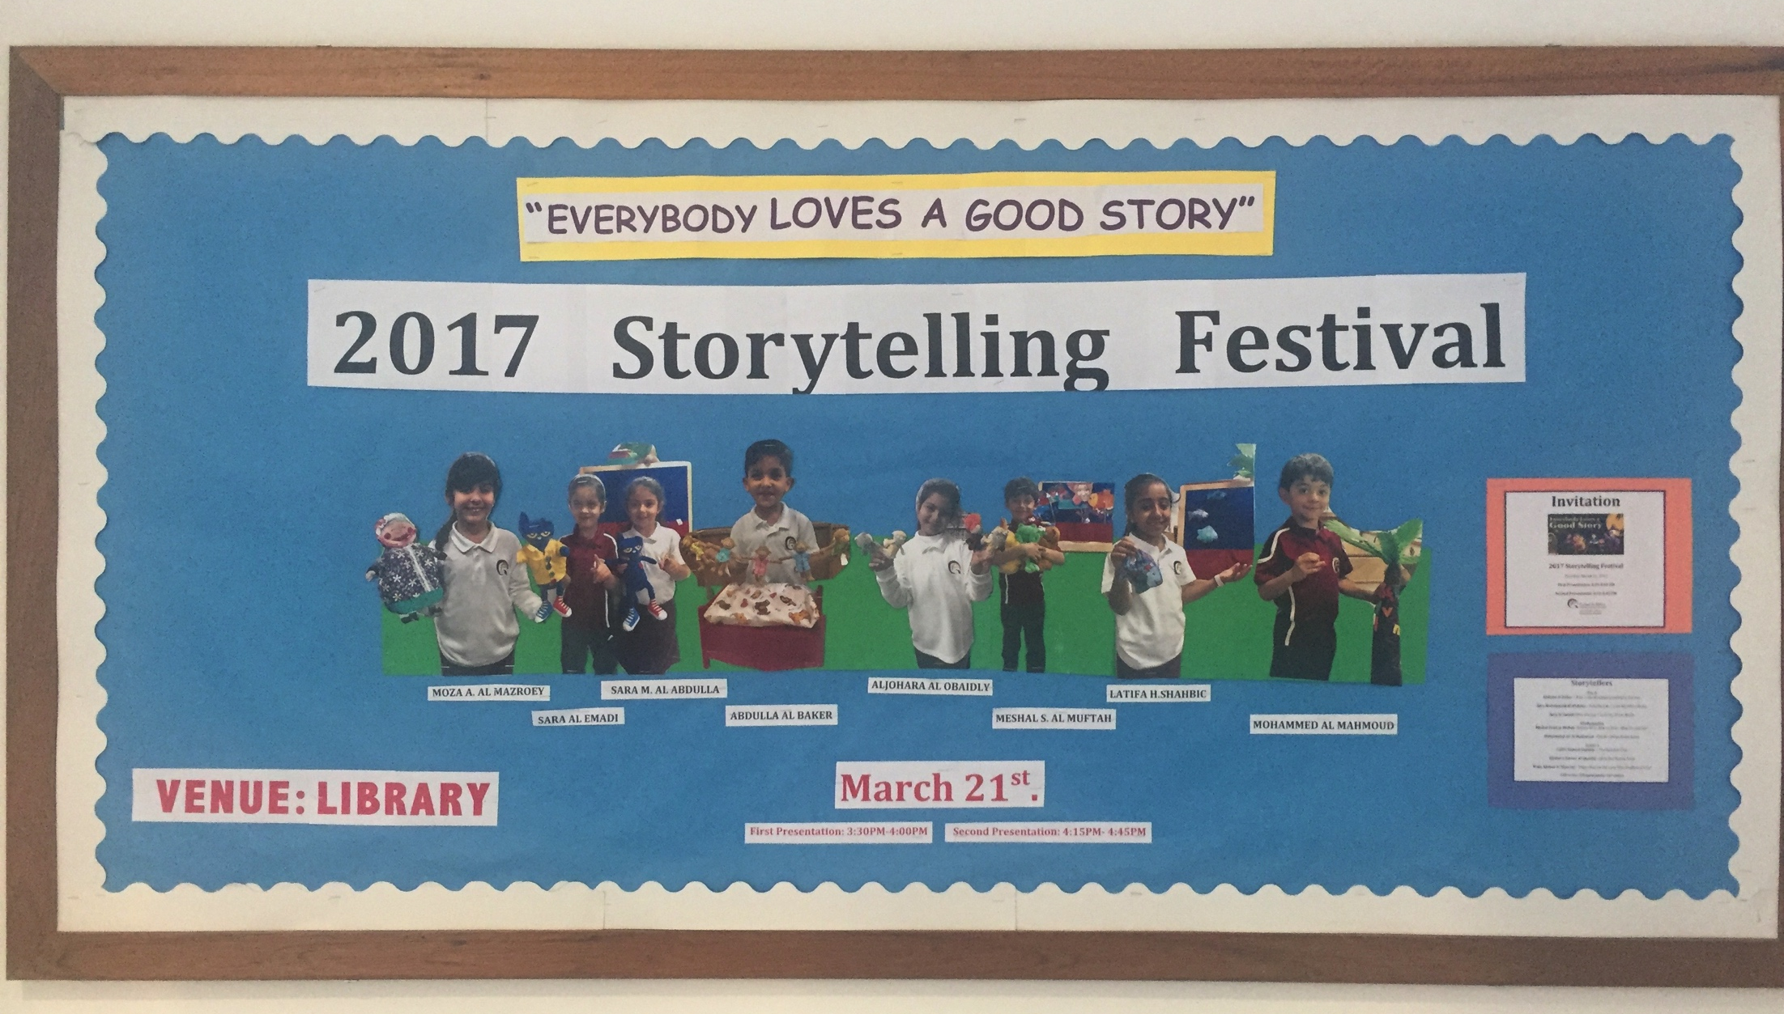
Coffee & Conversation
Monthly meeting with parents and teachers.
“Create occasions for family and community lives to intersect.”
DaSilva. Iddings & Katz, 2007, p. 313

Slide 25
Personality Activities: N.E.W.S.
Shows how you may be from a different country/culture however your personality may be similar.
http://www.nelms.org/pdfs/2014/degroff2014si/The%20Personality%20Compass.pdf

Slide 26
 | MOROCCO (Africa) | QATAR (Middle East) | MONGOLIA (Asia)
LANGUAGE | Moroccan Arabic, Arabic, Berber, French, Spanish | Arabic, English | Mongolian Russian (Adults
RELIGION | Islam: Dress Code Single Sex Schools | Islam: Dress code Single Sex School Islam Class | Freedom of Worship Buddhism Taboos
LITERACY RATE | 72.4 | 97.8 | 98.4
FOREIGN STUDENTS | 25% | 5% | 15
TOPICS OF INTEREST | Soccer, Filmaking, Painting, Music | Falcons, Camels, Sport Cars, Yachts, Weddings, Jewelry, Horses | Opera, Gymnastics, Horses, Yaks, Camels, Eagles, Ballet, Music, Shooting, Judo, Wrestling
BANNED TOPICS | Pigs- Magic, Nudity, Jewish, Witches, Human Body, Relationship, Homosexuality |  | Death
https://en.wikipedia.org/wiki/List_of_countries_by_literacy_rate

Slide 27
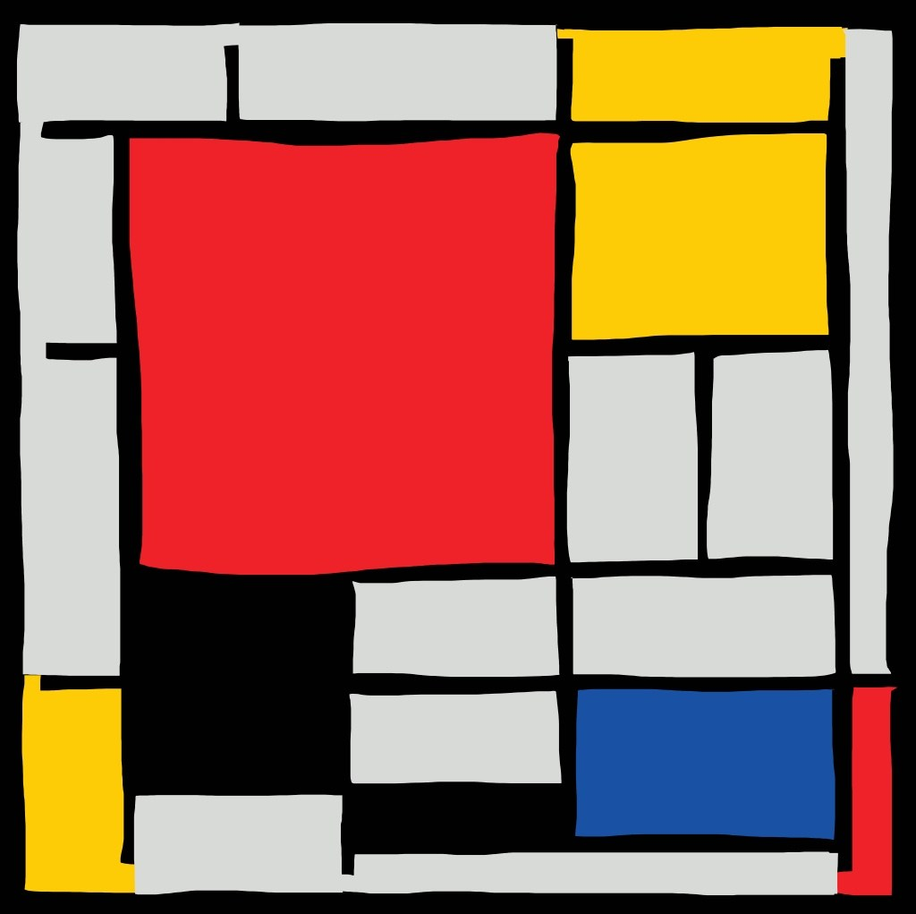
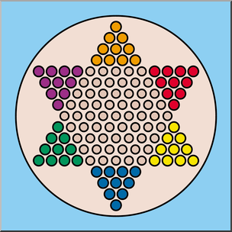
KEYS TO DIVERSITY

Slide 28
CREDITS
(n.d.). Green School Board. www.yopriceville.com https://gallery.yopriceville.com/Free-Clipart-Pictures/School-Clipart/Green_School_Board_PNG_Clipart_Picture#.Wx0ZvFOFP-Z
Diana Mecham (2011).YELLOW PUZZLE. WWW.CLKER.COM http://www.clker.com/clipart-yellow-puzzle-piece-2.html
(n.d.). Gold Key. www.clipartpanda.com . http://www.clipartpanda.com/clipart_images/do-you-need-a-key-clip-art-for-38946619
Piet Mondrian (n.d.). Art Picture. www.erikimphotography.com . http://erickimphotography.com/blog/2017/11/16/15-lessons-piet-mondrian-has-taught-me-about-art-and-photography
Carrie Teaching First (n.d.). Planet Earth Globe. www.clipartbest.com . http://www.clipartbest.com/clipart-y4c9gBMTE
(n.d.). Blue Book Clipart. www.clipartpal.com . http://www.clipartpal.com/clipart_pd/education/bluebook_10292.html
(n.d.). Chinese Checkers. www.abcteach.com . https://www.abcteach.com/documents/clip-art-chinese-checkers-color-i-abcteachcom-19214
Abatalk. (2011). Candy . www.clker.com . http://www.clker.com/clipart-candy-26.html
(n.d.) LGBT Symbol. www.kisspng.com . https://www.kisspng.com/png-lgbt-symbols-transgender-gender-symbol-16-1120267/
Getty Images (n.d.). Kaka. www.telegraph.co.uk . https://www.telegraph.co.uk/sport/football/teams/brazil/6607198/Kaka-Brazil-star-player-at-World-Cup-2010.html
(n.d.). Religious Symbols. www.ancient-symbols.com . https://www.ancient-symbols.com/religious_symbols.html
(n.d.). Japanese Lady . www.education.com . https://www.education.com/download/worksheet/68869/trad-dress-japan.pdf
(n.d.). Pele. www.iffhs.com . https://iffhs.com/dev/legend/edson-arantes-do-nascimento-pele-2/
(n.d.). Ronaldinho. www.beinsports.com . http://www.beinsports.com/us/soccer/news/ronaldinho-retires-the-greatest-brazilians-2/763918
(n.d.). Neymar. www.photofromtheworld.com . http://www.photofromtheworld.com/photo_Neymar.asp
(n.d.). Matador. www.mizuco.info . http://mizuco.info/matador-coloring-page/matador-coloring-page-matador-coloring-page-get-free-printable-matador-coloring-page-to-free
(2011). Spanish Lady. www.education.com . https://www.pinterest.com/pin/240872280041182817/

Slide 29
