Slide 1
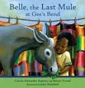
Using Mentor Text to Teach Reading Comprehension, Vocabulary, and Writing
Presented by
Michelle Antonacci, Reading Specialist
Lori Gross, Assistant Principal
Virginia Beach City Public Schools

Slide 2
Belle, the Last Mule at Gee’s Bend A CIVIL RIGHTS STORY By Calvin Alexander Ramsey and Bettye Stroud
Sitting on a bench waiting for his mother, Alex can’t help but notice a mule just across the way eating the greens in someone’s garden. When Miz Pettway sits down beside him, he asks about it. “Ol’ Belle?” she says. “She can have all the collards she wants. She’s earned it.”
So begins the story of Belle, a simple mule in Gee’s Bend, Alabama, and the role she played in the civil rights movement of the 1960’s. Based on real events, this is the story of how African Americans in an impoverished community, inspired by a visit from Dr. Martin Luther King Jr., defied local authorities and registered to vote, many traveling by mule-drawn wagon. Later, after Dr. King’s assassination, two Gee’s Bend mules pulled the farm wagon bearing Dr. King’s casket through the streets of Atlanta.
As he looks into the eyes of gentle Belle, one young boy begins to understand history in a new, very personal way. Readers will too.

Slide 3
On April 19, 1968, Belle and Ada pulled the humble funeral wagon of Dr. Martin Luther King, Jr. on a long, slow trek from Ebenezer Baptist Church to Morehouse College. It is estimated that 50,000 people marched in quiet procession behind the wagon. Belle and Ada had completed their part in the history of this great man.

Slide 4
ELA Standards & Objectives Taught Using this Mentor Text
ELA.5.5.6 Draw conclusions and make inferences from text, including inferences about character and theme
ELA.5.5.8 Explain the author’s purpose.
ELA.5.5.8a Describe how an author’s choice of vocabulary contributes to the author’s style
ELA.5.5.9 Identify cause and effect relationships
ELA.5.5.10 Describe character development
ELA.5.5.12 Identify main idea or theme
*See handouts for lesson activities/examples
ELA.5.5.11 Describe the development of plot and explain the resolution of conflict(s)
ELA.5.5.4 Identify and ask questions to clarify various points of view
ELA.5.5.5 Summarize during and after reading and include supporting details

Slide 5
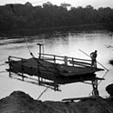
Vocabulary Words Taught Using this Mentor Text & the Robust Vocabulary Instruction Model
Teachers may choose from the following:
pesky
loyal
grieved
shuffle
honor
hauling
shameful
refused
escorted
*See handout of vocabulary lesson

Slide 6
Bringing Words to Life Robust Vocabulary Instruction by Beck, McKeown, & Kucan

Slide 7
Writing Standards/Objectives Taught Using this Mentor Text
ELA.5.7 TSW write for a variety of purposes: to describe, to inform, to entertain, to explain and to persuade (SOL 5.7)
ELA.5.7.1 Produce clear and coherent writing in which the development and organization are appropriate to task, purpose, and audience.
ELA.5.7.1a Identify intended audience.
ELA.5.7.1b Use a variety of prewriting strategies.
ELA.5.7.1c Organize information to convey a central idea.
ELA.5.7.1d Write a clear topic sentence focusing on the main idea.
ELA.5.7.1e Write multi-paragraph compositions.
ELA.5.7.1f Include supporting details that elaborate the main idea.
ELA.5.8 TSW edit writing for correct grammar, capitalization, spelling, punctuation, sentence structure, and paragraphing (SOL 5.8)
ELA.5.9.2 Draw on information from multiple print or digital sources, demonstrating the ability to locate an answer to a question or to solve a problem efficiently. (CCSS.ELA-Literacy.RI.5.5)

Slide 8
Narrative Writing – SWBST Format
Prompt Analysis
Read your prompt at least 2 times
Highlight the important words that help you to understand what you are asked to write about
Make notes around your prompt to demonstrate your understanding
Complete your TAPF
After listening to and discussing the story Belle, the Last Mule at Gee’s Bend and studying the photograph you are given, reflect upon what it would be like to live during this historical time period and experience, first-hand, the events taking place.
After this reflection, write a first-person point of view narrative using the “Somebody… Wanted…, But…., So….Then…” format, so your reader understands what it was like to live during that time.
*See handout of writing prompt, TAPF (analysis), graphic organizer, and historical photographs

Slide 9
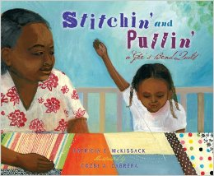
Related Titles
Stitchin' and Pullin': A Gee's Bend Quilt by Patricia McKissack
MOTHER AND DAUGHTER, grandmother and granddaughter, aunt and niece, friend and friend. For a hundred years, generations of women from Gee’s Bend have quilted together, sharing stories, trading recipes, singing hymns—all the while stitchin’ and pullin’ thread through cloth. Every day Baby Girl listens, watches, and waits, until she’s called to sit at the quilting frame. Piece by piece, she puzzles her quilt together— telling not just her story, but the story of her family, the story of Gee’s Bend, and the story of her ancestors’ struggle for freedom.

Slide 10
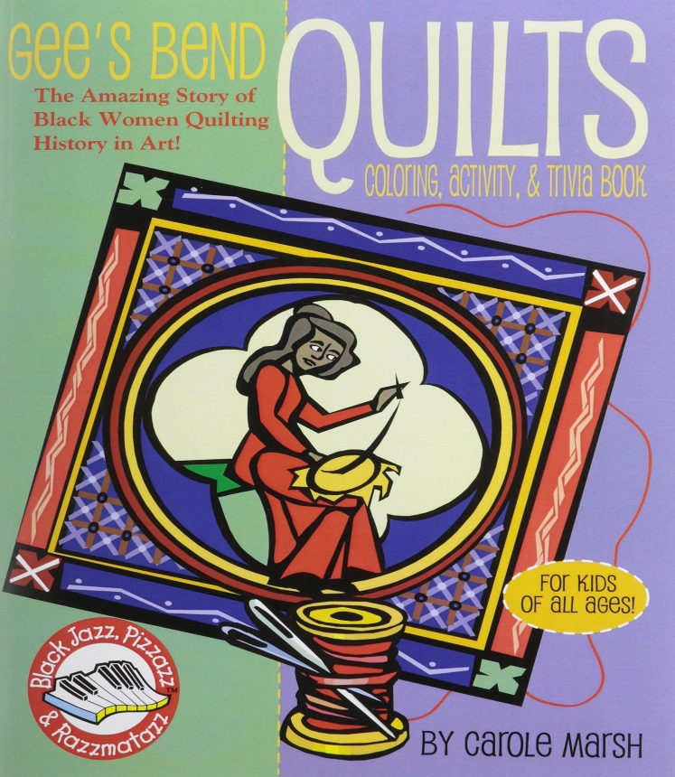
Related Titles
Gee's Bend Quilts by Carole Marsh
The Gee's Bend Quilts Coloring, Activity and Trivia book includes the history of the amazing story of generations of the Quilts of Gee's Bend. This book includes art and activities that are reproducible.

Slide 11
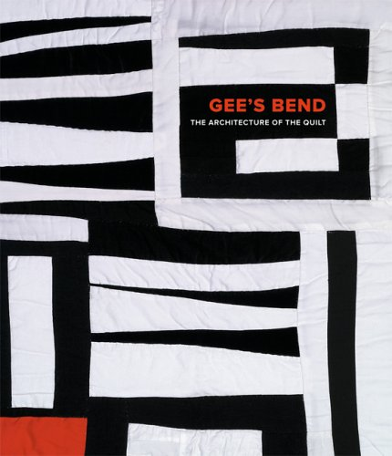
Related Titles
Gee’s Bend: The Architecture of the Quilt by Paul Arnett
In 2002, Gee’s Bend burst into international prominence through the success of Tinwood’s Quilts of Gee’s Bend exhibition and book, which revealed an important and previously invisible art tradition from the African American South. Critics and popular audiences alike marveled at these quilts that combined the best of contemporary design with a deeply rooted ethnic heritage and compelling human stories about the women.
Notes:
‘s

