Slide 1

Rainwater Harvesting Systems Metagenomics
Jade Riddle and Julia Parsons
Dr. Beach
Department of Biological and Integrated Environmental Sciences

Slide 2
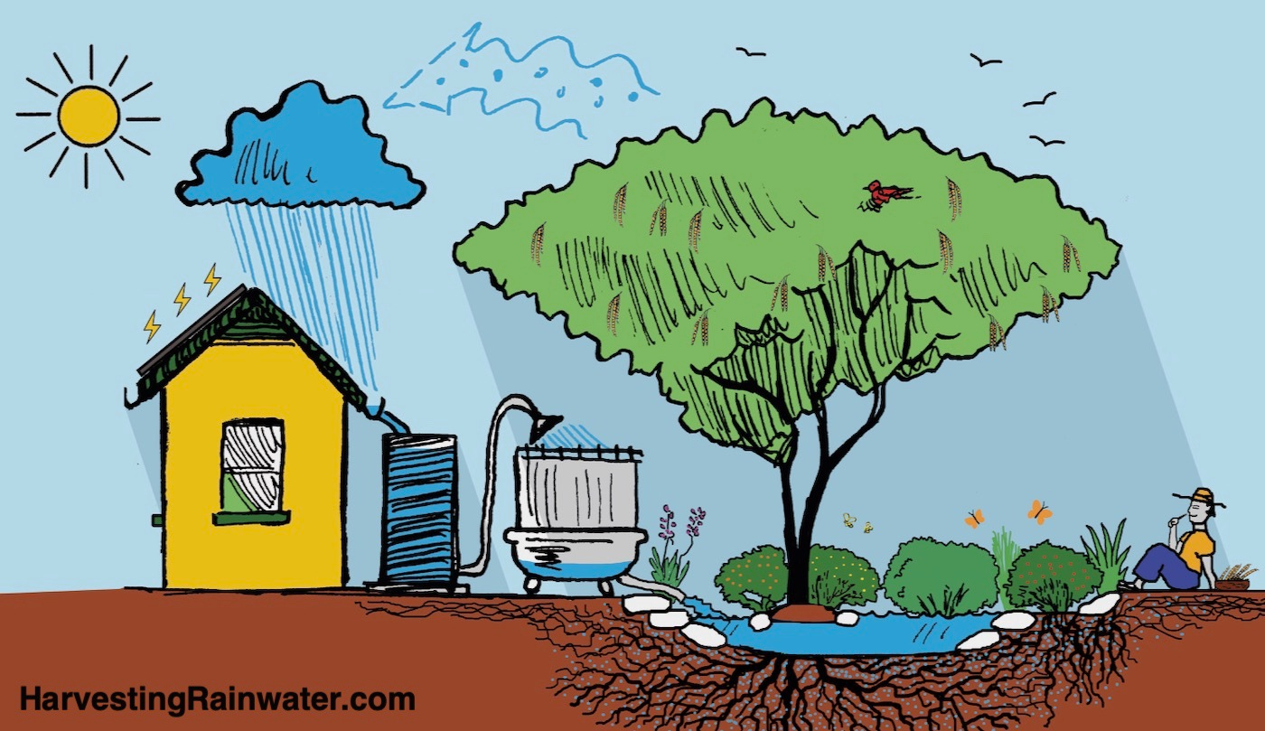
Introduction
Interest in alternative water sources
Rainwater as potential solution
Requires large, open barrels of water
Exposure to environmental bacteria
https://www.harvestingrainwater.com/
Notes:
Julia

Slide 3
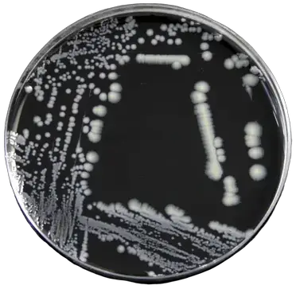
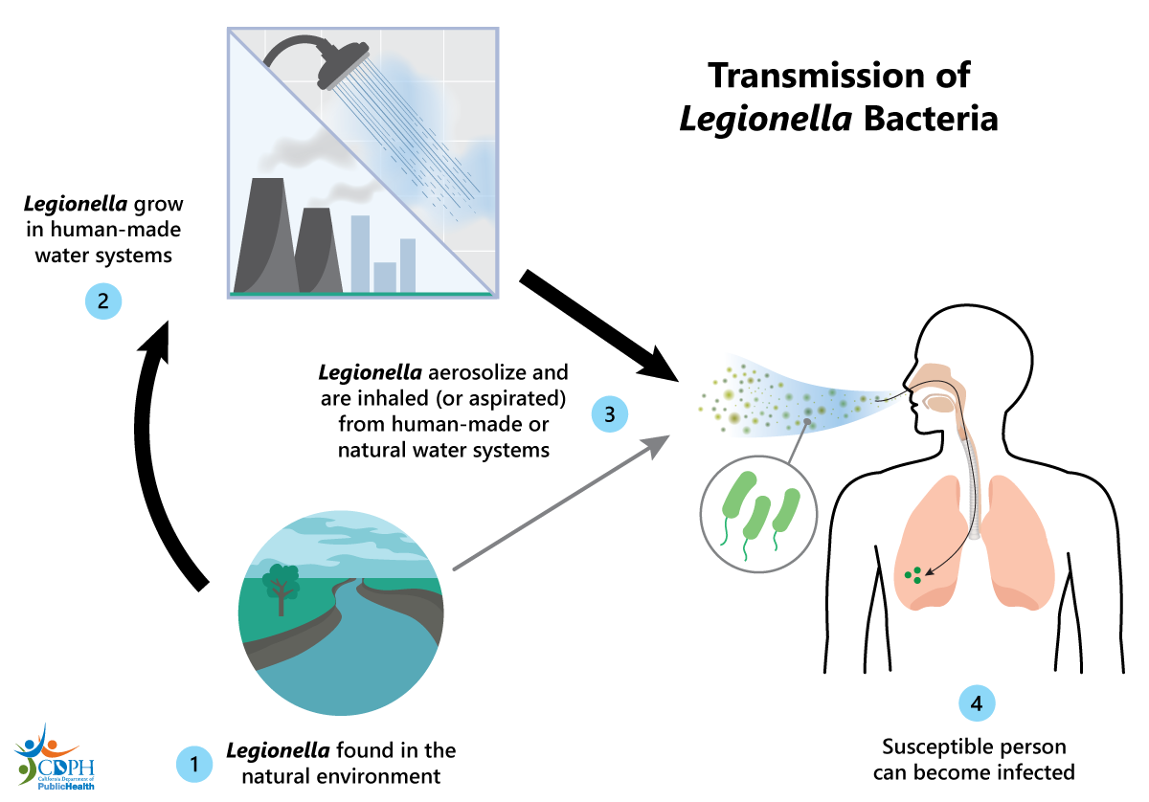
Previous Work
https://microbeonline.com/legionella-pneumophila-properties-pathogenesis-lab-diagnosis/
Quantification of Legionella pneumophila
  Aquatic pathogen
  Cause of Legionnaires’ disease
Legiolert, qPCR, and culture methods
(Dr. Gee)
https://www.cdph.ca.gov/Programs/CID/DCDC/Pages/Legionellosis%28Legionella%29.aspx
Notes:
Julia

Slide 4
Micro-environment
Haven for bacterial growth
Little research done in continental US
Opportunity to study environmental systems rich in biological diversity
Research Questions:
  What is the bacterial diversity in water harvesting systems?
  What are some of the bacteria present?
  Can we find uncharacterized bacteria?
Notes:
Jade

Slide 5
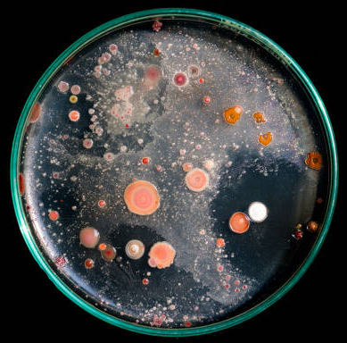
Biological Variation
Cultures show a variety of organisms
Incomplete picture from previous methods
  Culturing doesn’t show everything
  Directed PCR only identifies known organisms
  Geographic diversity
https://www.istockphoto.com/photos/bacteria-culture-plate
Notes:
[Jade]

Slide 6
PRISM Approach

Slide 7
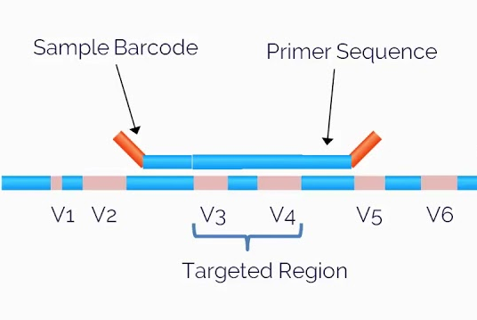
Metagenomics
Genetic screening of environmental DNA
Population-based analysis
Using the 16S rRNA gene
  Conserved regions flank variable regions
  PCR amplification
Use Next-Gen sequencing
Overview of bacterial diversity
16s rRNA gene
https://www.youtube.com/watch?app=desktop&v=_IpZOqFP9iY
Notes:
[Jade]

Slide 8
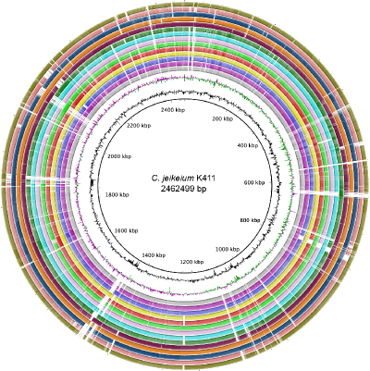
Whole Genome Sequencing
Sequence whole genome of an individual organism
Provides information on species
Specific genes
  Antibiotic resistance
  Virulence factors
  Novel biochemical pathways
https://depts.washington.edu/molmicdx/mdx/tests/NGSTYP.shtml
Notes:
[Julia]

Slide 9
Methodology
Water Collection & Filtration
Genomic DNA Isolation
Nanopore Sequencing
Sequence Analysis
1
2
3
4
Notes:
[Julia]

Slide 10
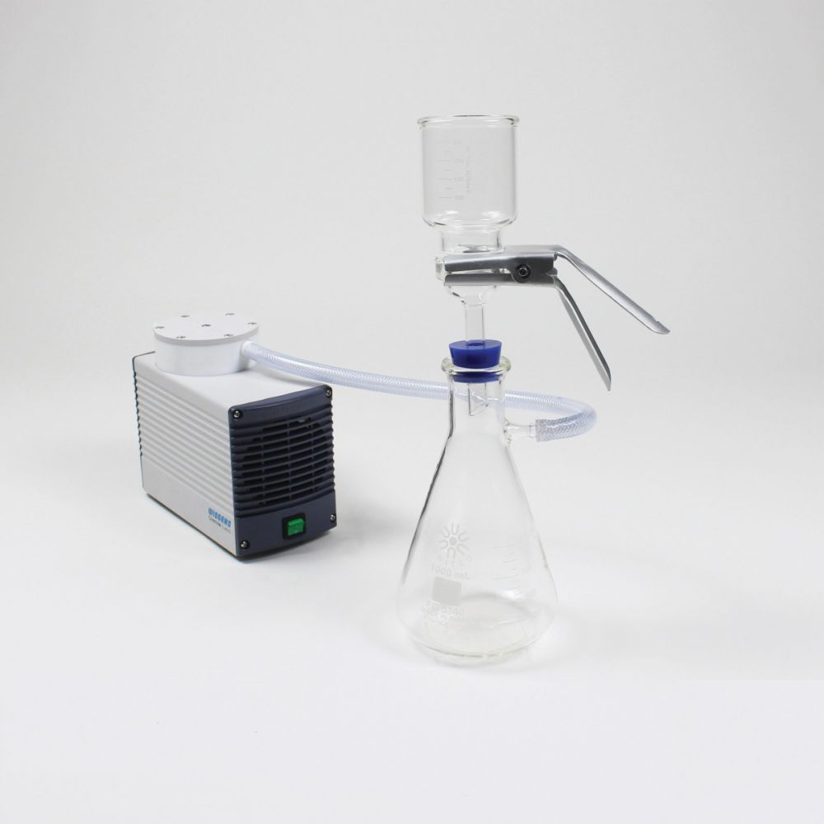
Water Collection and Filtration
https://www.southernlabware.com/media/catalog/product/cache/d31df7fa3080bff44e13fcb361438faf/f/h/fhft47-c_1.jpg
Notes:
[Julia]

Slide 11
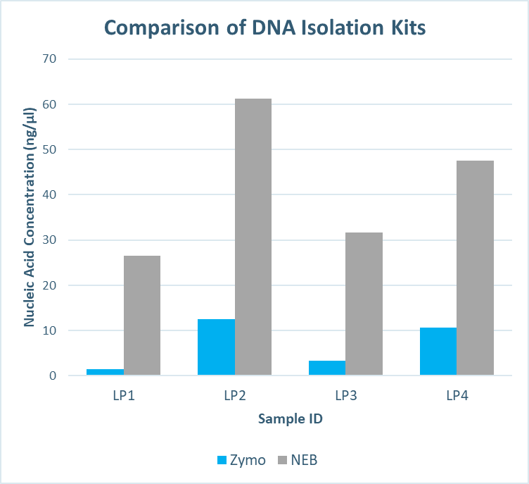
Genomic DNA Isolation
Legionella cell pellets
Split evenly between two kits
Followed manufacturer’s protocols
Measured and compared the yield of DNA product produced
Notes:
Julia?

Slide 12
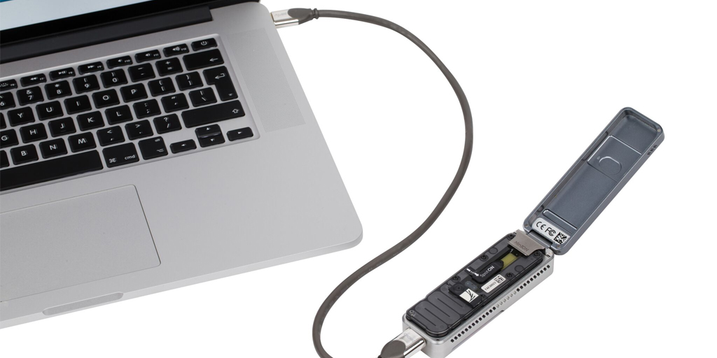
Nanopore Method
126 pores
99% accuracy
Run for 16 hours
Can collect 2.6 Gb of data in one experiment
https://directorsblog.nih.gov/2018/02/06/sequencing-human-genome-with-pocket-sized-nanopore-device/
Notes:
Jade

Slide 13
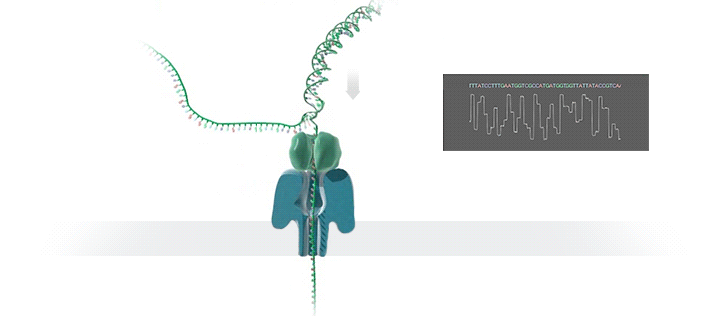
Nanopore Sequencing
https://www.labiotech.eu/trends-news/oxford-nanopore-whole-genome-sequencing/
Notes:
Jade
Biological pore -> real protein modified from E. coli

Slide 14
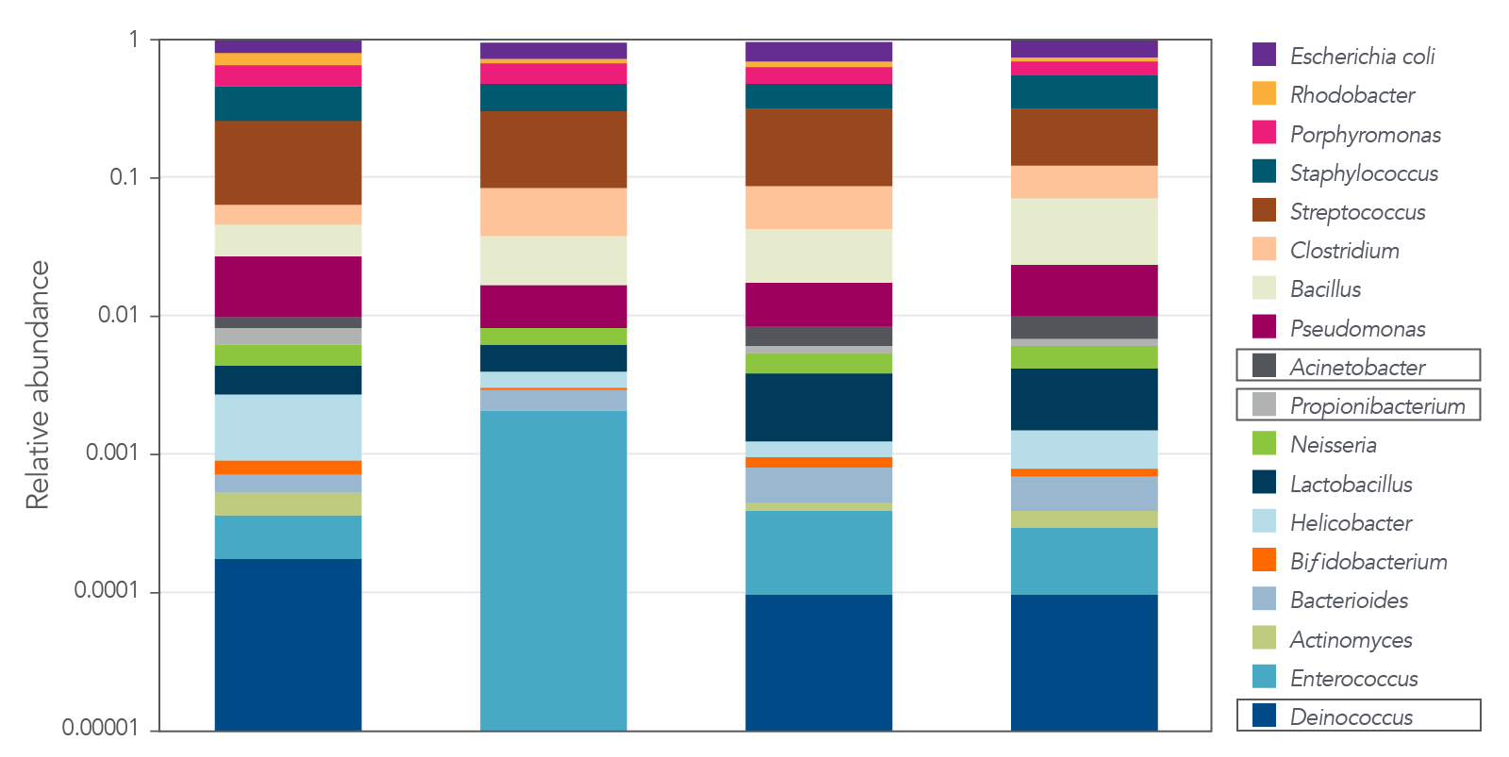
Sequence Analysis - Expected Results
A
B
C
D
https://www.idtdna.com/pages/products/next-generation-sequencing/workflow/xgen-ngs-amplicon-sequencing/predesigned-amplicon-panels/metagenomics-amp-panels
Notes:
Julia?

Slide 15

Conclusions
Future
Special Thanks
Metagenomics
Describe biological variation in RWHS
Identify human pathogens
Characterize geographic distribution
Whole Genome
Characterize new organisms
Find virulence factors
Identify antibiotic resistance
Discover novel biochemical pathways
Notes:
Jade

Slide 16
QUESTIONS?
https://www.harvestingrainwater.com/

Slide 17
References
Flongle - Oxford Nanopore Technologies. Oxford Nanopore Technologies. https://nanoporetech.com/products/sequence/flongle.
Garner E, Davis BC, Milligan E, Blair MF, Keenum I et al. 2021. Next generation sequencing approaches to evaluate water and wastewater quality. Water Research. 194(116907).
Hamilton KA, Reyneke B, Waso M, Clements T, Ndlovu T et al. 2019. A global review of the microbiological quality and potential health risks associated with roof-harvested rainwater tanks. Npj Clean Water. 2(1).
Quon H, Jiang S. 2023. Decision making for implementing non-traditional water sources: a review of challenges and potential solutions. npj Clean Water. 6(56).

