Slide 1
Animal Frequency in the Presence & Absence of Human Disturbance
Jade Riddle, Angel Stanley, Teresa Orellana

Slide 2
Introduction
Changes within animal behavior from disturbance (Gill et al. 1996).
Animals avoid high human disturbance areas (Lewis et al. 2021).
Known difficulty determining the correlation (Tablado and Jenni 2015).
The question:
Is there a correlation between animal frequency and human disturbance?
The hypothesis:
Higher animal frequency in the absence of human disturbance.

Slide 3
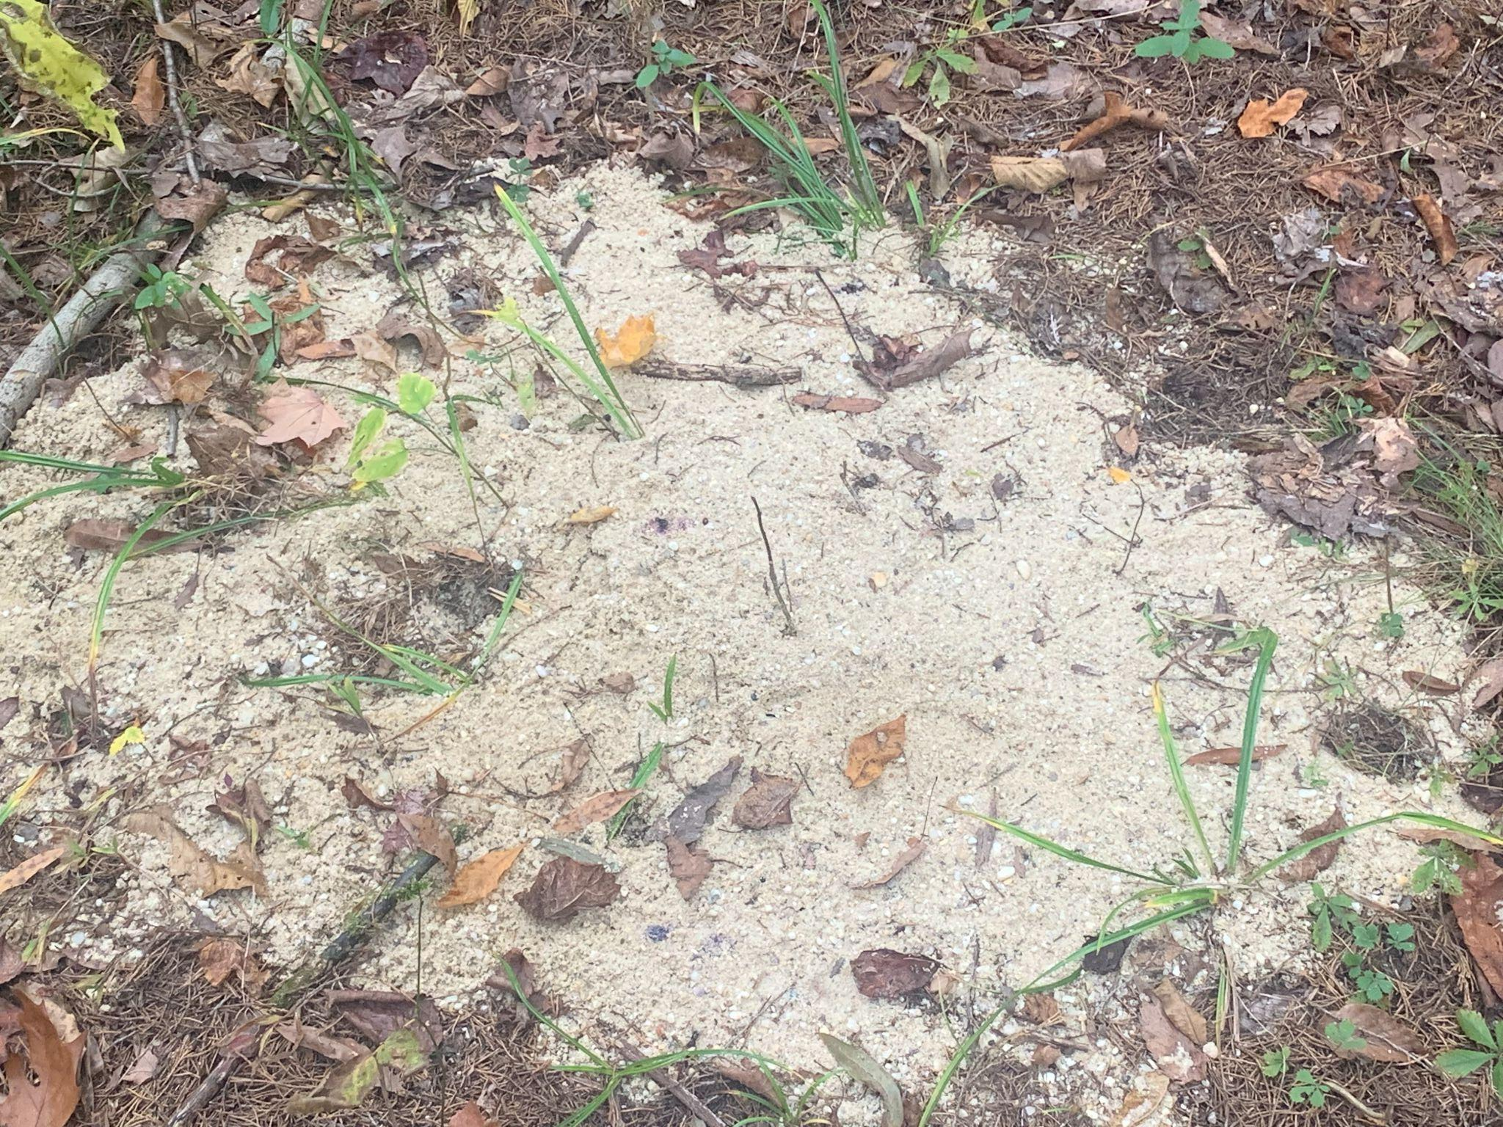
Methods
Hawkray digital trail cameras were used.
Sand traps were also used to collect data.
Tracks prints
These were checked often:
Monday, Wednesday, Friday
Site 1: 14 nights
Site 2: 14 nights
Site 3: 6 nights

Slide 4
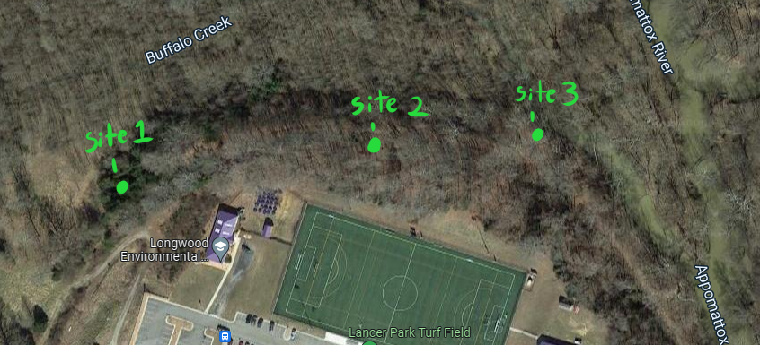
Methods Continued: Site Locations

Slide 5
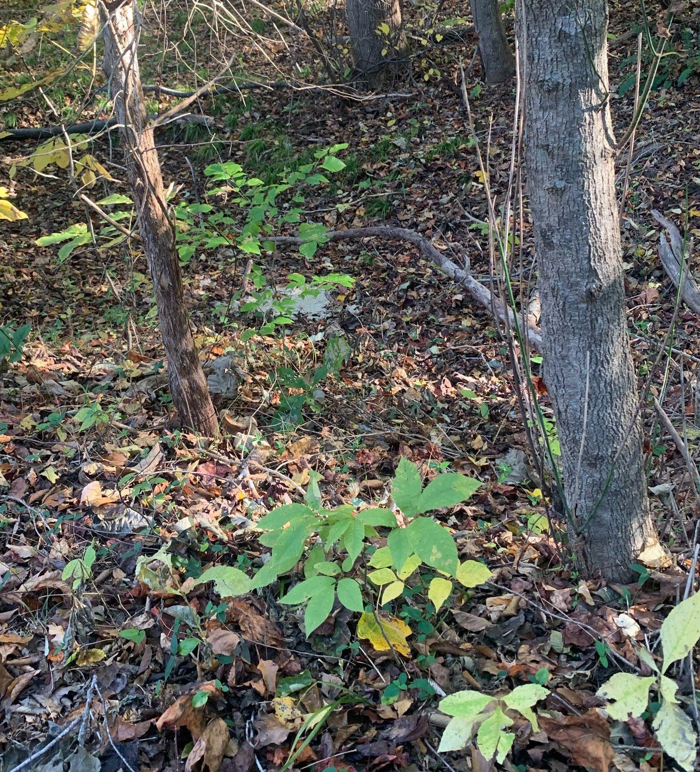
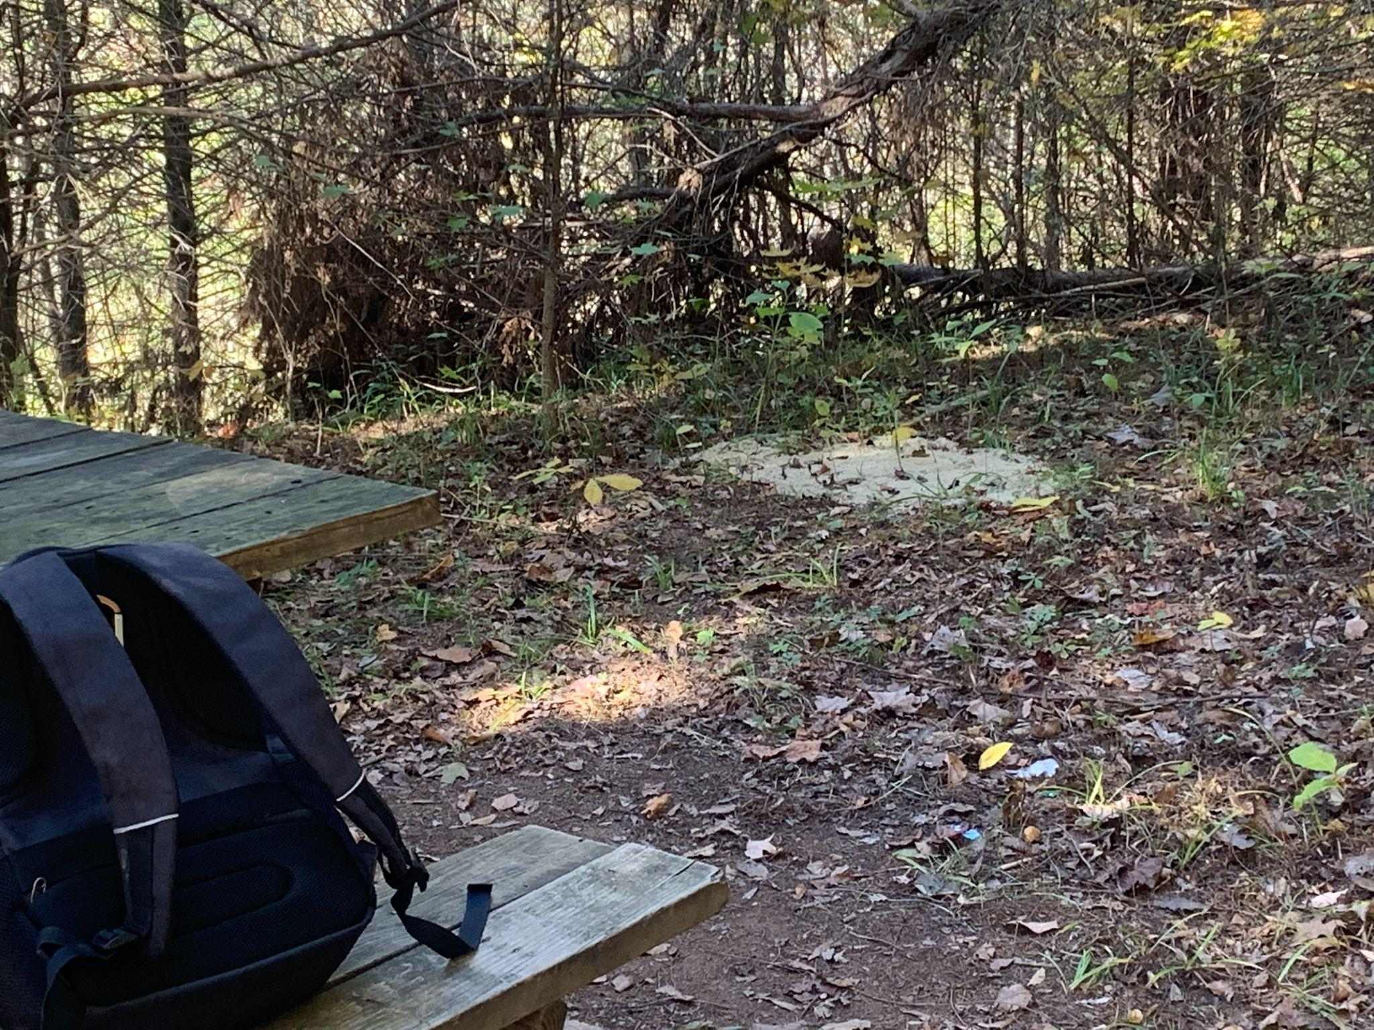
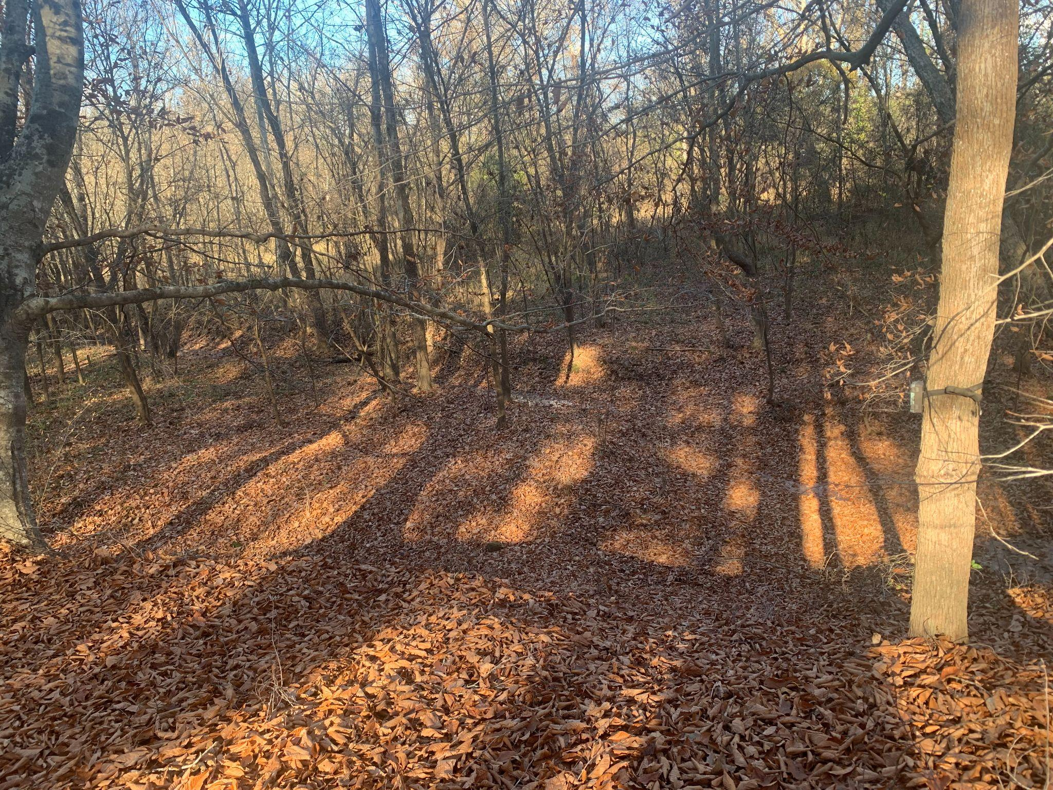
Methods Continued: Sites
Site 1
Site 3
Site 2

Slide 6
Best Shots
(Disclaimer: no human photos included for ethical reasons).

Slide 7
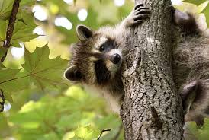
Species Richness at Each Site
Site 1 | Site 2 | Site 3

Slide 8
Frequency Differences (Cameras vs. Sand Traps)

Slide 9
ANOVA table for animal frequency on each night at each site

Slide 10
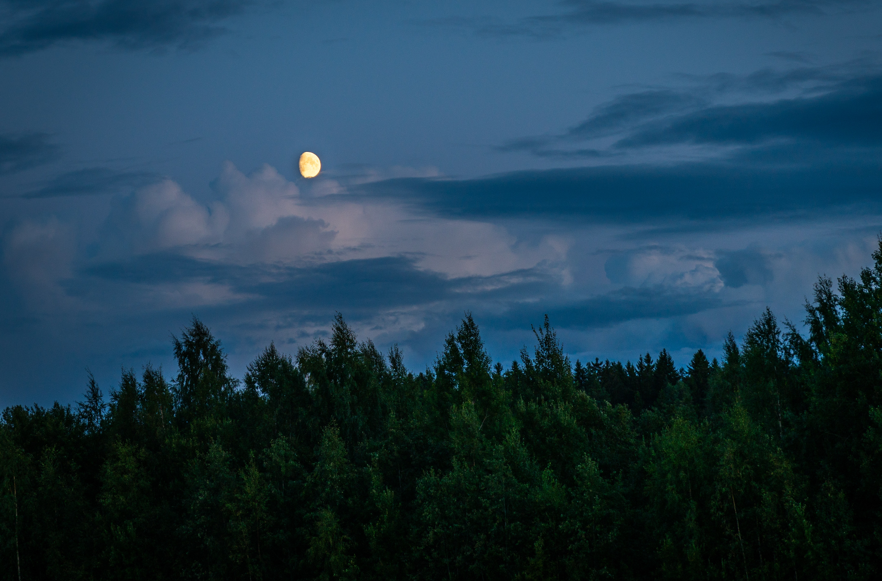
Animal Frequency Day vs. Night
There is no animal frequency during the day
Could be because of high human disturbance during the day?

Slide 11
Overall Frequencies at Each Site

Slide 12
Correlation Results

Slide 13
Conclusions
Conflicting results
According to cameras, there is no correlation
Sand trap data does show a correlation
From limited data
ANOVA returned a significant p-value
May be attributed to lack of data at Site 3
Hypothesis rejected
Differences in species among sites
Potential unexpected positive effects of human disturbance
Results do not align with previous studies (Lewis et al. 2021).

Slide 14
Discussion: Limitations
Potential issues with Site Two’s camera.
Human disturbance not adequately captured in sand traps
Entire study area experienced some disturbance.
Proximity to parking lot and residential building.
Results may be misleading:
Limited area of study
Short study period
Small amount of data
Late addition of Site Three

Slide 15
Discussion: Future Research
More diversity in study areas
Different ecosystems
Different levels of urbanization
Investigate effects of different kinds of human disturbance
Noise pollution
Foot traffic
Littering
Study different effects on animal behavior
Variance among species

Slide 16
Works Cited:
Gill J. A., Sutherland W. J., Watkinson A. R. 1996. A method to quantify the effects of human disturbance on animal populations. J Appl Ecol, 33: 786. https://doi.org/10.2307/2404948.
Lewis J. S., Spaulding S., Swanson H., Keeley W., Gramza A. R., VandeWoude S., Crooks K. R. 2021. Human activity influences wildlife populations and activity patterns: implications for spatial and temporal refuges. Ecosphere, 12(5):e03487. https://doi.org/10.1002/ecs2.3487.
Tablado Z., Jenni L. 2015 Oct 14. Determinants of uncertainty in wildlife responses to human disturbance. Biol Rev, 92: 216-233. https://doi.org/10.1111/brv.12224.

