Slide 1
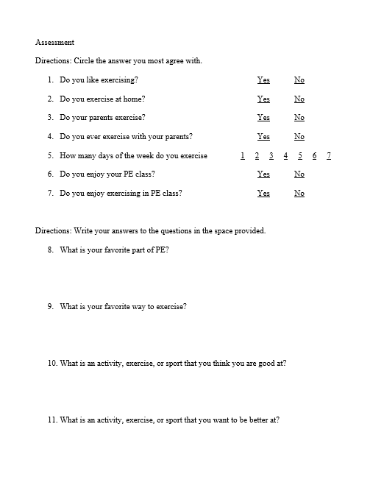
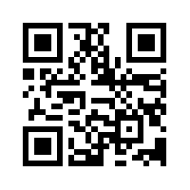
Movement Motivation
Nicolette Harris
Longwood University
Abstract
Materials and Procedure
Results
This focus of this project was to assess a group of students at an elementary school. After observing the students, a lack of motivation and risk for obesity were discovered. An assessment tool of a survey was created to measure the students’ opinions and motivation towards physical activity during and outside of PE class. This project demonstrates how a teacher can increase student motivation and reduce the risk of childhood and adult obesity by allowing the students the opportunity to be active in a multitude of ways and finding a way that the students enjoy being active outside of school.
Program Plan: This program will begin with a survey that will measure the students attitudes and habits of physical activity both in and out of the PE class. Then the teacher will give the students a pre-test in the form of a survey that will measure their preferred and favorite activities that allow them to be physically active. The students will then participate in a 20-day program. The first five days of the program the teacher will teach 5 different activities to the students, focusing on one activity a day. Then the next five days will consist of stations where the students have the opportunity to engage with these activities for a longer period of time. The students will complete a different activity each day until they have completed all of the activities. The students will fill out a form that allows them to rank the activities and if they would be likely to complete a similar activity outside of school either on their own or with friends and family. The next ten days will repeat the same cycle but with five different activities. The teacher has written and planned for assessments of objectives for each activity, that of which are based on SHAPE America National standards and the Virginia Standards of Learning. At the end of the 20 days, the students will complete a post-test which is the same survey they completed for the pre-test.
Resource list: Soccer balls, basketballs, volleyballs, jump ropes, balance beams, floor tape, yoga mats, mats, floor and wall targets, bean bags, space in the gym/outside, whiteboard, and wall posters
Data Collection: Data will be collected in various forms. There is the initial survey that measures the attitudes and habits of physical activity of the students both in and out of the PE class as well as pre and post tests that are completed in the form of a survey that measure the students preferences of physical activity. A third survey will allow the students to rank the completed activities and the likelihood of completing similar activities on their own time. Throughout the program data will be collected that allows the teacher to see if the students are meeting the set objectives for each activity. This is done in the form of formative and summative assessments. Examples of these assessments are teacher observation, checklists, exit tickets, and student performance.
Data Analysis: The survey questions will be organized and categorized into similar concepts. The necessary responses will be coded in order to analyze the data efficiently. Then the data will be logged into frequency tables to understand the overall results. The main variables that will be observed will be the attitudes students have about PE class, their attitudes about exercising on their own, if they have a favorite way to exercise, and how often they exercise. These questions will be analyzed together to see if there can be any correlation found between their interests in exercising, their attitudes about exercising, and if they actually exercise. This will be done for all three surveys that are administered. The other forms of data being measured by the teacher assessments are for the teacher to determine what students might need more assistance and further instruction or development for certain activities.
The anticipated results of this program would be an increase in student motivation and enjoyment of their PE class and physical exercise. There will also be an increase in the likelihood of the students’ physical activity levels outside of PE class as well. While some students still might not enjoy physical activity in general. It is hoped that through this experience they will be able to find at least one activity, sport, or exercise that they enjoy and will pursue in the future to remain active.
The survey questions will be organized and categorized into similar concepts. The necessary responses will be coded in order to analyze the data efficiently. Then the data will be logged into frequency tables to understand the overall results. The main variables that will be observed will be the attitudes students have about PE class, their attitudes about exercising on their own, if they have a favorite way to exercise, and how often they exercise. These questions will be analyzed together to see if there can be any correlation found between their interests in exercising, their attitudes about exercising, and if they actually exercise. This will be done for all three surveys that are administered.
Background
Students at the elementary school were observed to be unmotivated to participate in the PE class. Several students were observed to be overweight. In the third-grade students are at the industry v. inferiority stage of Erikson’s psychosocial development. At this stage the students begin to either develop self-confidence and a sense of accomplishment, or they begin to feel inferior and like they cannot be successful (Snowman & McCown, 2015). The physical characteristics of 3rd graders are that they are extremely active and need various opportunities to expel some energy and they tend to be very extreme in their physical activity which can be dangerous (Snowman & McCown, 2015). A main cause of obesity is children being inactive, educators need to teach them that there are multiple ways to be active and the importance of being active (U.S. Department of Health and Human Services, 2010). . The Annie E. Casey Foundation (2020) found that 23% of the female children and 32% of the male children in Virginia were obese in 2016-2017.
Rationale/Purpose
The main purpose of this program is to reduce the risk of childhood obesity by increasing the enjoyment of physical activity among the population of third graders. In addition to increasing physical activity this program also allows the PE teacher to meet some of the SHAPE America national standards and the Virginia Standards of Learning. This program developed goals and objectives for 10 different activities that allowed the students to move in various ways and interact with multiple types of equipment. These activities include interacting with a volleyball, basketball, jump ropes, balance equipment, bean bags, soccer balls, music, and more. Each of the activities and objectives aligns with the standards the PE teacher has to meet.
The lesson plans and assessments were planned in a way that allowed the students to be able to both receive information and demonstrate their learning and skills in various ways. Howard Gardner developed a theory about multiple intelligences which addresses how students have a preferred learning style and way to demonstrate their knowledge such as bodily-kinesthetic, interpersonal, intrapersonal, naturalist, logical-mathematical, linguistic, spatial, and musical (Snowman & McCown, 2015). The lesson plans and assessments were designed with these learning styles and intelligences in mind.
Discussion
Evaluation: This program will be evaluated by looking at the results of the surveys and seeing if the students are also able to meet the objectives that the teacher set. Both of those components are needed in order to be able to determine the overall success of the program.
Changes will be made, if needed that will improve the overall flow of the program. The teacher will also see if there was any activity that could be improved or changed based on the students’ responses.
The teacher will also consult with other PE teachers to see what types of activities have high participation rates and their students really enjoy for ideas for future activities to include.
Method
References
Participants
Snowman, J., & McCown, R. (2015). Psychology applied to teaching (14th ed.). Stamford, CT:
Cengage Learning.
U.S. Department of Health and Human Services. (2010). The surgeon general’s vision for a
healthy and fit nation. Rockville, MD: U.S. Department of Health and Human Services,
Office of the Surgeon General, January.
Virginia Department of Education. (2019). Carysbrook Elementary. Retrieved from
https://schoolquality.virginia.gov/schools/carysbrook-elementary#fndtn-desktopTabs-enrollment
The population that is being served by this assessment is the 237 third graders at Carysbrook Elementary School in Fluvanna County, VA. The racial and ethnic makeup of Carysbrook Elementary School, which only has third and fourth grade students, is 68.4% white, 15.3% black, 9.8% two or more races, 5.3% Hispanic, 1.1% Asian, and 0.2% Native Hawaiian (Virginia Department of Education, 2019). 39.5% of students are economically disadvantaged at Carysbrook Elementary School (Virginia Department of Education, 2019).
Notes:
1

