Slide 1

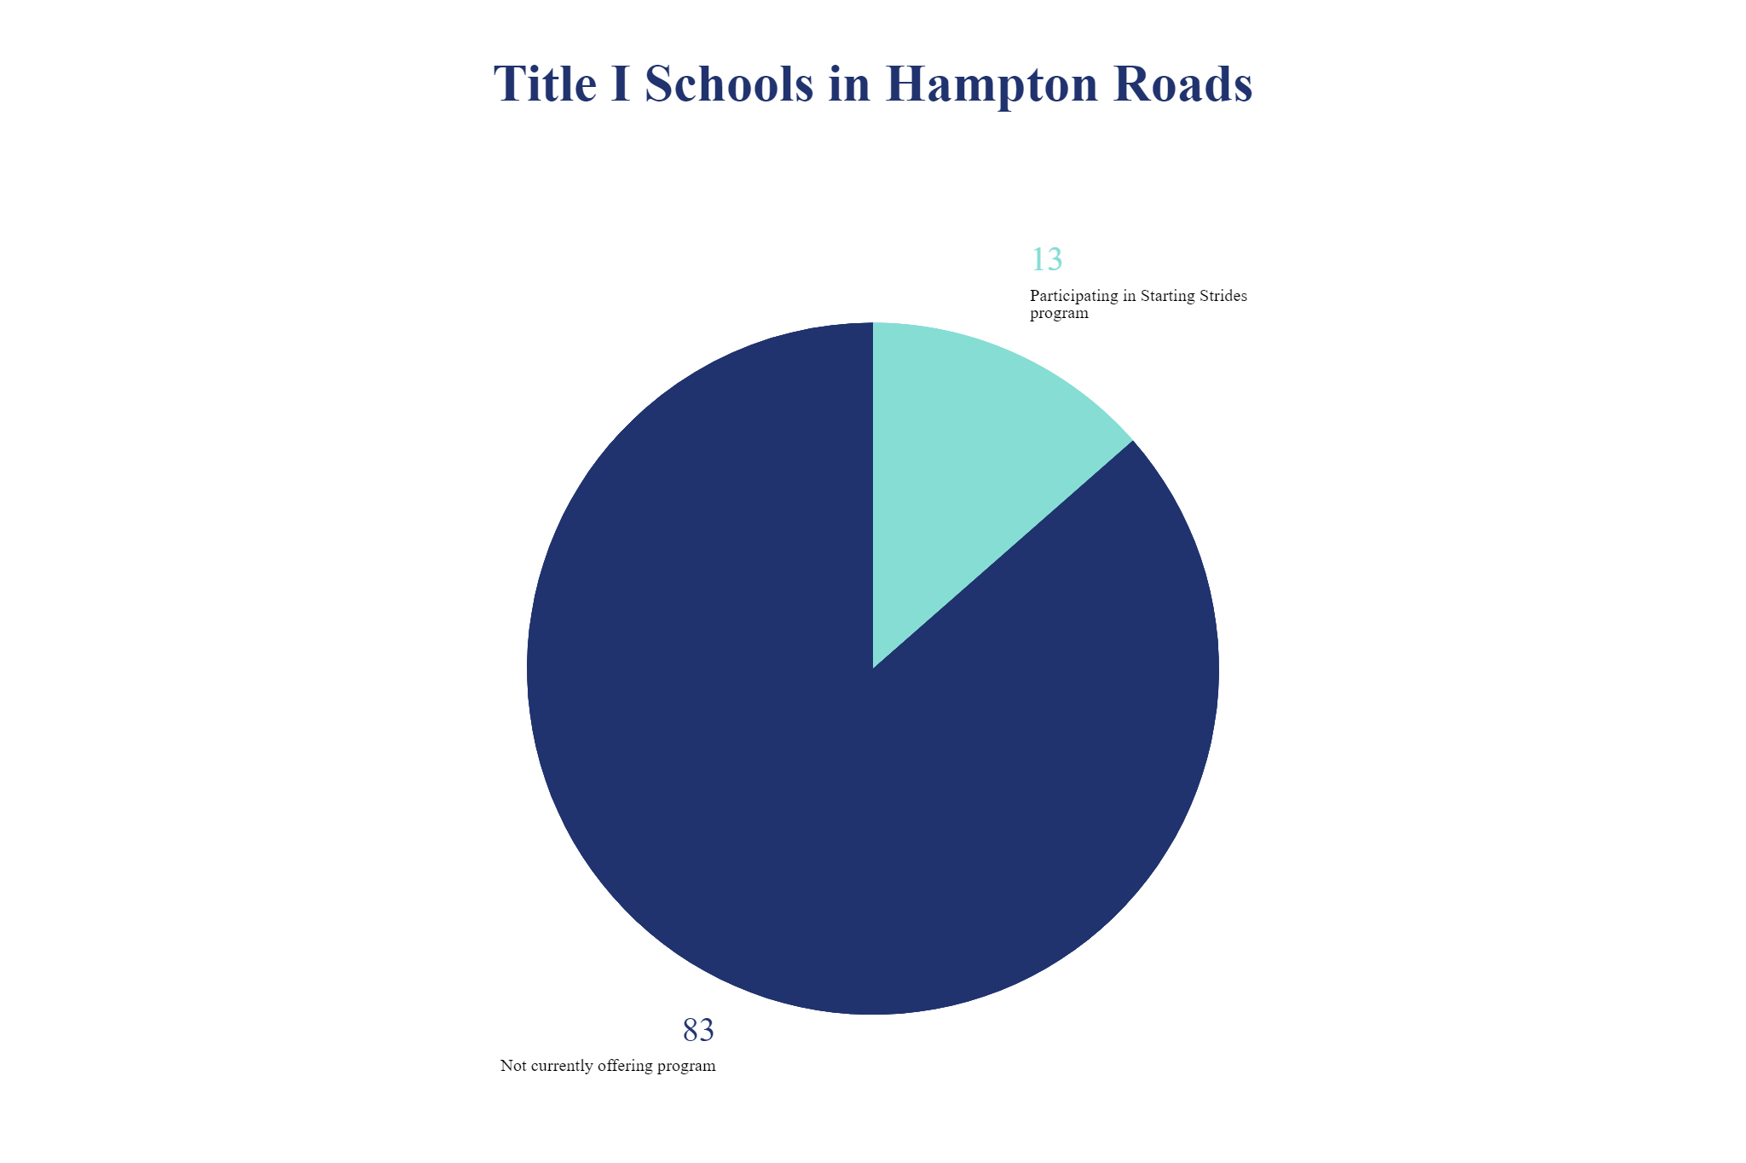
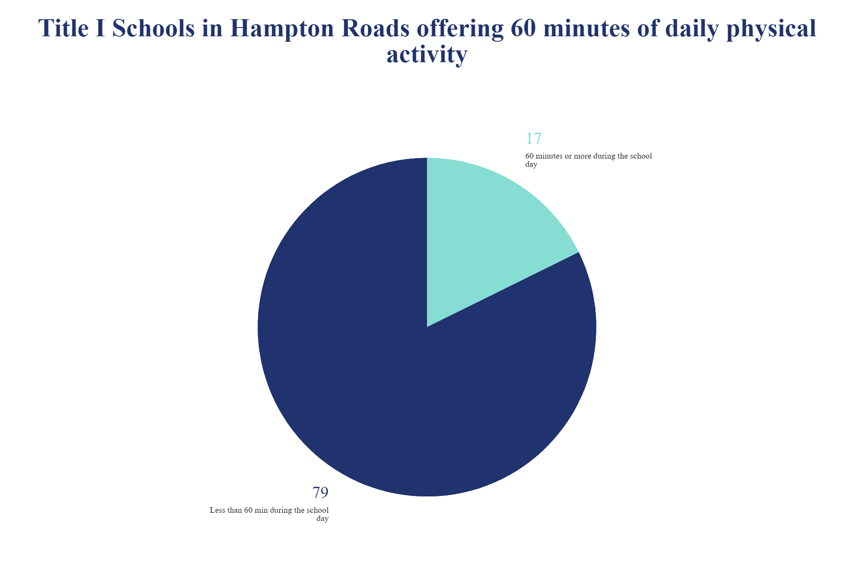
Starting Strides Moving Forward
Lei C. Dunn
Longwood University
Abstract
Method
Results
Creating opportunities for youth to move is the focus of many programs within and surrounding public schools. Certain children may have less opportunity to move despite programs available in their schools and neighborhoods. Research and literature reviews show that in families where students are living at or below the poverty line, there are a variety of reasons that affect the physical activity level and connected health of school-aged children. These include obvious issues such as lack of funds and transportation, however additional factors include perceived lack of safety, inefficiency of programs, community connections and lack of trained volunteers. The Starting Strides program, created by J&A Racing, began as a small endeavor to give a few dozen students in the Hampton Roads community the opportunity to train for and participate in a large-scale road race event. By connecting directly with Title 1 public schools, Starting Strides has been able to reach their target population and has received positive feedback from students participating in the program. Researched and structured changes to the program will allow the program to reach a wider portion of their target population, create an easily replicable and reliable physical activity and education program for youth and produce qualitative and quantitative feedback as to the effectiveness of the program for increasing physical activity in youth living in low-income families.
Participants
Changes made to the program implementation from its current iteration will allow the program resources to reach a larger number of participants and have greater affect on the youth within the community.
Anticipated results are that Title I schools around the region will see the potential benefit of the Starting Strides program and elect to offer it to their students.
The greatest anticipated results are that students who participate in the Starting Strides program will increase their daily physical activity to at least sixty minutes and choose to continue with this daily activity even after the completion of the program.
Another potential affect is for low-income families to increase their awareness of the importance of physical activity and perceive the availability of safe , inexpensive options for their students to participate in regular physical activity.
These results will likely also have the benefit of increasing awareness of the needs of low-income students, the community partnerships that J&A Racing have created in Hampton Roads and the potential for other outreach programs by similar organizations.
Schools within the seven cities of the Hampton Roads, Virginia region Schools with identified Title I designation with greater than 50% of their overall student population qualifying for free or reduced-price lunch programs Students in grades kindergarten – fifth grade at these schools
Materials and Procedure
Phase 1 – Quality of Life
Input from both the individual and their family in regard to their current state of health and physical activity level will be gathered.
Phase 2 - Health Issues
Participants’ current level of health will be assessed using questions about asthma and obesity.
Phase 3 – Behavior and Environmental Assessment
Participants and their families will be asked to identify their current level of physical activity, their feelings on the importance of physical activity, whether they prioritize physical activity for the student participant in their daily life, descriptors of the home and school environment and how that enables or hinders physical activity.
Phase 4 – Predisposing, Reinforcing and Enabling Factors
Predisposing factors for adverse health conditions and lack of physical activity for the student participants might include school district, family education level, extended family health, attitudes towards activity, sport and recreation and past experiences in physical activity. Reinforcing factors might include teachers, school administration, families and peers. Enabling factors could be socio-economic status, community sponsors, and program volunteers and community infrastructure for active lifestyle.
Phase 5 – Intended Program
The Starting Strides program addresses the needs of the participants through a running and fitness program to promote physical activity with weekly goals and a culminating running event structured to allow for before, during or after school implementation with as little as 30 minutes of active time necessary and including all necessary resources for participation.
Background
The program that is connected to this initiative serves a dual role – connecting with youth in low income environments as well as encouraging participation in a physical activity promotion program (J&A Racing, 2019). The company focus is on creating events that allow runners of all capabilities to experience a world-class race experience even before the actual race day (J&A Racing, 2019). There are a total of 96 Title I designated schools within the Hampton Roads region (Virginia Department of Education, 2020). In 2019, J&A Racing reports 4,910 finishers in the Operation Smile Final Mile, the culminating event in the YFI. While 13 Title I schools participated, 10 of them were from one city, Virginia Beach. Even in a community where adults are highly active, children in low income communities are much less active than other children of a similar age, with varying reasons being given ranging from safety, lack of resources and lack of interest (Finkelstein, Petersen & Schottenfeld, 2017). Children from lower-income families being less likely to participate in physical activity (Cottrell et.al., 2015). Physical inactivity can lead to obesity, increased risk for heart disease, increased risk for type 2 diabetes, increased risk for some types of cancer and decreased bone density (CDC, 2018).
Evaluation
Planning committee will review feedback from partner schools, participants and families at the culmination of each year to evaluate changes that need to be made.
Results of the program will be shared with the community and stakeholders using various avenues including press releases, social media and statistical reports.
Rationale/Purpose
Suggested Program Mission Statement:
Provide scholarships to schools with economically disadvantaged communities to help eliminate the barriers that prevent students from running the Operation Smile Shamrock Final Mile, increase physical activity and creating a foundation for lifelong health and fitness.
Goal #1 By November 2020, Implement the Starting Strides program in 50% of Title I schools in the Hampton Roads region.
  Objective #1 – By September of 2020, contact by email the principals of all Title I elementary principals in the area with the results of the needs assessment and an invitation to participate in the 2021 Starting Strides program.
  Objective #2 – Increase the number of Starting Strides participant schools by 50%, from 14 to 21, by October of 2020.
  Objective #3 - Use 100% of available scholarship funds at the 14 existing Starting Strides program schools by January of 2021.
Goal #2 By March, 2021, increase the daily physical activity of Starting Strides participants by 25%.
  Objective #1 – By August of 2020, create a digital and written physical activity documentation log aligned to elementary reading and math standards so as to be used independently by Starting Strides participants.
  Objective #2 – By August of 2020, create training pamphlets and a video to assist site liaisons with implementing the Starting Strides program.
  Objective #3 – Have a J&A Racing Foundation Board member, J&A Racing employee and at least once scholarship sponsor visit each Starting Strides school site no less than one time between January 2021 and March 2021.
(McKenzie, Neiger, & Thackeray, 2016)
References
Cottrell, L., Zatezalo, J., Bonasso, A., Lattin, J., Shawley, S., Murphy, E., Lilly, C., &Neal, W. A. (2015). The relationship between children's physical activity and family income in rural settings: A cross-sectional study. Preventive medicine reports, 2, 99–104.doi:10.1016/j.pmedr.2015.01.008
Finkelstein D.M., Petersen, D.M., & Schottenfeld, L.S. (2017) Promoting children’s physical activity in low-income communities in Colorado: What are the barriers and opportunities? CDC. https://www.cdc.gov/pcd/issues/2017/17_0111.htm.
J&A Racing. (2019a). About us. Retrieved from https://www.jandaracing.com/.
McKenzie, J. F., Neiger, B. L., & Thackeray, R. (2016). Planning, implementing, and evaluating health promotion programs: A primer (7th ed.). Benjamin Cummings.
The Centers for Disease Control and Prevention. [CDC]. (2018). Adolescent and youth health. Retrieved from https://www.cdc.gov/healthyyouth/data/yrbs/overview.htm.
Notes:
1

