Slide 1
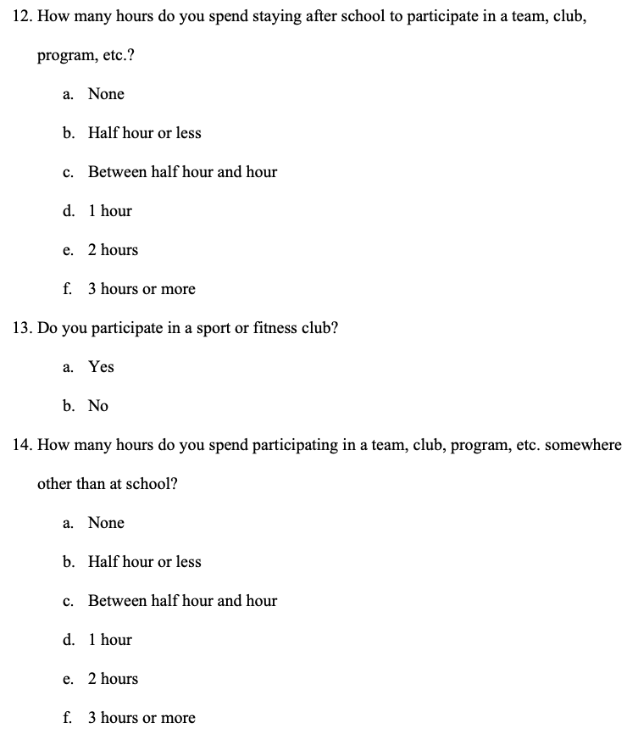
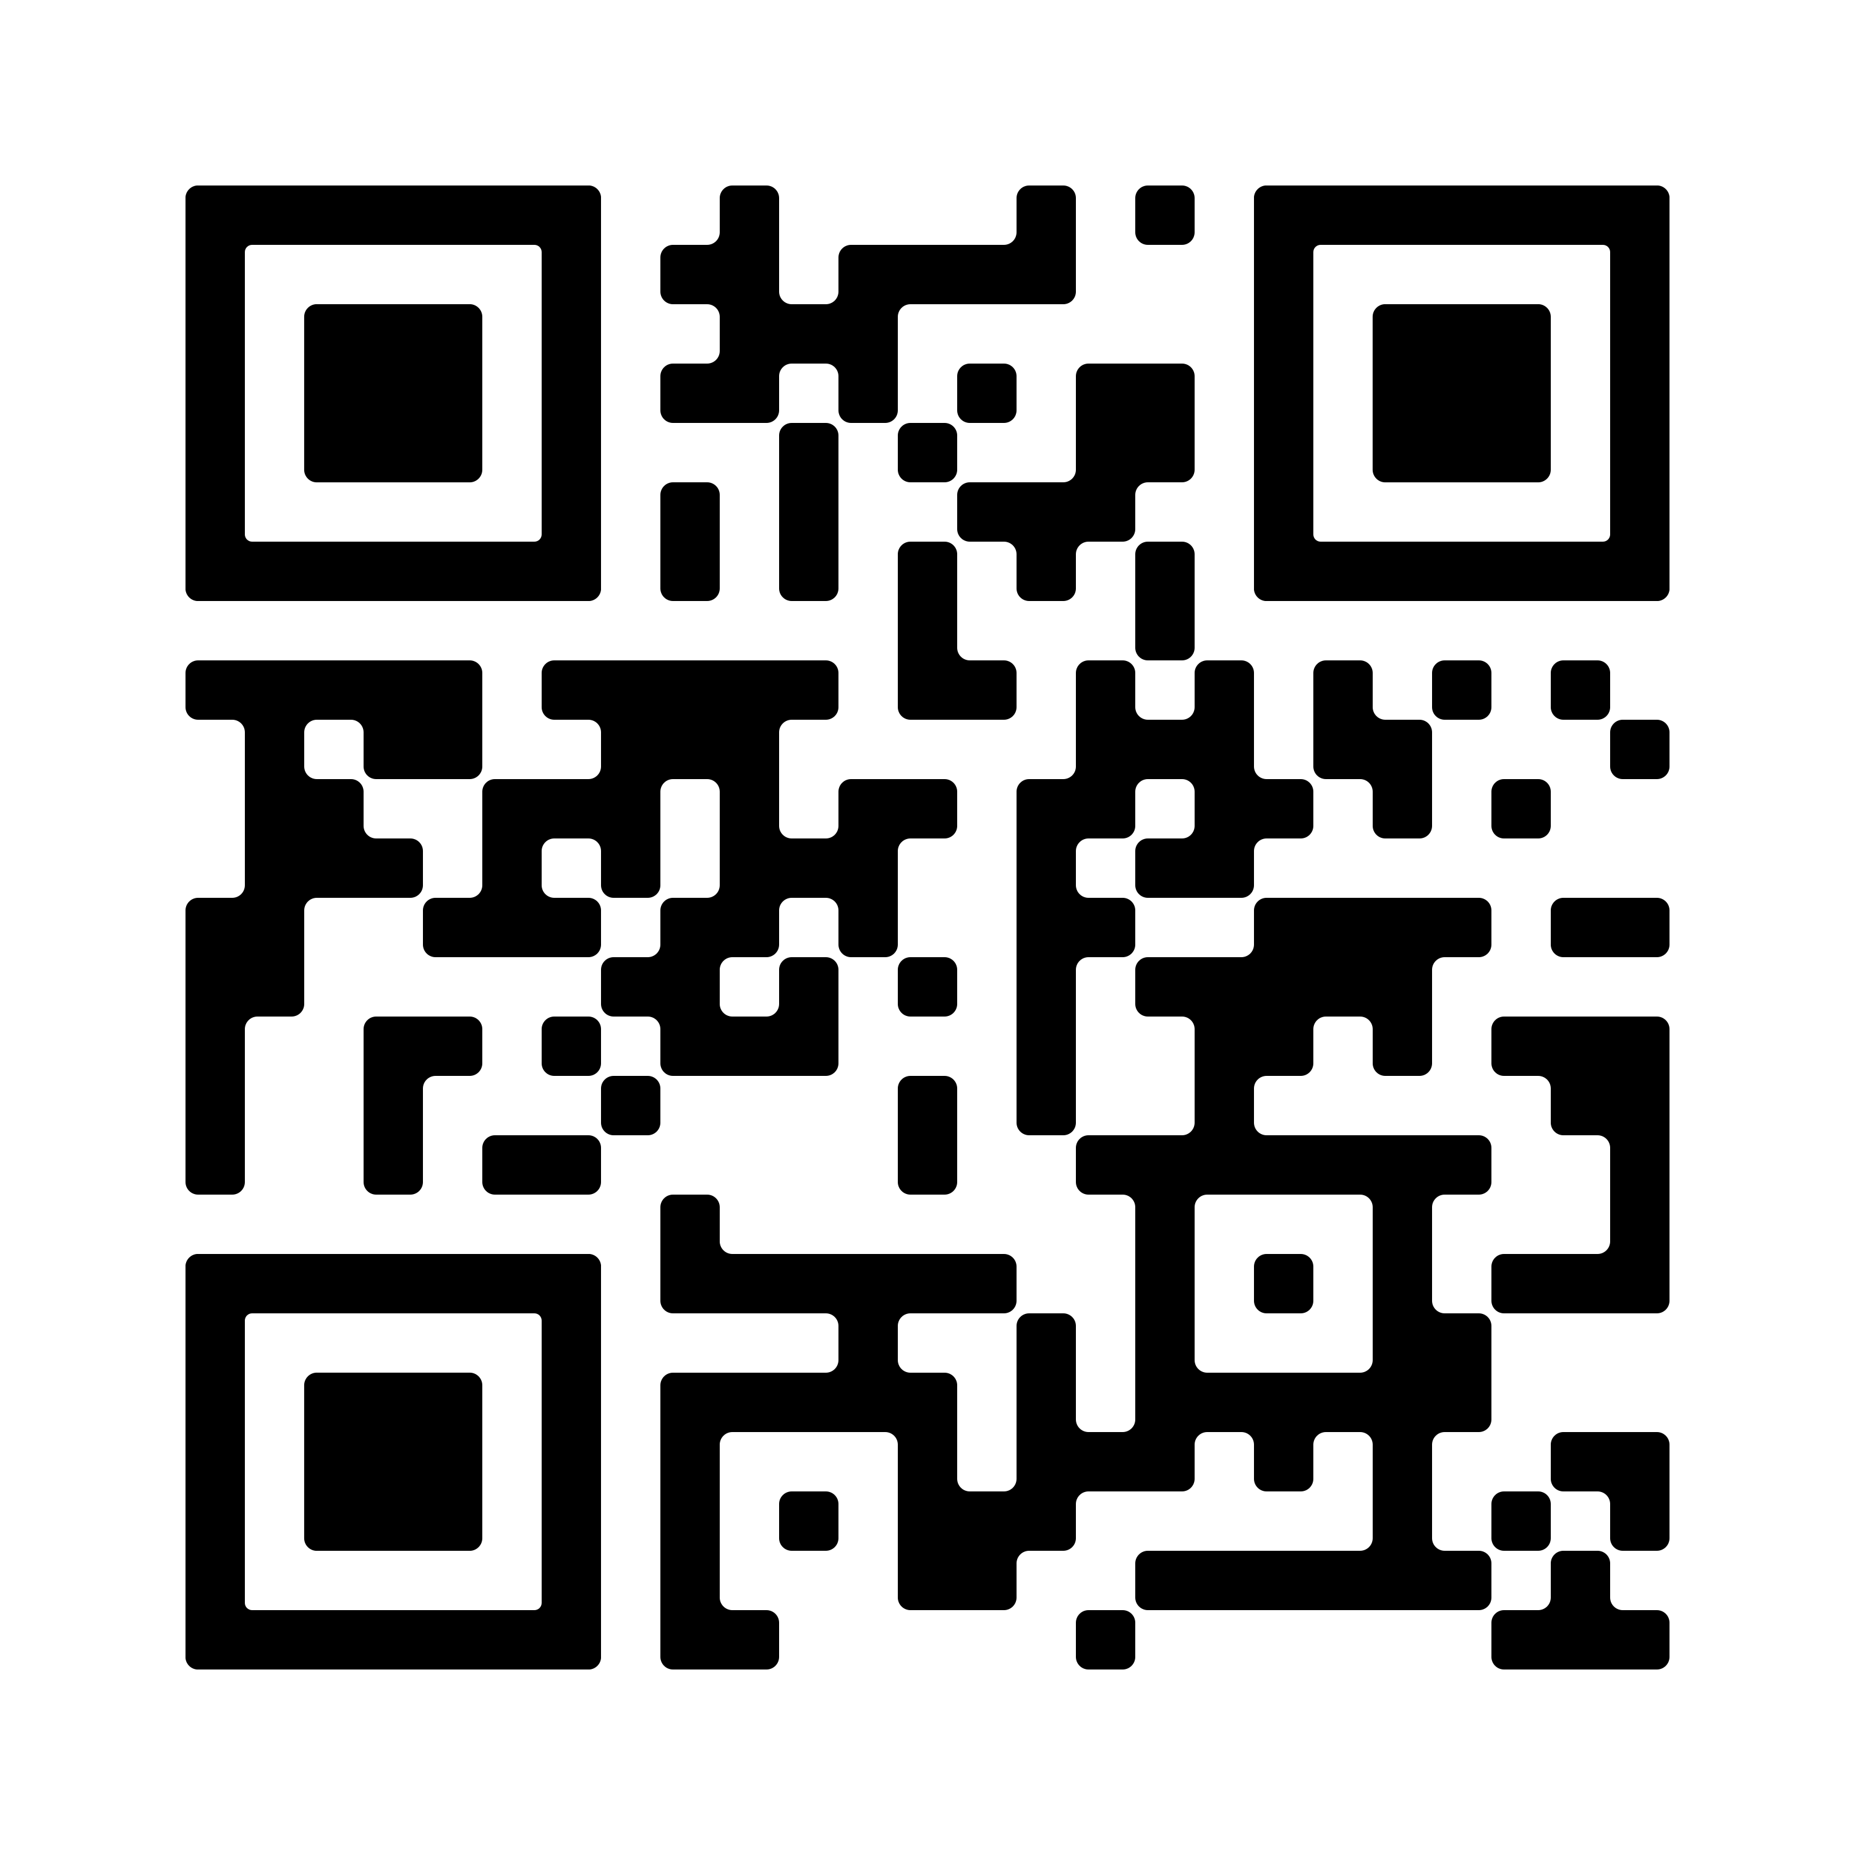
Coordinated Approach to Child Health
Devin Lynn Anderson
Longwood University
Abstract
Results
Materials and Procedure
The program will be evaluated annually to identify a decrease in the prevalence of obesity in the Fairfax County CATCH program population. Interpreting the data collected will provide an understanding of the strengths and weaknesses of the program. There are many different methods used to interpret and utilize data. One method of interpreting data would be determining whether the objectives have been achieved (McKenzie et al., 2016). An example of this includes, evaluating students after the program utilizing the same survey to determine if habits have changed in order to improve their health. It is important to assess if the objectives and goals of the program were met by the end. After collecting data and providing a written report of results to the school and community, the data can also be displayed in other ways. The data can be presented in a graph to display the differences between the answers in the survey before and after the program. A graph can also be displayed to show the difference between students in the CATCH program and those not. This can better display the importance of having the CATCH program in the community for students to understand the importance of getting healthy.
One in three children are obese (The Coordinated Approach to Child Health, Global Foundation, 2020). CATCH has been proven to prevent childhood obesity. In Fairfax County, VA a school wide-survey is sent out every year to provide data about student health. According to the results of the Fairfax County 6th grade Youth Survey (2018), 42% of students reported being active for at least 1 hour per day. Forty-two percent indicates an 8% decrease from the 2010 data. This decrease may be life threatening to students who are considered to be obese. The CATCH program is implemented in schools during school and after-school programs to teach students about nutrition, health, and physical activity. To implement this program, the school and community need to work together to fight obesity by educating youth. The survey will be administered to students before and after program implementation to determine its influence on nutrition, health topic knowledge, and physical activity among program participants. This study will determine the benefits of the CATCH program to educate and motivate students to live a healthy lifestyle.
Below is an example of the data collection instrument used:
Background
The CATCH program provides instruction to students identify healthy foods and increase the involvement in vigorous exercise (CATCH Global Foundation, 2020). The Center for Disease Control and Prevention (CDC) (2019) states that childhood obesity is a major problem in the United States. This obesity prevalence can be used to emphasize the importance of educating youth about nutrition and physical activity. To educate the youth on these important topics, schools and their surrounding communities will assist in working with the CATCH program. This program is brought to schools and put in place by supporting staff members. These staff members may include teachers, administrators, cafeteria workers, instructional assistants, and etc. They will utilize lesson plans through the CATCH program as well as create school specific plans in order to meet the needs of their surrounding community. This program can be incorporated through the school day and after school activities. This program will help improve students level of understanding on the importance of healthy nutritional choices and being physically active daily.
Discussion
The CATCH program is evaluated before, during, and after the program to ensure it is following or meeting its goals and objectives. These evaluations occur in order to make sure the program is successful and if it is unsuccessful in reducing the prevalence of obesity isn’t continuing if it is a bad program (McKenzie et al., 2016).
Framework for Program Evaluation
The following steps should be used for any evaluation (McKenzie et al., 2016).
Step 1- Engaging stakeholders –Stakeholders are the people within the program that are involved in program operations or affected by the program. In the CATCH program these people include the staff, students, parents, and community.
Step 2- Describing the program – The program is described to include the mission, goals, and objectives. Details on the purpose of the program will provide lessons, activities, and assessments used to educate students about nutrition and physical activity.
Step 3- Focusing the evaluation design- This step assures the program is using their time and resources effectively. This is displayed in the CATCH program by having a set schedule for classes, a unit plan, and activities in order to evaluate the program effectively.
Step 4- Gathering credible evidence- In this step the CATCH program provides evidence of collecting data by using the questionnaire instrument in a Pre and Post- assessment process to ensure learning is occurring.
Step 5- Justifying Conclusions – This step is provided in the CATCH program to justify the importance of the program. Interpreting data from Fairfax County health data and national health data. This program will also be compared to others with similar goals and objectives to see if it is as successful.
Step 6- Ensuring use and sharing lessons learned- This step is used at the end to ensure the evaluation results are being shared with appropriate people. The CATCH program results should be shared with the school system, community, and health department. These results will be a written report stating all the evidence of the success of the CATCH program.
Improvements
Communicate with other schools involved in the CATCH program to improve
Apply for funding early on to gain resources for implementation
Provide CATCH professional development for teachers and staff
Rationale/Purpose
Procedure
Pilot testing will occur to check for reliability and validity of questions
Surveys will be sent to students through elementary schools in FCPS
Students will be required to complete surveys
Survey results will be analyzed by school administrators and compared to CATCH program information
CATCH programs will be implemented through school or after school programs
Resources to obtain funding
Grants- School grants for healthy kids, get schools cooking, etc.
Local partnerships with athletic and nutrition services
Organizational partnerships- Center for Disease Control and Prevention & Fairfax County food and nutrition services
Fundraising through the school- Fun run, bake sale, car wash, etc.
The purpose of conducting this needs assessment is to evaluate the youth of Fairfax County to determine if the CATCH program would be of benefit . CATCH is a coordinated approach to a child’s health; the goal is to prevent childhood obesity by educating young children about health and fitness.
Goals and Objectives
Improve student’s nutrition level
At the end of the program 80% of students will be able to provide three reasons why consuming fruits and vegetables are healthy with 100% accuracy.
At the end of the program all students will demonstrate the ability to create a balanced meal according to MyPlate recommendations.
During a class session at least 50% of students will identify healthy and non- healthy foods on a worksheet with 80% accuracy.
Increase student’s level of physical activity
At the end of the class period students will have been active for more than 50% of the class time.
At the end of the program all students will complete a 5 question exit ticket rating the importance of physical activity.
At the end of the program at least 50% of students can provide at least 2 examples from the program that increased their physical activity levels.
Validity and Reliability of the Instrument
Method
Reliability will be achieved by providing the same survey for all participants and assessed by a health education specialist in the field. Validity will be achieved by making sure all questions are related to the topic at hand and are pilot tested first to ensure they are easily understood.
Provided to all elementary schools in Fairfax County Public Schools (FCPS)
All students are required to complete the survey
Parents are notified of the surveys
Participants
References
Center for Disease Control and Prevention. (2019). Childhood obesity facts. https://www.cdc.gov/obesity/data/childhood.html
Coordinated Approach to Child Health. (2020). The most cost-effective program proven to prevent childhood obesity. https://catchinfo.org/wp- content/uploads/2015/04/CGF-Evidence-Summary.pdf
Fairfax County Public Schools. (2018). 2018 Fairfax County 6th Grade Youth Survey. Fairfax County Government. https://www.fairfaxcounty.gov/health- humanservices/sites/health- humanservices/files/assets/documents/youth%20survey/2018- 2019%20ys/2018%20fairfax%206th%20final_09_09_19.pdf
McKenzie, J. F., Neiger, B. L., & Thackeray, R. (2016). Planning, implementing, and evaluating health promotion programs: A primer (7th ed.). Benjamin Cummings.
Youth ages 11-13
6th grade students
Students enrolled in Fairfax County Public Schools
Notes:
1

