Slide 1
“Who Has Time For That?”: Effectively Integrating Disciplinary Literacy Practices
Notes:
This session will address evidence supporting why content-area literacy is so important, provide promising strategies, and make the case that effective integration of content and literacy learning allows us to find the time for both.

Slide 2
What is literacy?

Slide 3
Disciplinary/ Content-Area Literacy
SCIENCE
ELECTIVES
HISTORY
READING, WRITING, SPEAKING, LISTENING
LANGUAGE ARTS
MATH
Notes:
For the purposes of this presentation, I will be using these terms interchangeably.

Slide 4
5 Interrelated Principles for Effective Disciplinary Literacy
Expect students to read and write in every class.
Teach students strategies for reading and writing complex texts.
Choose texts that span a range of difficulty, topics, and genres.
Focus reading and writing on BIG IDEAS.
Dedicate time to self- selected reading.
Fisher, D., & Ivey, G. (2005). Literacy and Language as Learning in Content-Area Classes: A Departure From "Every Teacher a
Teacher of Reading". Action In Teacher Education, 27(2), 3-11.
Notes:
Expectations matter. If students think reading and writing is “just for language arts” they will struggle to apply their skills and strategies in other classes.
We need to support students through difficult texts through modeling and read-alouds.
Balance and variety are key to keeping students engaged.
Relevance- always connect what they are reading and writing about to authentic conceptual understandings.
Kids NEED time to read. Time to think and learn and reflect on what they read is paramount.

Slide 5
Why is content-area literacy important?

Slide 6
“National Assessment of Educational Progress results indicate that most American youth lack the skills to successfully engage in the higher-level literacy, reasoning, and inquiry needed for an information-generating and information-transforming economy.”
Greenleaf, C., Litman, C., Hanson, T., Rosen, R., Boscardin, C., Herman, J., Jones, B. (2011). Integrating Literacy and Science
in Biology: Teaching and Learning Impacts of Reading Apprenticeship Professional Development. American Educational
Research Journal, 48(3), 647-717.

Slide 7
Achievement gaps in reading are “echoed” by gaps in content area classes like science and history.
Greenleaf, C., Litman, C., Hanson, T., Rosen, R., Boscardin, C., Herman, J., Jones, B. (2011). Integrating Literacy and Science
in Biology: Teaching and Learning Impacts of Reading Apprenticeship Professional Development. American Educational
Research Journal, 48(3), 647-717.

Slide 8
Middle school… texts are challenging for students because they typically deal with topics that are removed from student’s everyday life experience.”
Fang, Z. (2010). Improving middle school students’ science literacy through reading infusion. The Journal of Educational Research,
103(4), 262-273.

Slide 9
Impact of
Background Knowledge

Slide 10
Background Knowledge and Comprehension
Reading relied on background knowledge (content or cultural)
Reading on unfamiliar concept
(content or cultural)
Neuman, S. B., Kaefer, T., & Pinkham, A. (2014). Building Background Knowledge. Reading Teacher, 68(2), 145-148.
Johnson, P. (1982). Effects on Reading Comprehension of Building Background Knowledge. TESOL Quarterly, 16(4),
503-516.
Notes:
The Neuman article is a study involving children of low and middle SES. Children from the middle SES group had more background knowledge and their reading comprehension scores were higher. When both groups read a text on which they had the same amount background knowledge, the comprehension results were the same.
The results from the Johnson article reveal that students who had prior experience with the culture they were reading about had superior comprehension of the text.

Slide 11
What struggling readers do with new knowledge:
Assimilation
Adding to prior knowledge
Accommodation
Replacing prior knowledge with new knowledge
Alvermann, D., Smith, L., & Readence, J. (1985). Prior Knowledge Activation and the Comprehension of Compatible and
Incompatible Text. Reading Research Quarterly, 20(4), 420-436.
Notes:
When presented with information that conflicts with their prior knowledge, readers will often disregard the text information and rely on their previous understanding.
It is SO important to make sure that we are helping students build an ACCURATE background knowledge on a variety of subjects and topics.

Slide 12
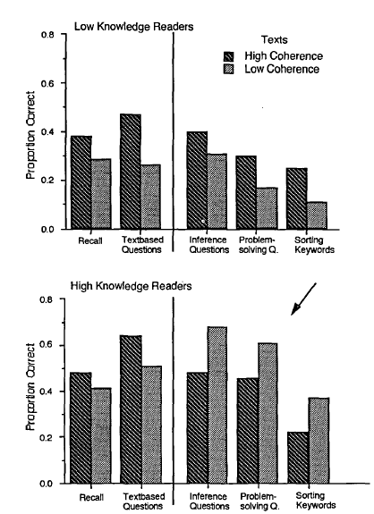
Critical
Thinking
McNamara, D. S., & Kintsch, W. (1996). Learning from texts: Effects of prior knowledge and text coherence. Discourse
Processes, 22, 247-288.
Notes:
This study looked at the connections between background knowledge, text readability, and comprehension.
When answering critical thinking questions (inferencing, problem solving, concept sorting) it’s best for students to have strong background knowledge and read a complex text.
Revising complex texts to be easier to understand is, “beneficial only for low-knowledge students and may be counterproductive for students who have the necessary knowledge background to understand low-coherence texts on their own.”
“Spoon feeding” or simplifying challenging texts is not the answer. If we want our students to think critically we need to build their background knowledge and support them through rich, complex texts.

Slide 13
How can we help?

Slide 14
SUCCESS
Struggling readers

Slide 15
Scaffolding
Give students just enough support to enable them to fully unpack the text.
Build & assess prior knowledge
Pre-teach potential troubling vocabulary
Model comprehension strategies through read & think alouds
Incorporate writing and discussion to reflect on learning.
Notes:
Before, During, and After support

Slide 16
Effective Strategies

Slide 17
Reading & Analyzing Nonfiction (R.A.N.) Strategy
What I think I already know...
Confirmed understandings...
Things I’ve changed my mind about...
Wonderings...
Stead, T. (2014) Nurturing the Inquiring Mind Through the Nonfiction Read-Aloud. The Reading Teacher, 67(7), 488-495.
Notes:
An upgrade of KWL chart (know, want to know, learned).This new strategy encourages readers to evaluate their own background knowledge and correct misconceptions.

Slide 18
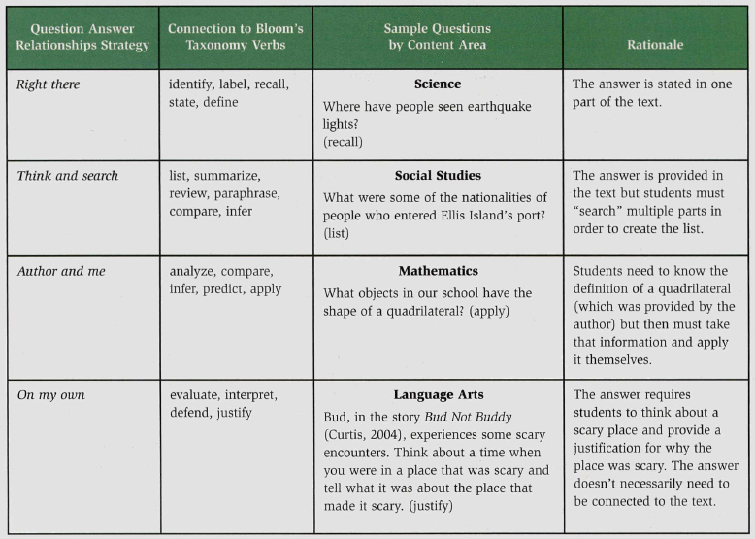
Question Answer Relationships
Fenty, S., McDuffie-Landrum, K., & Fisher, G. (2012). Using collaboration, co-teaching, and question answer relationships to
enhance content area literacy. Teaching Exceptional Children, 44(6), 28-37.
Notes:
Explicitly teach students to recognize different kinds of questions and how to go about answering them.

Slide 19
Engaging with authentic, rich texts
Books
Articles
Websites
Journals
Interviews
Magazines
“Simply providing strategy instruction is not sufficient… students need to engage in wide reading through which they can apply reading strategies and learn subject content.”
Fang, Z. (2010). Improving middle school students’ science literacy through reading
infusion. The Journal of Educational Research, 103(4), 262-273.

Slide 20
Collaboration
Barber, A. (2014). Reading engagement in social studies: Exploring the role of a social studies literacy intervention on reading
comprehension, reading self-efficacy, and engagement in middle school students with different language backgrounds. Reading Psychology, 36(1), 31-85.
Notes:
When students work together it improves motivation and engagement because it builds their confidence and self-efficacy.

Slide 21
Nonfiction Literature Circles
Discussion Director
Develops a list of questions for the group to discuss
Focuses on big ideas in the reading and reactions, thoughts, feelings, and concerns
Summarizer
Prepares a brief summary of the reading.
Writes a 3-5 sentence statement that covers the key points, main ideas, or general overview
Webmaster
Takes the information and adds it to a graphic organizer
Uses keywords, phrases, and examples from the reading
Draws a graphic organizer which can be student made or teacher provided
Vocabulary Enricher
Finds important, puzzling, unfamiliar words in the reading
Defines words using the text, dictionary, or other source
Wilfong, L. (2009). Textmasters: Bringing Literature Circles to Textbook Reading across the Curriculum. Journal of Adolescent &
Adult Literacy, 53(2), 164-171.
Notes:
This is just one role based strategy that can be used to support collaboration.

Slide 22
Collaboration
Prior knowledge
Rich, engaging texts
Vocabulary
Modeling
Notes:
Yes- There is a lot to think about and consider especially with a jam-packed curriculum.

Slide 23
It only takes a drop to infuse your class with reading instruction
Fang, Z. (2010). Improving middle school students’ science literacy through reading infusion. The Journal of Educational
Research, 103(4), 262-273.

Slide 24
In one week
270 instruction minutes total
20 min. for reading strategy instruction
250 min. content instruction
“A modest amount of reading instruction made a significant difference,” in content literacy.
Fang, Z. (2010). Improving middle school students’ science literacy through reading infusion. The Journal of Educational
Research, 103(4), 262-273.

Slide 25
Generic strategies and techniques
Brozo, W., Moorman, G., Meyer, C., & Stewart, T. (2013). Content Area Reading and Disciplinary Literacy: A CASE FOR
THE RADICAL CENTER. Journal of Adolescent & Adult Literacy, 56(5), 353-357.
Notes:
Instead of pushing a multitude of strategies at content area teachers, reading specialists need to work WITH teachers to empower them to feel confident implementing disciplinary literacy skills.

Slide 26
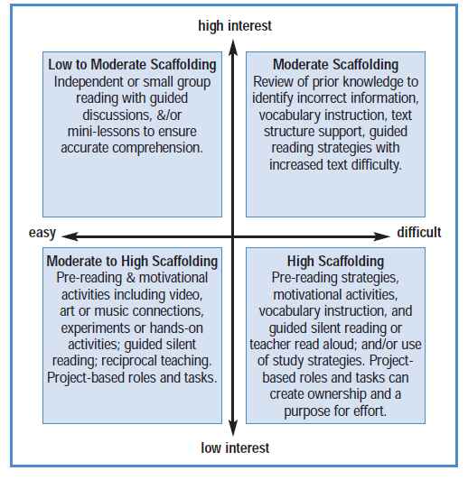
Combs, D. (2004) A framework for scaffolding content area reading strategies. Middle School Journal, 36(2), 13-20.
Notes:
This is a guide for content-area teachers to help them know how much of which strategies to use depending on the text.

Slide 27
If we want our students be more comfortable with rigorous activities that require higher-level critical thinking, how do we effectively support our content-area teachers to successfully integrate literacy practices?

Slide 28
References
Alvermann, D., Smith, L., & Readence, J. (1985). Prior Knowledge Activation and the Comprehension of Compatible and
Incompatible Text. Reading Research Quarterly, 20(4), 420-436.
Barber, A. (2014). Reading engagement in social studies: Exploring the role of a social studies literacy intervention on reading
comprehension, reading self-efficacy, and engagement in middle school students with different language backgrounds. Reading Psychology, 36(1), 31-85.
Brozo, W., Moorman, G., Meyer, C., & Stewart, T. (2013). Content Area Reading and Disciplinary Literacy: A CASE FOR THE
RADICAL CENTER. Journal of Adolescent & Adult Literacy, 56(5), 353-357.
Bryant, D. P., Ugel, N., Thompson, S., & Hamff, A. (1999). Instructional strategies for content-area reading instruction.
Intervention In School & Clinic, 34(5), 293.
Combs, D. (2004) A framework for scaffolding content area reading strategies. Middle School Journal, 36(2), 13-20.
Fang, Z. (2010). Improving middle school students’ science literacy through reading infusion. The Journal of Educational
Research, 103(4), 262-273.
Fisher, D., & Ivey, G. (2005). Literacy and language as learning in content-area classes: A departure from "every teacher a
teacher of reading". Action In Teacher Education, 27(2), 3-11.
Greenleaf, C., Litman, C., Hanson, T., Rosen, R., Boscardin, C., Herman, J., Jones, B. (2011). Integrating Literacy and
Science in Biology: Teaching and Learning Impacts of Reading Apprenticeship Professional Development.
American Educational Research Journal, 48(3), 647-717.
Ness, M. K. (2016). Reading comprehension strategies in secondary content area classrooms: Teacher use of and attitudes
towards reading comprehension instruction. Reading Horizons (Online), 55(1), 58-84.
Neuman, S. B., Kaefer, T., & Pinkham, A. (2014). Building Background Knowledge. Reading Teacher, 68(2), 145-148.
Stead, T. (2014) Nurturing the inquiring mind through the nonfiction read-aloud. The Reading Teacher, 67(7), 488-495.

Slide 29
Thank you!
Questions?
Contact:
Sandy Johnson
Longwood University
Reading, Literacy, & Learning program
sandbergjohnson@gmail.com

