Slide 1
"Gotta catch 'em all": Selecting Instructional Approaches and Programs to Meet the Specific Reading Needs of Struggling Middle Schoolers
Presented by:
Heather Street and Susie Hinshaw
Notes:
Talk about our class/research; problem we see in our school
Proposal:
Middle school teachers often struggle with uncertainty about how to incorporate appropriate instructional approaches to meet the individual needs of their struggling readers. Research shows mixed results when it comes to reaching struggling middle schoolers (Apel & Swank, 1999).Unfortunately most middle school teachers have not had the training to identify specific needs of struggling learners, which makes it challenging to make instructional decisions about how to meet those needs, and incorporating instruction to meet individual needs into the whole class setting is particularly complex (McMaster, Espin, & Broek, 2014). McKenna and Stall identify three components as primary sources of reading comprehension difficulties in their 2003 cognitive model. All reading difficulties come from these three main components, with comprehension as the end goal (McKenna & Stahl, 2003). The identification of specific areas of need for struggling middle schoolers and the appropriate selection of instructional approaches accordingly will be discussed. This knowledge can help middle school teachers make more targeted instructional decisions for their struggling learners.

Slide 2
Read This Passage
Once when I was a yonder, my tomly and I were mayle in line to buy mott for the Blimbat. Finally, there was only one plam between us and the mott munt. The plam made a big ampler on me. There were eight utz all probably ord the age of 12. You could tell tures did not have a lot of willen. Their pard weer not yanker, but tures were clean. The utz were well-matter, all of the mayle in line, two-by-two zors their potent holding zibits. Tures were telly temering about the plums, fonts, and other yoks tures would wint that noster.
What is Setting?

Slide 3
Once when I was yonder, my tomly and I were mayle in line to buy mott for the Blimbat. Finally, there was only one plam between us and the mott counter. The plam made a big impression on me. There were eight utz, all probably under the age of 12. You could tell meyle did not have a lot of willen. Their pards were not yanker, but tures were clean. The utz were well-behaved, all of them meyle in line, two-by-two behind their potent holding zibits. Tures were excitedly temering about the plums, fonts, and other acts tures would see that night.

Slide 4
Once when I was a teenager, my tomly and I were standing in line to buy mott for the circus. Finally, there was only one palm between us and the mott counter. This plam made a big impression on me. There were eight utz, all under probably the age of 12. You could tell they did not have a lot of money. Their clothes were not expensive, but they were clean. The utz were well-behaved, all of the standing in line, two-by-two behind their parents holding hands. They were excitedly jabbering about the clowns, fonts, and other acts they would see that night.

Slide 5
Once when I was a teenager, my boyfriend and I were standing in line to buy tickets for the circus. Finally, there was only one family between us and the ticket counter. This family made a big impression on me. There were eight children, probably all under the age of 12. You could tell they did not have a lot of money. Their clothes were not expensive, but they were clean. The children were well-behaved, all of them standing in line, two-by-two behind their parents holding hands. They were excitedly jabbering about the clowns, animals, and other acts they would see that night.

Slide 6
Problem
Middle school teachers often struggle with uncertainty about how to incorporate appropriate instructional approaches to meet the individual needs of their struggling readers. Research shows mixed results when it comes to reaching struggling middle schoolers (Apel & Swank, 1999).
There is no program that can meet all of the needs of every student you teach - you need to take a multifaceted approach.
One size does NOT fit all!

Slide 7
What does the Research Say about specific programs?
The research shows mixed results and there is a need for more research to find answers.
According to Watson, Gable, Gear and Hughes (2012), you can’t target one area of reading (i.e. decoding), you have to look at all areas.
Roberts, Torgesen, Boardman, and Scammacca (2008) recommend providing instruction/strategies in the five critical areas of reading (word study, fluency, vocabulary, comprehension, and motivation) for an older struggling reader.

Slide 8
What does the research Say about specific strategies?
Some students may not respond to reading comprehension interventions and is it related to their cognitive psychology (how they process text).
It is important to figure out “to whom” and “under what conditions” certain strategies are most beneficial for.
It is important to be responsive to the whole group and the individual student at the same time.
Preteaching vocabulary and other important concepts first, instructing on how to use look backs when comprehending a passage, and then the teacher giving explicit feedback to each individual student.
(McMaster, K. L., Espin, C. A., & Broek, P., 2014)

Slide 9
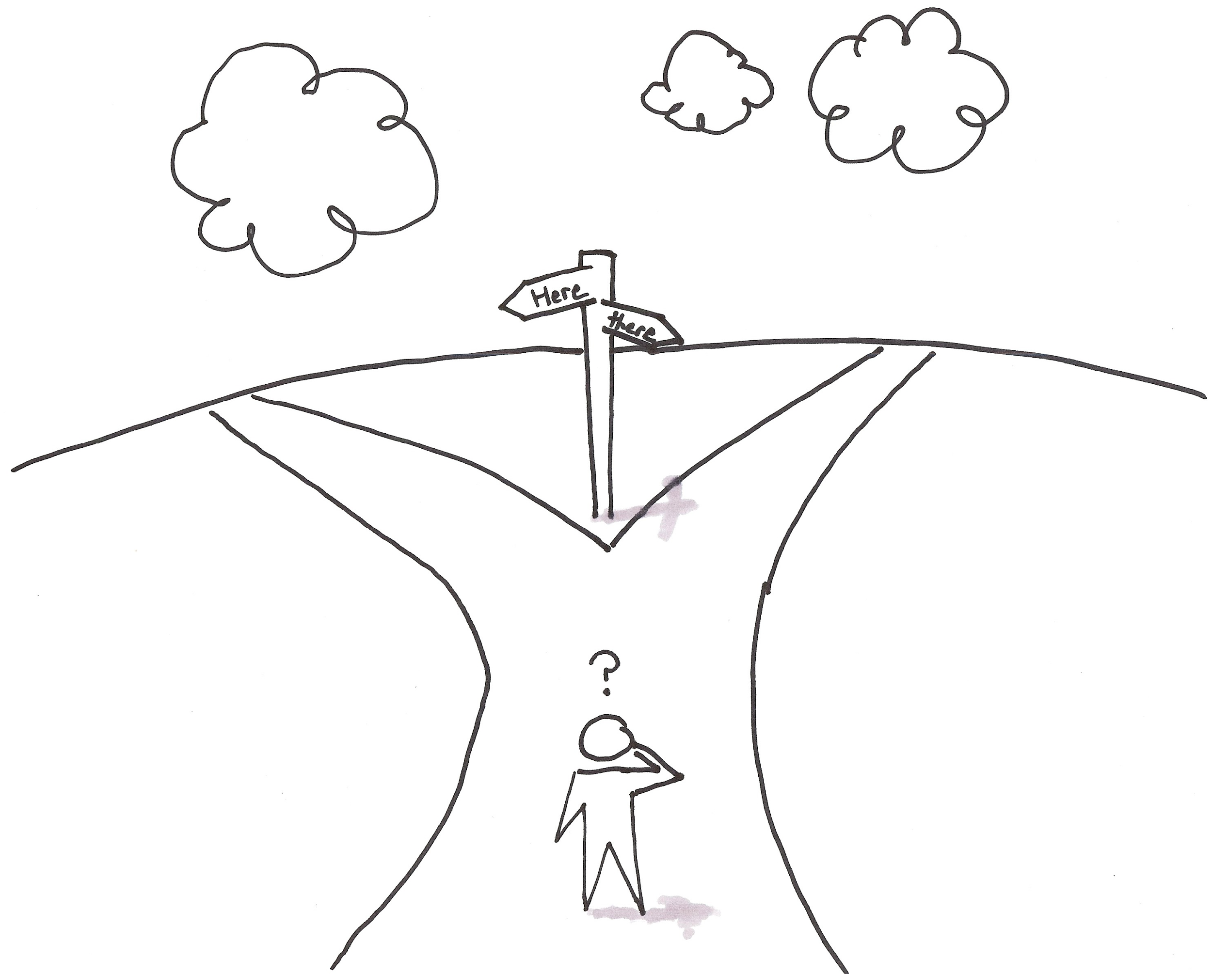
So where do we go from here?
Notes:
We know what works...but how do we use what we know to make it work for our students??

Slide 10
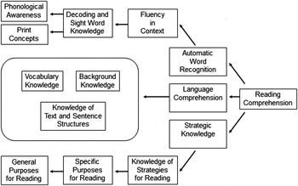
Cognitive Model
MAIN GOAL!
McKenna & Stahl, 2003
Notes:
McKenna and Stahl’s cognitive model
The end goal of reading is always COMPREHENSION!
Often teachers or reading specialists are told that a child has a reading problem when, in fact, the child does not
Need a compilation of multiple sources of information that show a consistent pattern to figure out where the deficiency lies

Slide 11
So what are some successful programs that incorporate these strategies?
LLI (language Leveled Literacy)
Wilson Reading System

Slide 12
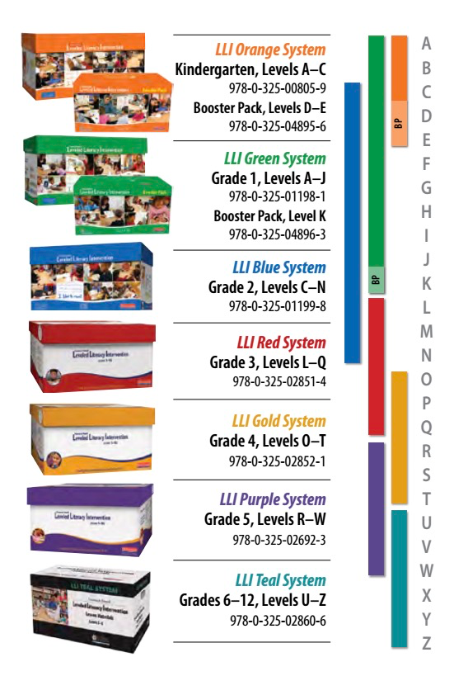
Leveled Literacy Intervention
The Fountas & Pinnell Leveled Literacy Intervention is a powerful, short-term intervention, that provides daily, intensive, small-group instruction, which supplements classroom literacy teaching. LLI turns struggling readers into successful readers with engaging leveled books and fast-paced, systematically designed lessons.
Notes:
This is a new program this year that took the place of the Read180 program. This is a 45 minute lesson that is used in addition to the regular curriculum. Kim Harrell uses it in her workshop class and Susie uses it in self-contained LA6 (only because 6th grade has split block so they still get a full block of regular LA instruction).

Slide 13
Leveled Literacy Intervention
Instructional and Independent leveled texts are alternated
Daily discussion of texts using close reading strategies
Word study/Phonics
Comprehension/Fluency/Vocabulary (based on student need)
Writing
Assessment with running record (about once a week per student)
Notes:
This is a new program this year that took the place of the Read180 program. This is a 45 minute lesson that is used in addition to the regular curriculum. Kim Harrell uses it in her workshop class and Susie uses it in self-contained LA6 (only because 6th grade has split block so they still get a full block of regular LA instruction). In our building, we have the blue, gold, purple, and teal systems - this covers reading level C to Z :)

Slide 14
Wilson Reading System
The Wilson Reading Program is a 12 step process designed to increase a student’s current skill in reading and spelling to a mastery level. The program teaches them to fluently and accurately decode. The students will start with sounds and progress to syllables, words, sentences, stories, and finally to books, learning from constant review and practice. Each lesson introduces new concepts while reinforcing those already learned.
Wilson Training System, 2017

Slide 15
Wilson Reading
The students will receive instruction in:
Phonemic Awareness
Decoding and Word Study
Sight Word Recognition
Spelling
Fluency
Vocabulary
Comprehension Wilson Training System, 2017
Main focus!
Notes:
Vocabulary and comprehension are “extras” - they are addressed but not the main focus of what Wilson is all about!

Slide 16
Classifying a Struggling Reader
Word Recognition
Poor
Good
Good
Poor
Dyslexia (Wilson) | No Impairment
Mixed Deficit (both) | Specific Comprehension Deficit (LLI)
Language Comprehension
Catts & Weismer, 2006

Slide 17
Let’s Practice

Slide 18
Scenario
Greg, a 7th grader, has been struggling in all of his academic classes.
well-liked by his peers
often considered the class clown
class behaviors have earned him several lunch detentions, an after school detention, and recently an in-school suspension
review of his SOL scores and other prior assessments show performance is often weak in all content areas, except for math
reading scores were particularly low
teachers feel he is unmotivated to do well in school
stumped as to how to encourage him
Recent relationship with his science teacher who he told he feels “stupid” in class/often doesn’t understand his class assignments
His teachers have tried to meet with Greg’s mother, but she is a single parent who works two jobs.

Slide 19
What can we do to help Greg?

Slide 20
Classifying a Struggling Reader
Word Recognition
Poor
Good
Good
Poor
Dyslexia (Wilson) | No Impairment
Mixed Deficit (both) | Specific Comprehension Deficit (LLI)
Language Comprehension
Catts & Weismer, 2006

Slide 21
What Are we Proposing?
Case Study
“Caleb” is a 6th grade struggling reader who is currently reading at a primer level.
Both the LLI and the Wilson Program will be implemented in order to determine if these interventions effectively contribute to the subject making significant progress toward his specific reading deficits.
The subject will be provided 9 months (Sept.- May) of instruction using the interventions.
Pre and post assessments, field notes, and subject interviews will be conducted to determine if the student makes substantial gains with his reading.

Slide 22
What are we hoping to Find?
“Caleb” will make substantial progress with his reading after nine months of receiving the reading interventions. Specifically, the gains will be in those areas where he shows deficits.
The reading interventions (LLI and Wilson) will contribute to the subject’s reading gains.
This research can be extended to studying a whole class in order to determine if the effectiveness of the programs will impact students with various reading needs.

Slide 23
The bottom line:
The earlier we catch them, the better!
It’s almost impossible to completely close the gap so it is our job to close it as much as possible and maintain what they have!
Every student’s reading needs look different. It is important that we identify those areas they struggle so that we can provide the most beneficial instructional approach/program.
It’s important for teachers to be trained in individual programs, but also use their professional knowledge as they see fit.

Slide 25
About Us...
Susie Hinshaw
Special Education Teacher
Chickahominy Middle School
shinshaw@hcps.us
Reading, Literacy and Learning Graduate Program
susan.owens@live.longwood.edu
Heather Street
Special Education Teacher
Chickahominy Middle School
hstreet@hcps.us
Reading, Literacy and Learning Graduate Program
margaret.rumuly@live.longwood.edu

Slide 26
References
Apel, K., & Swank, L. K. (1999). Second chances: Improving decoding skills in the older student. Language, Speech, and Hearing Services in
Schools, 30(3), 231-42.
Catts, H.W., Adlof, S.M., & Weismer, S.E. (2006). Language deficits in poor comprehenders: A case for the simple view of reading, Journal of
Speech, Language, and Hearing Research, 49, 278-293
McKenna, M. C., & Stahl, S. A. (2003). Assessment for reading instruction. New York, NY: The Guilford Press.
McMaster, K. L., Espin, C. A., & Broek, P. (2014). Making connections: Linking cognitive psychology and intervention research to improve
comprehension of struggling readers. Learning Disabilities Research & Practice (Wiley-Blackwell), 29(1), 17-24.
Roberts, G., Torgesen, J. K., Boardman, A., & Scammacca, N. (2008). Evidence-based strategies for reading instruction of older students with
learning disabilities. Learning Disabilities Research & Practice, 23(2), 63-69.
Watson, S. M. R., Gable, R. A., Gear, S. B., & Hughes, K. C. (2012). Evidence-based strategies for improving the reading comprehension of
secondary students: Implications for students with learning disabilities. Learning Disabilities Research & Practice, 27(2), 79-89.

