Slide 1
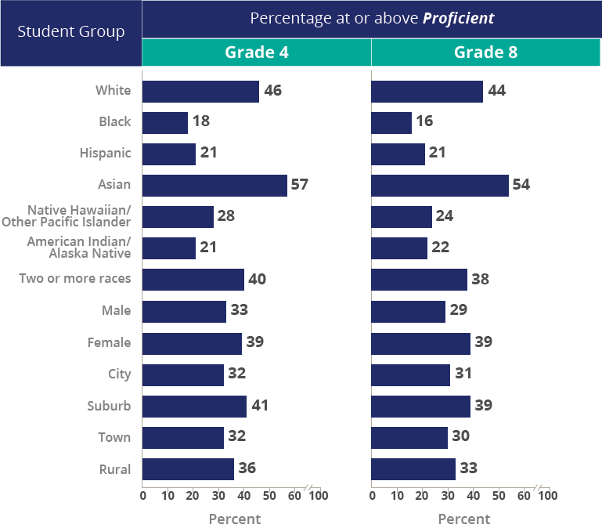
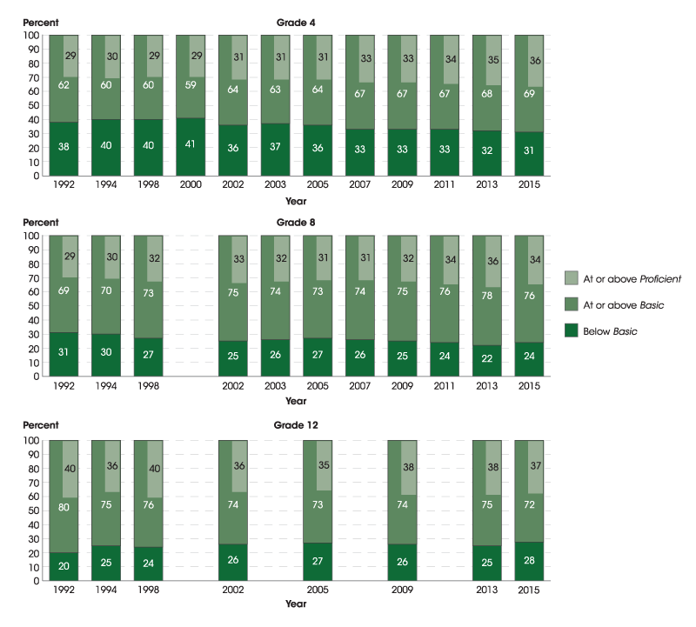
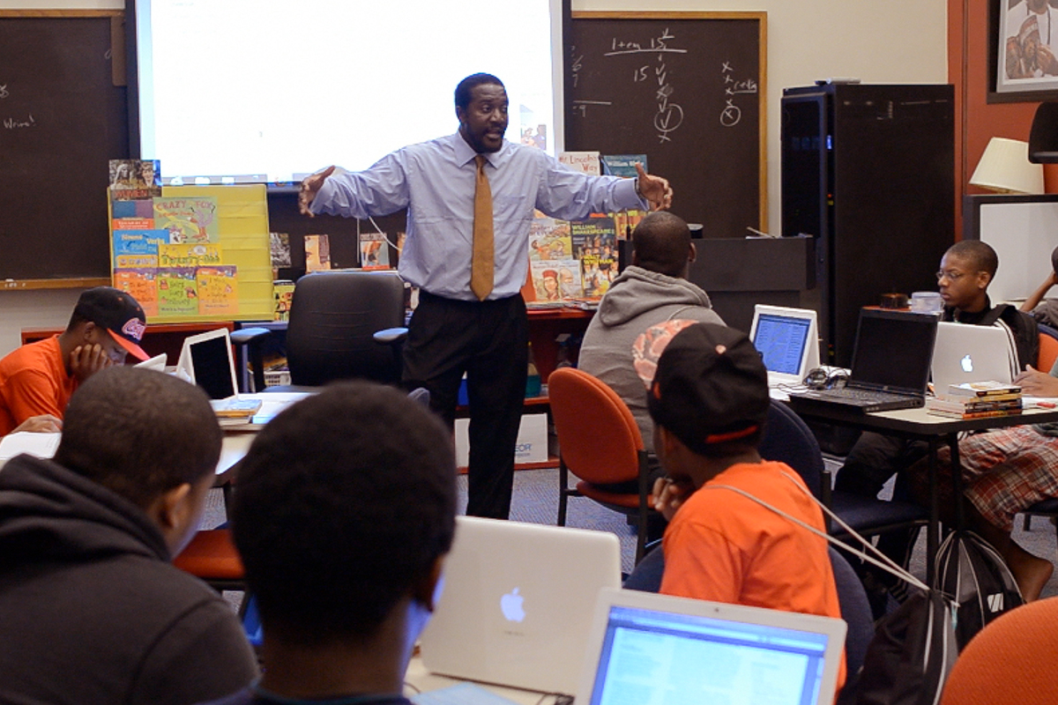
African American Adolescent Male Aliteracy
Deirdre Bates
Longwood University
ABSTRACT
RESEARCH QUESTIONS
MATERIALS
REFERENCES
The Nation’s Report Card is clear. We are failing our African American Adolescent learners in both reading and writing. Current classroom literacy exchanges do not offer authentic experiences that help students develop powerful identities. This study addresses the research questions: “How can I encourage the use of raw writing to promote the creation of literate identity in African American Adolescent secondary students?” and “How will authentic writing affect my students’ identities as literate citizens?” Twelve adolescent African American males, ages 12-17, chosen by school faculty for their non-reader, aliterate, identity meet three times weekly in a raw-writing workshop atmosphere to increase the development of each individual student’s positive literate identity. Both students and their English teachers will participate in a follow-up survey to determine whether reader identity is positively impacted by raw writing.
“How can I encourage the use of RAW writing to promote the creation of literate identity in African American Male Adolescent secondary students?”
“How will authentic/RAW writing affect my students’ identities as literate citizens?
This study requires minimal materials: 12 pocket folders, 12 packages of college ruled notebook paper, 12 boxes of lead pencils, an interactive whiteboard or a projector and speakers with internet access.
Alvermann, D. E. (2001). Reading adolescents' reading identities: Looking back to see ahead. Journal Of Adolescent & Adult Literacy, 44(8), 676-90.
Frankerberg, Erica; Lee, Chungmei; & Orfield, Gary. (2003). A multiracial society with segregated schools: Are we losing the dream?. UCLA: The Civil Rights Project / Proyecto Derechos Civiles.
Heath, S. B. (1982). What no bedtime story means: narrative skills at home and school. Language In Society, 11(1), 49-76.
Moje, E. B. (2000). "To be part of the story": The literacy practices of gangsta adolescents.Teachers College Record, 102(3), 651-690.
McCarthey, S. J., & Moje, E. B. (2002). Identity matters. Reading Research Quarterly, 37(2), 228-238.
Michaels, S. (1981). "Sharing time": Children's narrative styles and differential access to literacy. Language In Society, 10(3), 423-442.
NCES., The nation’s report card: 2015 mathematics and reading at grade 12. April 27, 2016. NCES 2016108
Smith, M. W., Wilhelm, J. D., & Newkirk, T. (2002). Reading don't fix no Chevys: Literacy in the lives of young men. Portsmouth, NH: Heinemann.
Storch SA, & Whitehurst GJ. (2002). Oral language and code-related precursors to reading: Evidence from a longitudinal structural model. Developmental Psychology, 38(6), 934-47.
Tatum, A. W. (2014). Orienting African American male adolescents toward meaningful literacy exchanges with texts. Journal Of Education, 194(1), 35-47.
Tatum, A. W., & Gue, V. (2010). Adolescents and texts: Raw writing: A critical support for adolescents. The English Journal, 99(4), 90-93.
Walsemann, K., & Bell, B. (2010). Integrated schools, segregated curriculum: effects of within school segregation on adolescent health behaviors and educational aspirations AM J PUBLIC HEALTH 2011 May; 101(5):775]. American Journal Of Public Health, 100(9), 1687-1695.
METHODS
The study participants will meet daily for a month. At the first weekly meeting, the students will engage in a writing warm-up with explicit instruction. On the second day of the week, students begin RAW writing. Next, students will meet with a mentor writer or visiting author in writer’s conferences. Finally, on the last day of the week, individuals share RAW writing with the group . Members of the workshop generate helpful critiques of the shared writing.
DATA COLLECTION
In order to determine the effect of the writing study on student’s identities I will use 2 qualitative surveys. One survey will focus on student dispositions toward literacy, and the questionnaire is for the classroom teacher to record any changes he has observed in the student’s attitude toward literacy since the study began. I expect to record the data from the questionnaires on site to maximize data collection.
DATA ANALYSIS
The qualitative surveys will allow participants to rate the questions of literate identity from 1-5. These scores will be totaled to show the highest rates of positive identity correlation. Data analysis should take approximately 40 hours to determine bias, or irregularities that might affect results.
PARTICIPANTS
National Assessment of Educational Progress (NAEP)
OBJECTIVE
Twelve adolescent African American males, ages 12-17, chosen by school faculty for non-reader identity. The students should be have passing SOL scores but, they should have a record of refusal to read or write for pleasure (for example, zero AR points since 6th grade). The students will be encouraged to participate in two ways. First, they have been selected as mentors for elementary students and will be trained during the IE period to mentor the younger writers. In addition, each participant will receive a notebook computer and internet access for the duration of the study. The participants’ English teachers and guardians will grant permission for the student to be involved in the study. The study will take place afterschool for the duration of one calendar month.
This study begin to determine the social and cultural benefits of a shared raw writing environment on African American male secondary students who identify as non-readers/non-writers (alliterate) by providing a workshop environment that celebrates unsanctioned literacy practices.
National Assessment of Educational Progress (NAEP)
ACKNOWLEDGEMENTS
I owe a great deal of thanks to Dr. Angelica Blanchette and Dr. Wendy Snow for their unwavering support, and their unflinching resolve to better the future of education, one student at a time.
deirdre.bates@longwood.edu
Alfred Tatum
cosboc.org

