Slide 1
Professional Development
The Key to Better Instruction and Achievement of English Learners
Christina Kline

Slide 2
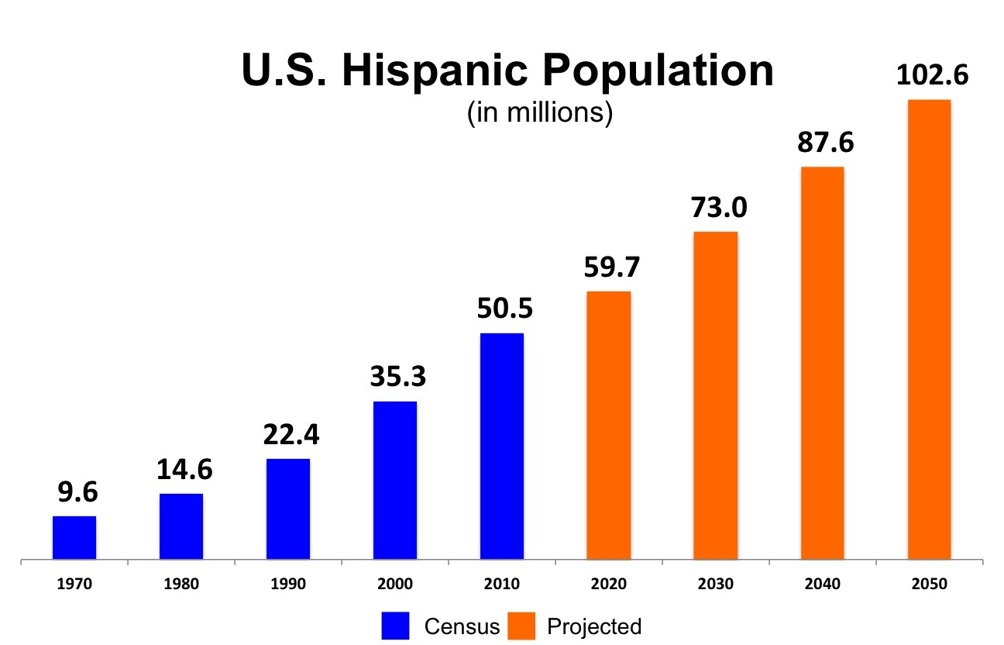
Changing Populations
Hispanic population
more than doubled 1980 to 2000
grew 51% 1998 – 2008
U.S. population grew only 7.2%

Slide 3
Changing populations
ELs not included: pass proficiency tests - struggle with academic language in classroom
lack of research concerning this student population
changing dynamics

Slide 4
Literacy crisis
pattern of underperformance
National Assessment of Educational Progress (NAEP) - reading section 2009 - 8th grade - proficient or advanced scores: 37% - non-Els: 34% - ELs: 3%
result of sophisticated academic language
low expectations - unbalanced environment

Slide 5
Lack of professional development (PD)
teachers unprepared for classroom dynamics
limited states requiring collegiate English as a second language (ESL) methods courses
2008: 26% teachers received PD for strategies to support Els
“one-shot workshops” ineffective
barriers preventing abundance of high-quality PD
teacher desire to learn for their students
lack of PD = negative impact on achievement

Slide 6
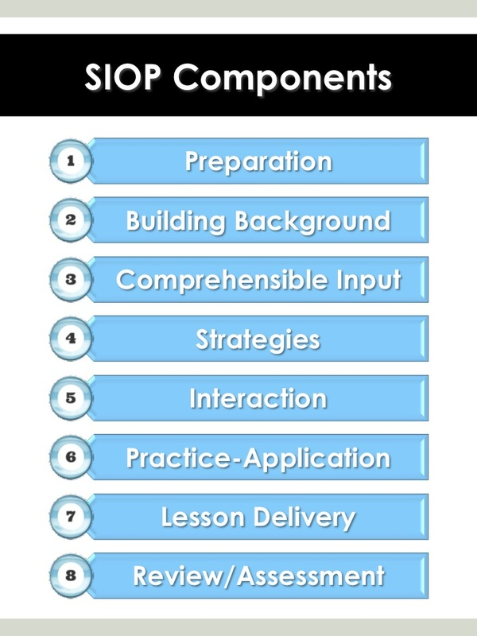
Improving instruction
need intense and high-quality PD - scaffolds
Sheltered Instructional Observation Protocol (SIOP) - Stephen Krashen
explicitly teach thinking and decision-making - not just activities
important: fidelity of implementation
two years of PD → long-term changes in instruction (“high implementers”)
coaching and mentoring

Slide 7
Improving student achievement
better professional development = higher performance of ELs
SIOP model → increased high-stakes scores
keep leaders and administrators informed of the model
understand the fundamental principles - why it works

Slide 8
Future steps
funds should be redirected for intensive, high-quality PD - lasting impacts
future research: SIOP in select classrooms vs. schoolwide SIOP model implementation

Slide 9
Research proposal
Simulated schoolwide SIOP Implementation

Slide 10
purpose
discover if a schoolwide implementation of the Sheltered Instruction Observation Protocol (SIOP) model results in greater achievement for ELs

Slide 11
Guiding principles
The SIOP model makes content area information accessible to all students while also supporting the language needs of EL students (McIntyre, Kyle, Chen, Muñoz, & Beldon, 2010).
Fidelity of implementing interventions is necessary for positive results in student achievement (Echevarria, Richards-Tutor, Chinn, & Ratleff, 2011; McIntyre, Kyle, Chen, Muñoz, & Beldon, 2010; Short, 2013; Short, Echevarria, & Richards-Tutor, 2011).
Teachers need at least two years of professional development to fully implement an intervention with high fidelity (Short, Fidelman, & Louguit, 2012).
School leadership needs to understand the intervention being implemented so they can ensure that it is being implemented properly and provide support to the teachers (Short, 2013).

Slide 12
Research questions
How can teachers provide an environment that fully embraces the SIOP model in every classroom?
How will consistent engagement in classrooms for every content area fully implementing the SIOP model further impact student achievement?

Slide 13
method
Participants - three schools in one district - participation voluntary via principal
Materials - assessments - observation forms - interview forms - other general resources

Slide 14
method
School 1 - control school
School 2 - implement SIOP model across entire grade level for two years (i.e. 4th)
School 3 - implement SIOP model across entire grade level for one year (i.e. 4th) - implement SIOP model across entire consecutive grade level for one year (5th)
simulation of schoolwide implementation

Slide 15
data
Collection - standardized assessments across subjects (pre and post) - Levels of Use Interview Protocol - observations by professional development team
Analysis - examine teachers’ fidelity of implementation - evaluate differences between student achievement in each school

Slide 16
Educational importance
add another layer of understanding to current research findings
long-term PD improves instruction and student achievement - taking it a step further
teachers become experts
students are immersed

